Slide 1
White Flint North Entrance Feasibility Study
Sara Benson
01/30/2019

Slide 2
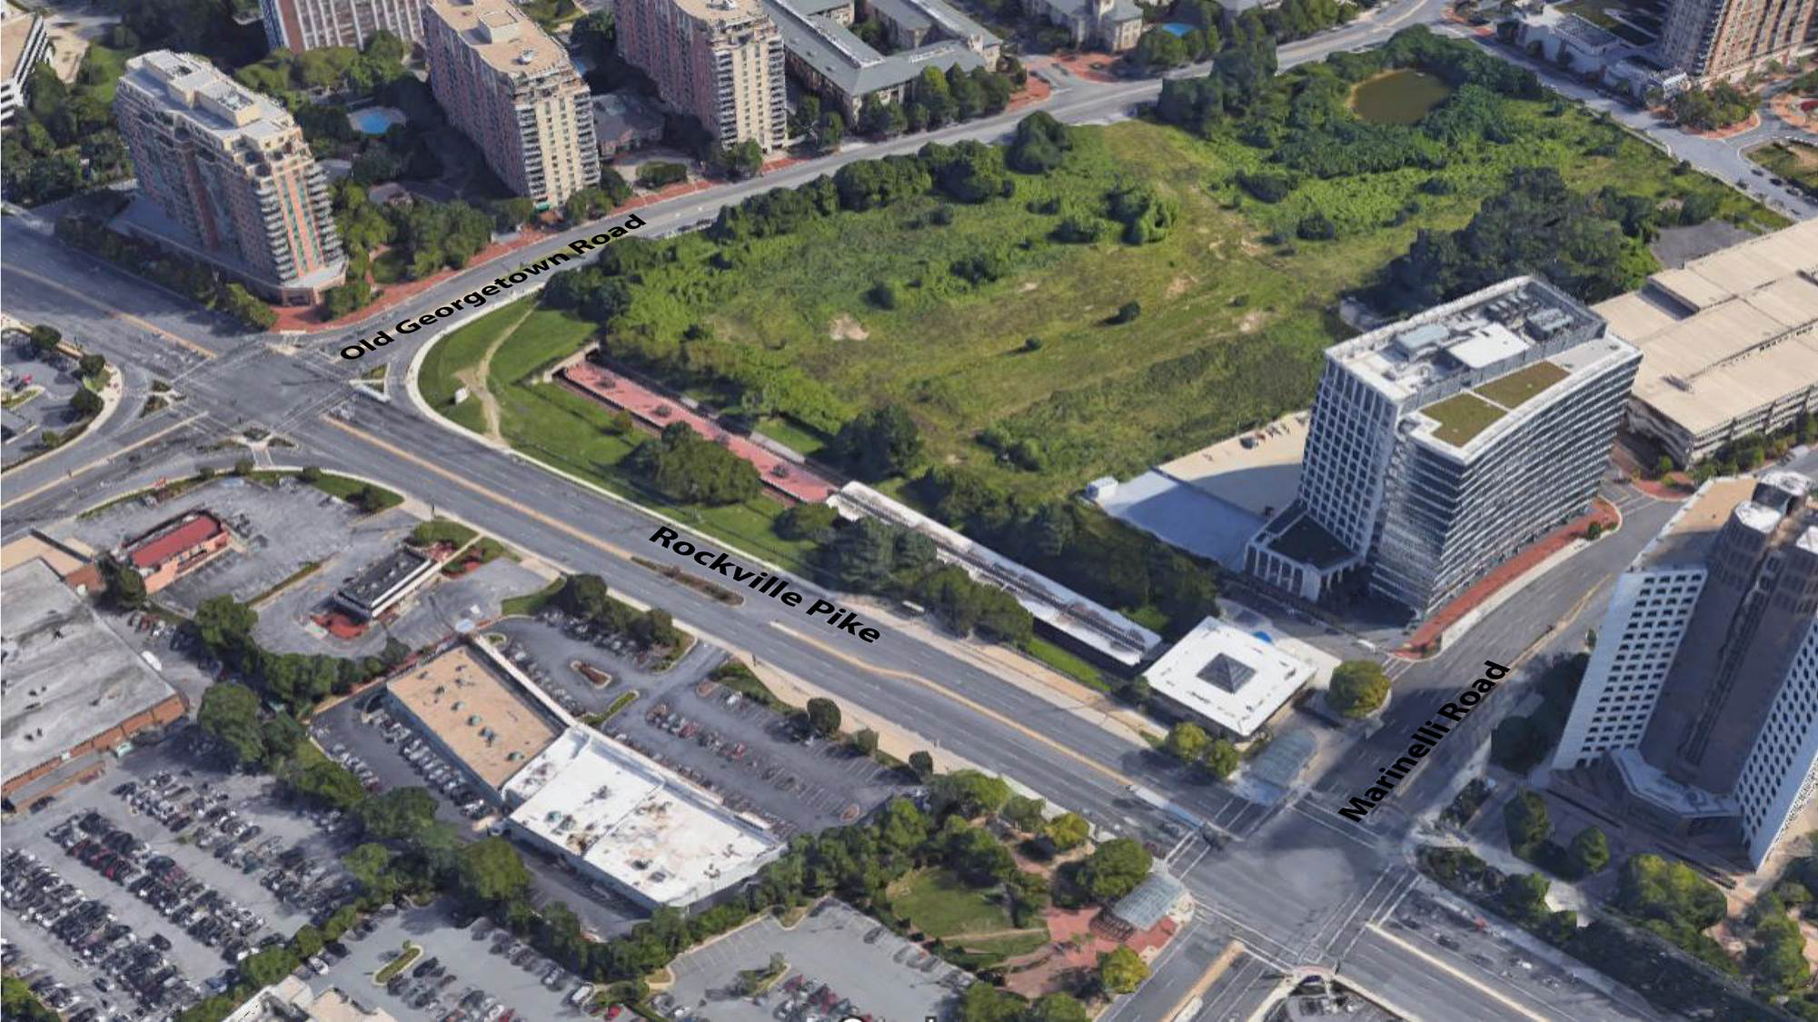
Project Area
White Flint North Entrance Feasibility Study

Slide 3
Agenda
White Flint North Entrance Feasibility Study
Overview of Past Studies
Current Study
Scope of Work
Schedule
Questions

Slide 4
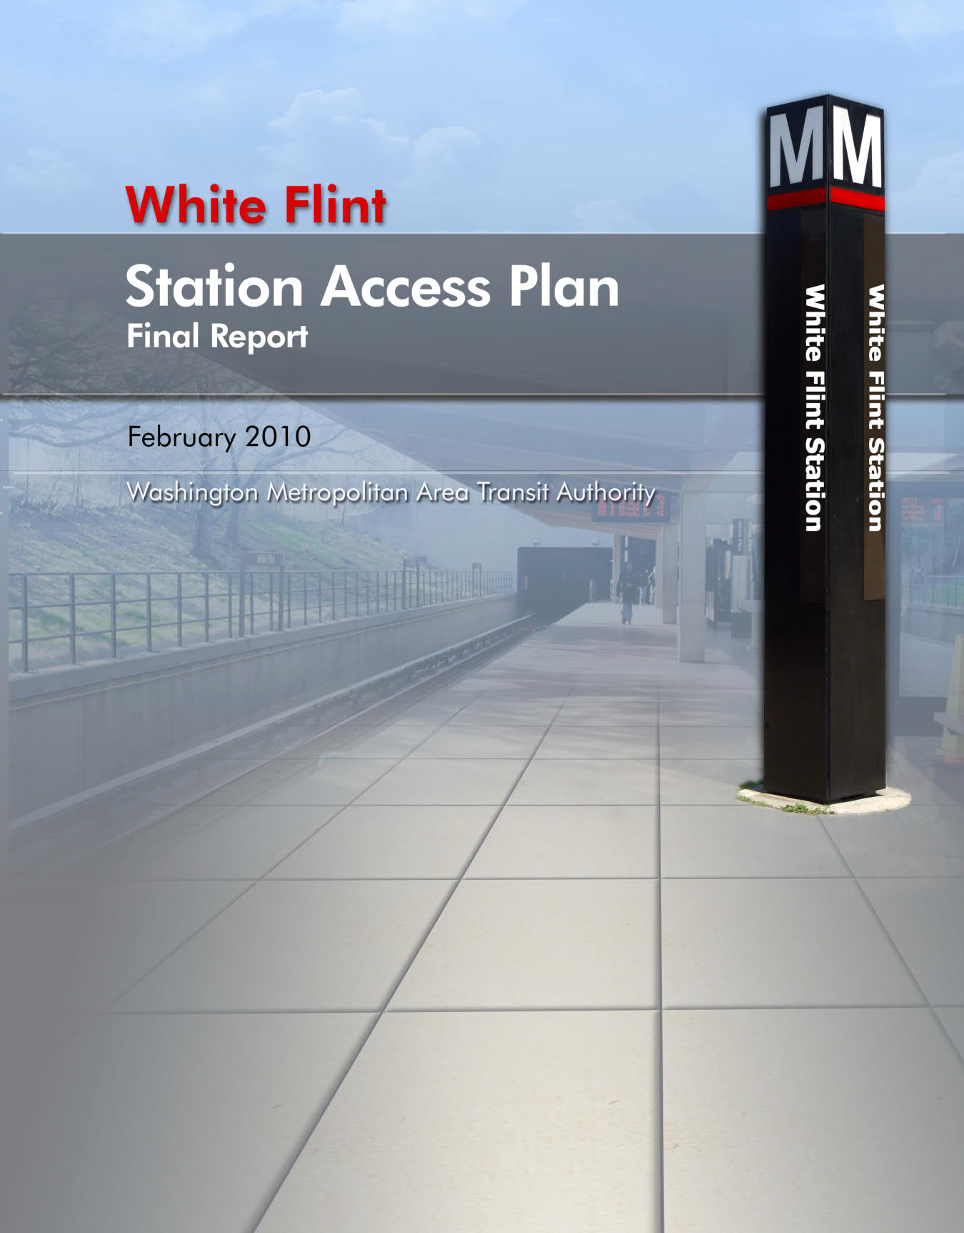
Overview of Past Studies
White Flint North Entrance Feasibility Study
2010 WMATA Station Access Plan
Better access at existing station entrance.
Developed two options for a new north entrance.
Studied possible alignments for a pedestrian connection

Slide 5
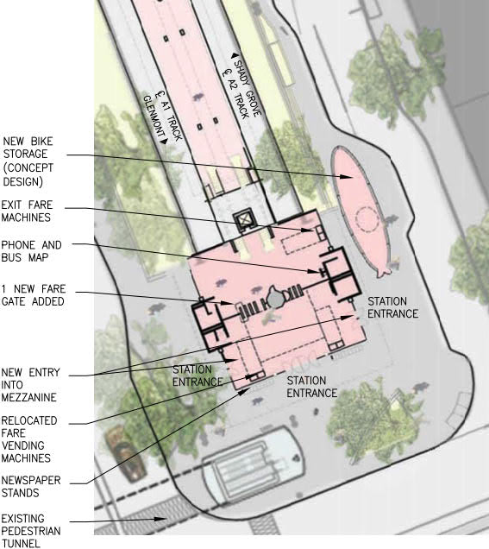
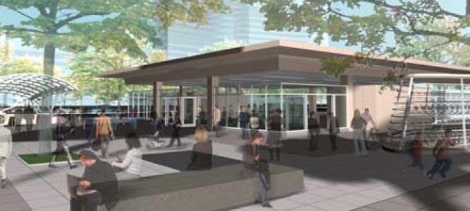
2010 Station Access Plan – Option 1: Existing South Entrance Improvements
White Flint North Entrance Feasibility Study

Slide 6
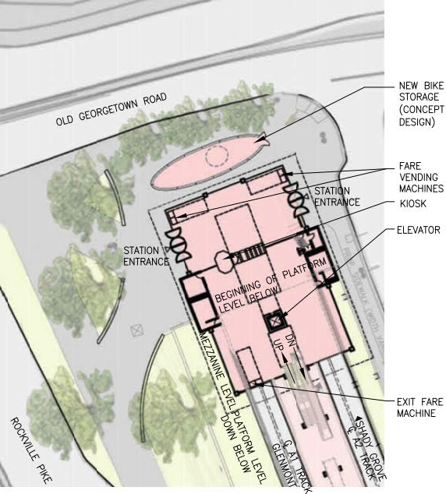
2010 Station Access Plan – Option 2A: New North Entrance
White Flint North Entrance Feasibility Study

Slide 7
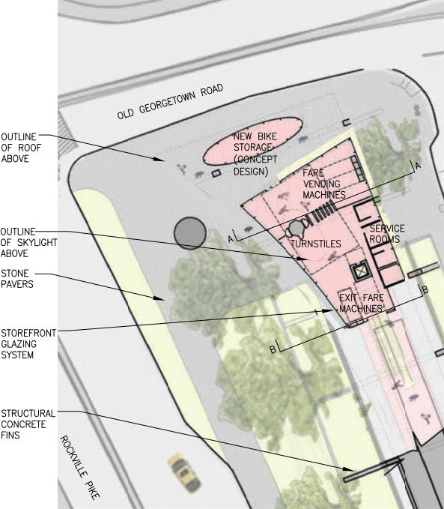
2010 Station Access Plan – Option 2B: New North Entrance
White Flint North Entrance Feasibility Study

Slide 8
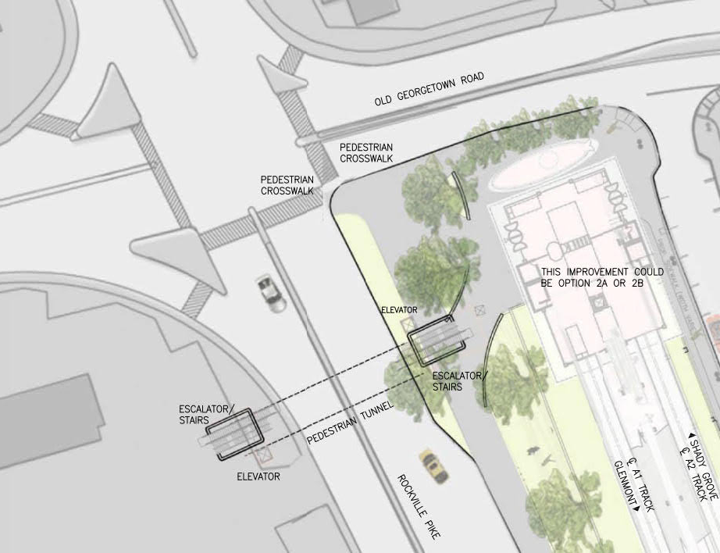
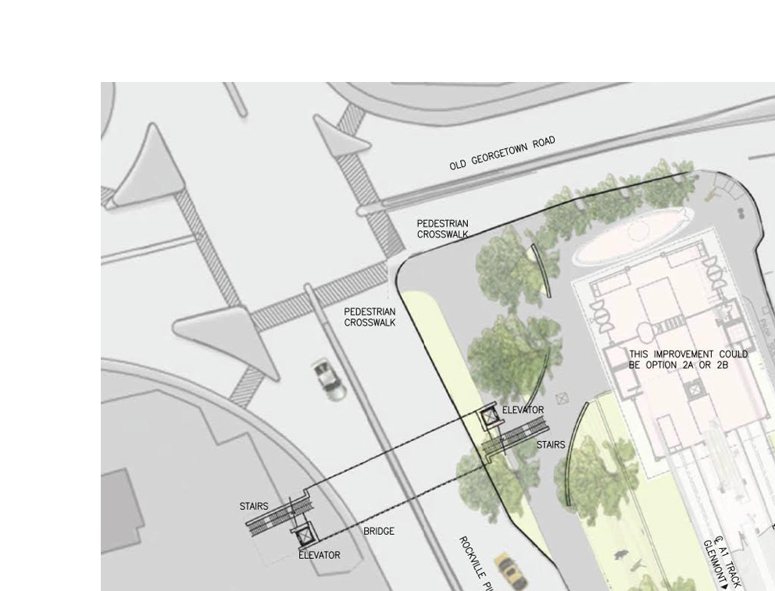
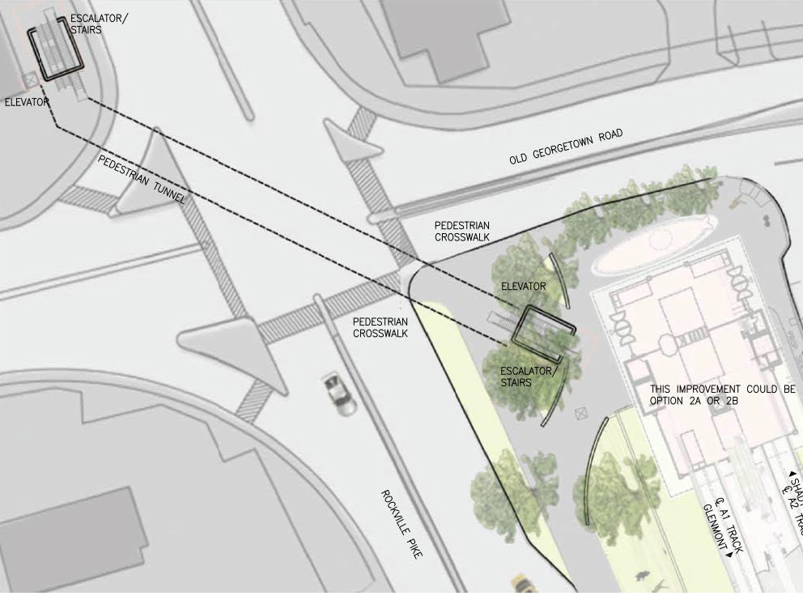
2010 Station Access Plan – Options 3A, 3B & 3C: Grade Separated Pedestrian Crossing
White Flint North Entrance Feasibility Study
3A - Tunnel
3B - Tunnel
3C - Bridge

Slide 9
2010 Station Access Plan – Evaluation of Improvement Options
White Flint North Entrance Feasibility Study

Slide 10
Overview of Past Studies
White Flint North Entrance Feasibility Study
2017 Federal Realty Study
Purpose
Reduce initial capital costs of the new north entry
Minimize the required footprint of Alternative 2A
Develop a range of phasing options for implementing the new north entry
Parameters
Initial phases not meant to be compliant with WMATA Design Criteria
Final phase (full build-out) would be compliant with WMATA Design Criteria
Limitations
Concepts focused only on the programmatic needs and geometric constraints of the new entry
Constructability and feasibility assessments were not performed
Concepts discussed with WMATA on the staff level. No formal technical reviews were conducted and no approvals granted.

Slide 11
2017 Federal Realty Study – Phasing Approach
White Flint North Entrance Feasibility Study
2010 Study
Entry 2A
2017 Study
Phase 4
2017 Study
Phase 3
2017 Study
Phase 2
2017 Study
Phase 1

Slide 12
Current Study
White Flint North Entrance Feasibility Study
New North Entry
Advance Alternative 2A from the 2010 study
Apply current WMATA Design Criteria
Develop two alternatives to structurally supporting the new entry
Determine a preferred alternative
Develop a phasing approach
Perform an engineering feasibility and constructability evaluation
Develop a ROM cost estimate
Grade Separated Pedestrian Crossing
Determine increase in ridership demand due implementing the new entry
Determine which corner of Rockville Pike a future pedestrian crossing should provide access to

Slide 13
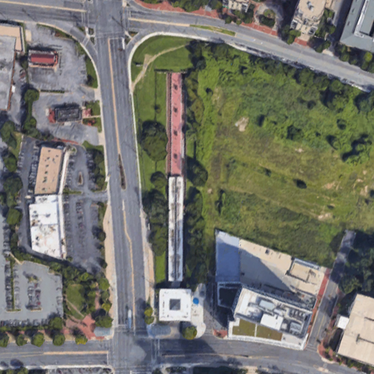
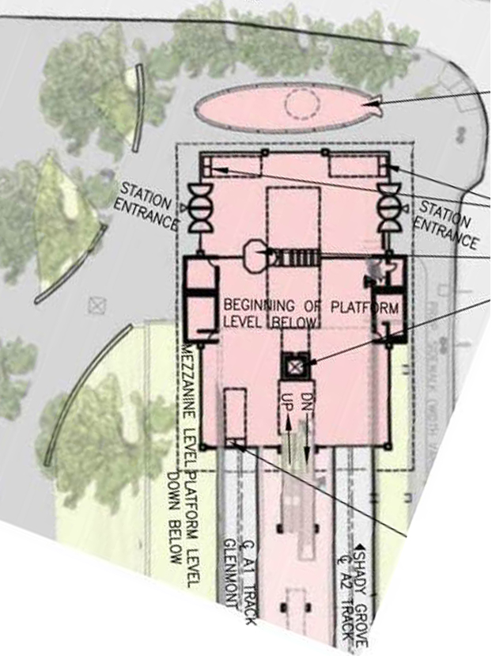
Current Study
White Flint North Entrance Feasibility Study
Site Plan
Alternative 2A – 2010 Study

Slide 14
Scope of Work
White Flint North Entrance Feasibility Study
Task 4.2 Review Existing Conditions
Task 4.3 Demand Assessment (pedestrian crossing)
Task 4.4 Alternatives Refinements (structural approaches 1 & 2)
Task 4.5 Engineering & Architectural Assessment
Architectural
Egress Analysis
Geotechnical
Utilities
Structural
MEP
Environmental Scan
Constructability Assessment
Risk Assessment
Refined Capital Cost Estimates
Task 4.6 Final Report

Slide 15
Project Schedule
White Flint North Entrance Feasibility Study
Project Start: December 2018
Stakeholder Kick Off: January 2019
Task 4.2 – Existing Conditions: January 2019
Task 4.3 – Demand Assessment: February 2019
Task 4.4 – Alternatives Refinement: February 2019
Task 4.5 – Feasibility Assessment: April 2019
Task 4.6 – Final Report: May 2019
Project Wrap Up: June 2019

Slide 16
Thank You
White Flint North Entrance Feasibility Study
Sara Benson, PE
sebenson@wmata.com
202-962-1583

