Slide 1
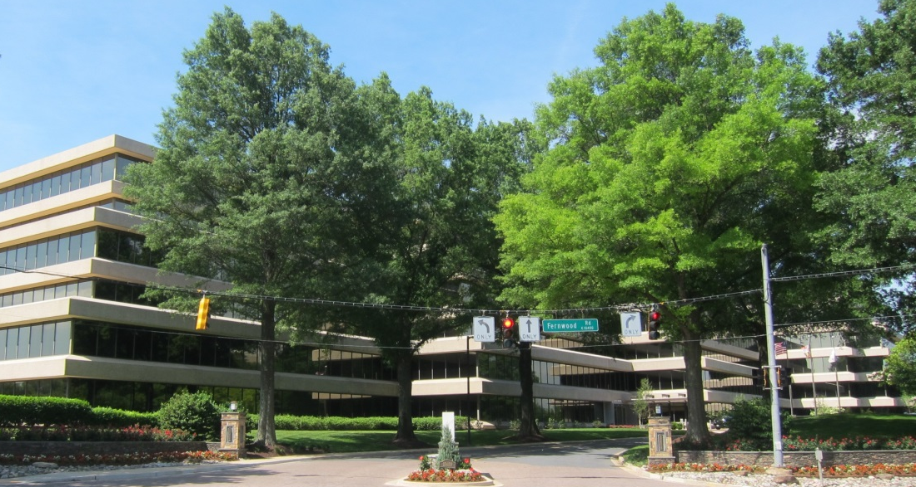
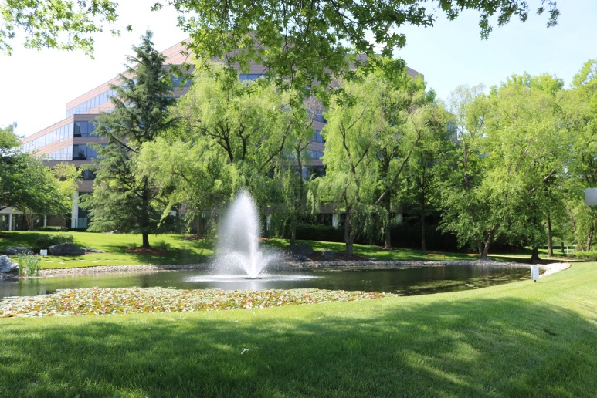
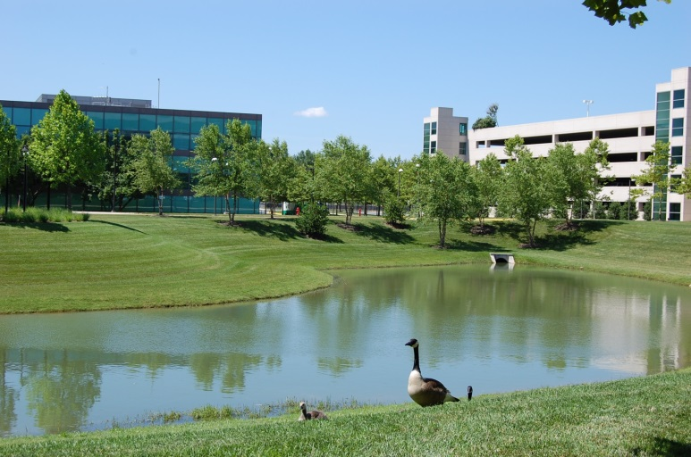
Presentation to the North Bethesda Transportation Management District
Advisory Committee July 15, 2015

Slide 3
Purpose
1. Re-evaluate a typical suburban office park with an automotive-oriented street network and large parking garages and surface parking spaces
2. Examine opportunities for the following:
a new street network
public use spaces and amenities
residential and non-residential uses
sustainable environmental measures
infrastructure needs for the area
linkages to the proposed transitway
1

Slide 4
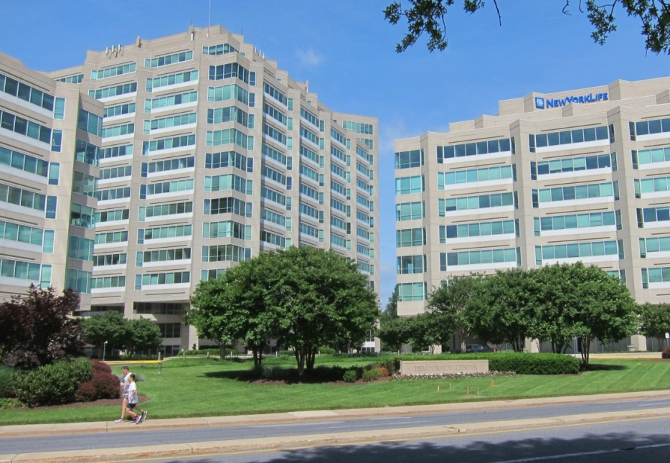
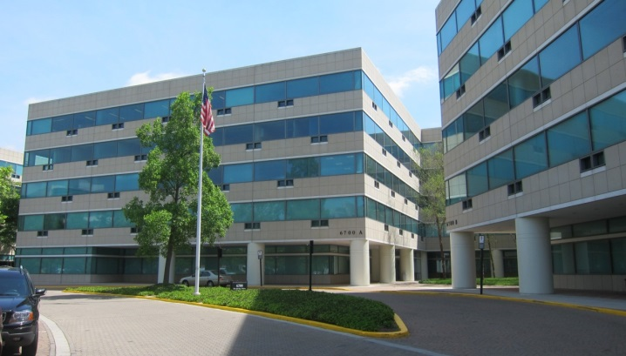
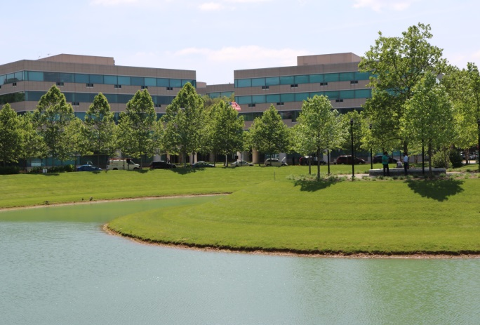
Office Park

Slide 5
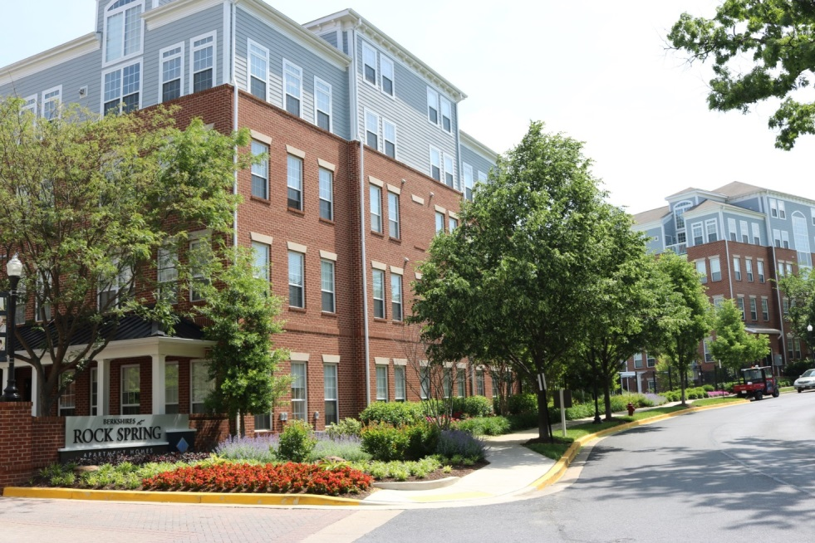
Housing

Slide 6
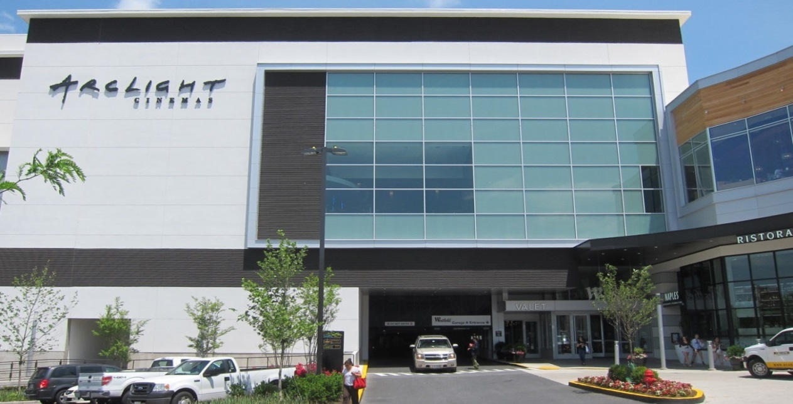
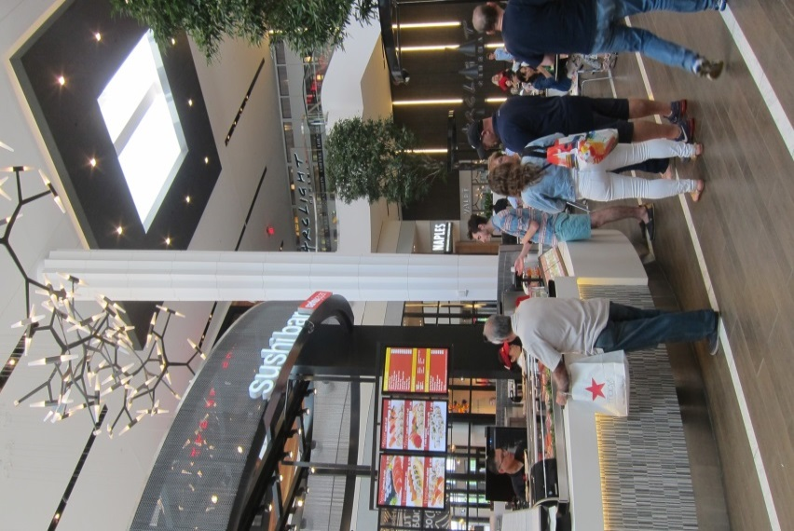
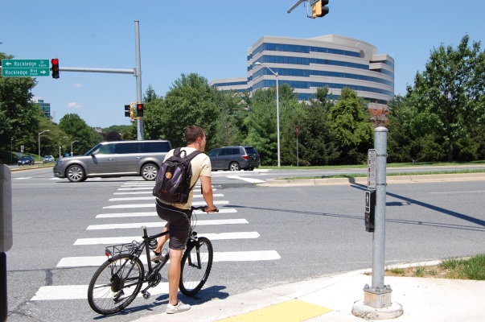
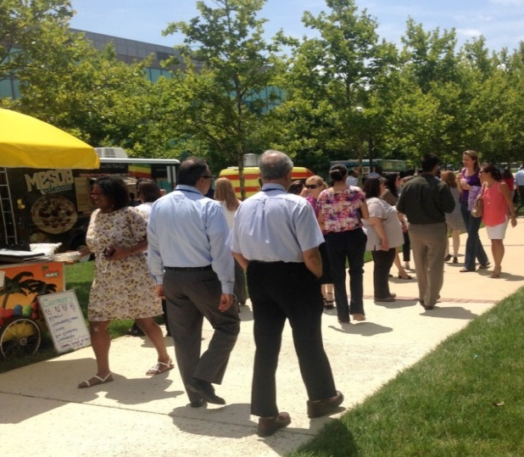
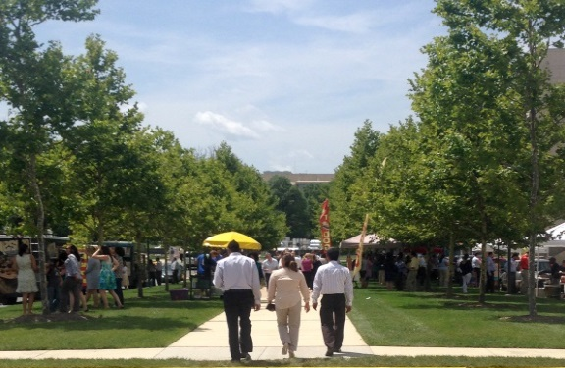
Amenities

Slide 7
Transit

Slide 8
Next Steps
NEXT STEPS
Meetings with Property Owners Summer-Fall 2015
Community Kick Off Meeting September 1, 2015
Community Meetings Winter-Spring 2016
Working Draft (aka Staff draft) July 2016
Planning Board Public Hearing September 2016
Planning Board Worksessions October – January 2017
County Executive and County Council February 2017
County Council Public Hearing April 2017
County Council Worksessions Summer 2017
Plan Adoption Fall 2017

Slide 9
Staff Contacts
Mike Bello, Urban Designer, 301.495.4597 | Michael.Bello@montgomeryplanning.org
Glenn Kreger, Area 2 Chief, 301.495.4653 | Glenn.Kreger@montgomeryplanning.org
Kristin O’Connor, Planner, 301.495.2172 | Kristin.Oconnor@montgomeryplanning.org
Nancy Sturgeon, Area 2 Supervisor, 301.495.1308 | nancy.sturgeon@montgomeryplanning.org
Don Zeigler, Planner, 301.495.4638 | Don.Zeigler@montgomeryplanning.org
Aaron Zimmerman,Transportation,301.495.4629 | Aaron.Zimmerman@montgomeryplanning.org
http://www.montgomeryplanning.org/rockspring/

