Slide 1

Ride On extRa
New Limited Stop Service
On Maryland Route355
(Lakeforest to Medical Center Station)
Dan Hibbert, Chief
Division of Transit Services

Slide 2
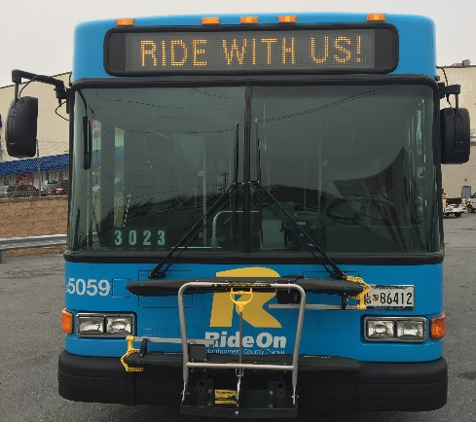
Ride On Overview
Ride On
  850 Employees
  343 Buses
  79 Routes
  24 Million Boardings Per Year
  39 Largest Transit System in miles traveled
  5,000 Bus Stops, 500 Bus Shelters
  Regional Partner with WMATA, Prince George’s, VA & MTA
Medicaid & Senior Transportation

Slide 3
Ride On Bus Service
  Current State
  Ridership down 7% YTD
  Over capacity on MD 355 Corridor (Routes 46 and 55)
  Increasing traffic congestion

Slide 4
Ride On Bus Service
(continued)
  Future State
  3 Tiers of Bus Service
    Ride On
    Ride On extRa (an extension of Ride On brand)
    BRT (separate and distinct brand)
      Reduces congestion on major arteries

Slide 5
Ride On extRa - Service
Limited Stop service: operates between Lakeforest Transit Center and Medical Center Metro Station.
Due to limited stops-the Ride On extRa will operate 30-40% quicker than local buses.
Transit Signal Priority (TSP) will be utilized at 15 to 17 intersections to help ensure the Ride On extRa service reliability.
17 dedicated and specially branded buses will be utilized to provide10 minute headways during the peak periods (530a-930a/330p-730p).

Slide 6
Ride On extRa – Service
(continued)
Buses will include WiFi and USB charging outlets.
15 bus stops will be provided with new amenities including Real Time Information Monitors.
Connections will be made to multiple MetroRail Red Line Stations, the MARC Brunswick Line, MTA Commuter buses, 42 Ride On routes and 15 MetroBus routes while serving high residential and commercial points in the corridor.
The Ride On extRa will begin operation October 2, 2017.

Slide 7
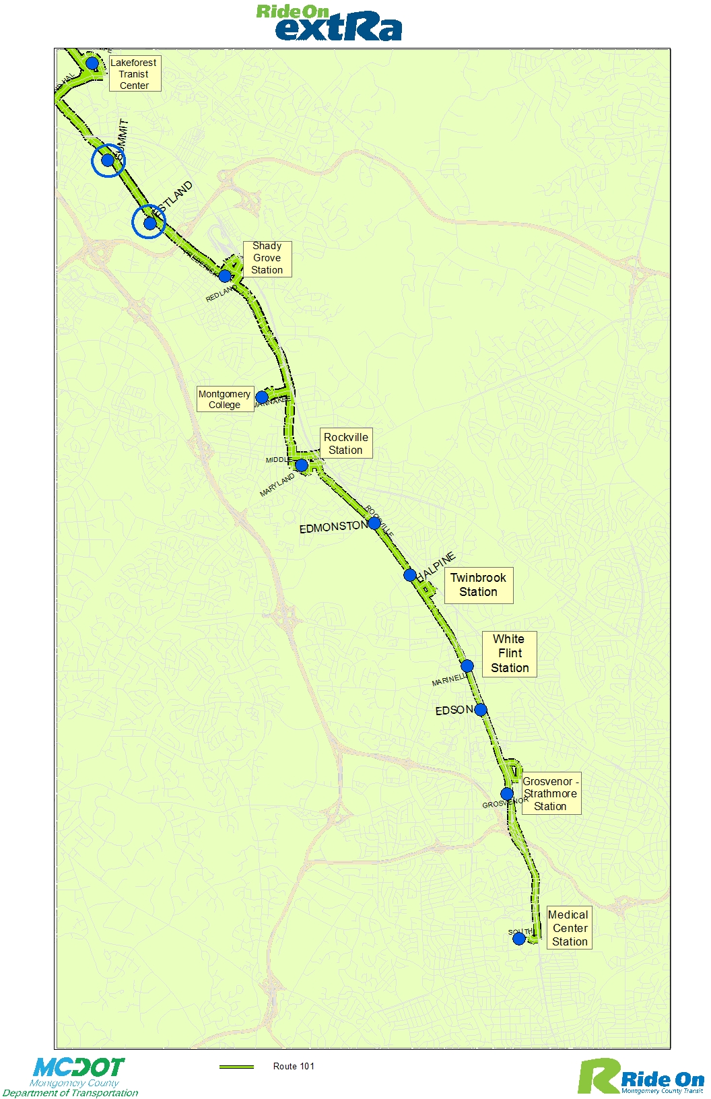

Slide 8
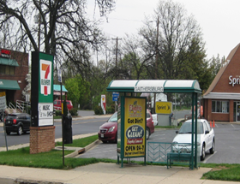
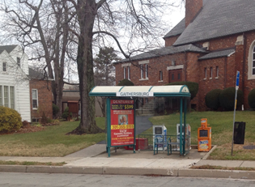
Shelters in
City of Gaithersburg
Frederick Ave and North Westland Drive
Four current shelters will be replaced with the new Ride On extRa shelters
Frederick Ave and South Summit Avenue

Slide 9
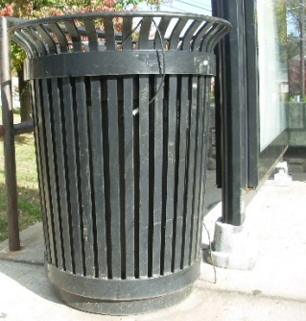
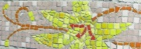
Bus Shelter Graphic Design
Shelter will be painted silver to match buses
Artwork on concrete pad RealTime Monitor on left wall extRa flag on bus stop pole

Slide 10
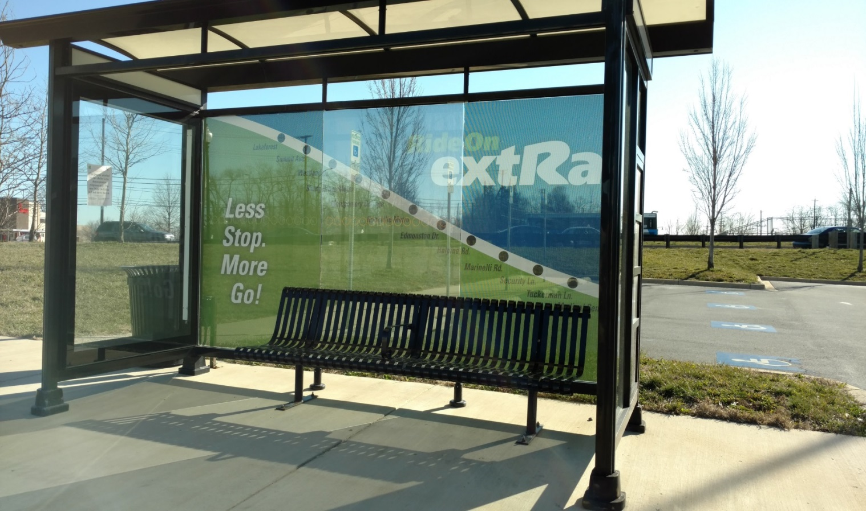
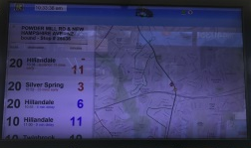
Bus Shelter Graphic Design
(continued)

Slide 11
Communications Plan

Slide 12
Communications Plan
(continued)
Media Releases: April, July, and October
Presentations
Gaithersburg City Council
Rockville City Council
Bethesda Regional Services Center Citizens’ Advisory Group
UpCounty Regional Services Center Citizens’ Advisory Group
TMD Advisory Committees: North Bethesda, Shady Grove

Slide 13
Communications Plan
(continued)
Friends of White Flint – Amy Ginsburg is Executive Director
White Flint Partnership – developer interests (JBG and FRIT)
White Flint Downtown Committee
White Flint Implementation Advisory Committee
NIH/Walter Reed
Montgomery College/Rockville

Slide 14
Exterior Bus Ad Designs

Slide 15
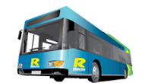

Thank You!

