Slide 1
NextGen TDM Proposed Code Changes & Executive Regulations
Supporting Transportation Demand Management
And Multi-Modal Options
For New Developments,
Employers and Multi-Unit Residential Projects

Slide 2
NextGen TDM – Goals of the Effort
Streamline Process
Reduce need for negotiation during development process
Shorten time for approval of TDM programs
Provide Flexibility
Provide more choices of TDM strategies, tailored to type of project, geography, availability of transportation options
Provide ability to make adjustments, change strategies over time
Ensure Fairness
Clarify requirements, including costs to the project
Improve consistency and predictability
Increase Effectiveness
Extend TDM/multi-modal approaches to broader segment of the County
Improve monitoring, reporting & enforcement
Provide incentives/disincentives to promote goal achievement
Enhance ability to achieve County’s transportation goals

Slide 3
NextGen TDM – Overview
Two Components
Revisions to Chapter 42A, Article II of County Code:
“Transportation Demand Management”
Accompanying Executive Regulation (Method 2)
Approach
Maintain/enhance shared responsibility for implementing TDM
County, developers, employers, property owners, residents, public
Leave current Transportation Management Districts (TMDs) as they are
Establish a Countywide TDM program - & allow for Countywide TMD(s)
Revise Code to improve processes & include flexibility for future changes
Adopt Executive Regulation to clarify implementation
Enable TDM strategies to be added, revised
Enable other implementation adjustments over time without legislation

Slide 4
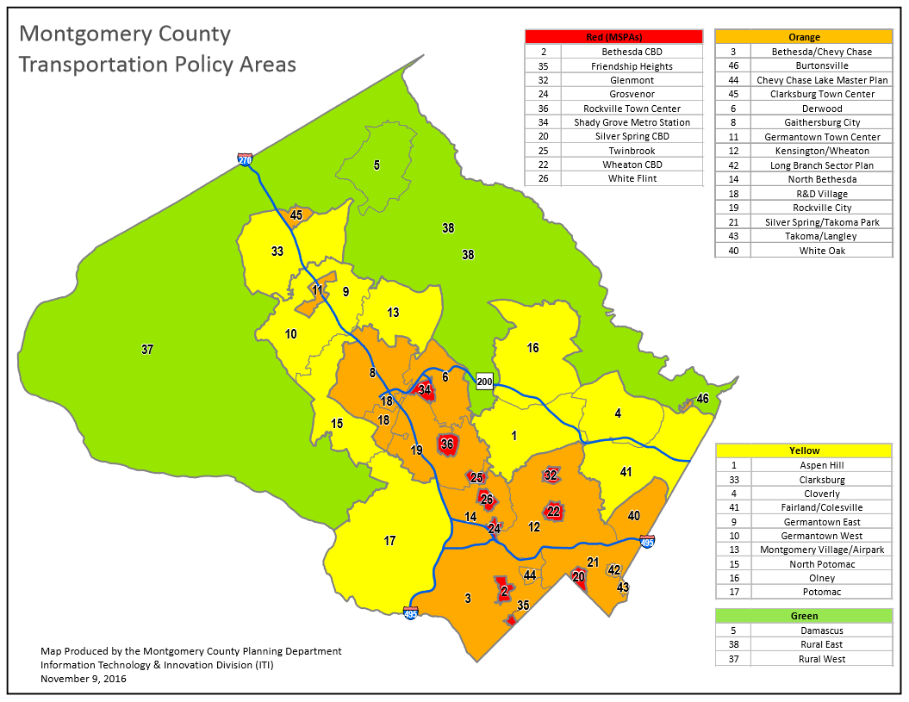

Slide 6
Changes to Chapter 42A, Article II – Transportation Demand Management
Modified to incorporate Subdivision Staging Transportation Policy Areas/Color Categories
New developments required to have TDM program with varying minimum sizes:
Red – 25K GSF Orange – 50K GSF Yellow – 75K GSF
Three levels of TDM programs: Basic, Action, Results
Subdivision Staging Policy Area | No Requirements | TDM Basic Program (No TMAg) | TDM Action Program (“Action-Based TMAg”) | TDM Results Program (“Results-Based TMAg”)
Red Areas | <25K GSF | 25K – 100K GSF | Not Applicable | >100+K GSF
Orange Areas | <50K GSF | 50K – 100K GSF | >100-200K GSF | >200+K GSF
Yellow Areas | <75K GSF | 75K – 100K GSF | >100K GSF | Not required – May be used upon request

Slide 7
TDM Program Levels
Basic Program – Bare minimum
Appoint contact person, coordinate/cooperate with County program efforts
Facilitate outreach to on-site population
Provide Real Time and other TDM-related information
Otherwise relies on County programs
Action Program – Mid-range commitment: Must contribute to achieving TMD goal
Commitment to implement specific strategies (some required, some applicant-selected)
Minimum funding commitment as necessary to achieve progress toward goal
Self-monitoring, reporting
Addition/substitution of program elements if progress is not being made
One-step of modest penalties for non-performance
Rewards for ongoing performance
Results Program – Highest level commitment: Must achieve TMD/Project goal
All the above plus:
Independent monitoring
More substantial penalties if result (goal) not obtained after multiple monitoring periods
Rewards for ongoing goal achievement

Slide 9
Employer Traffic Mitigation Plans
Current Code Requirements:
Employers located in TMDs who have 25 or more employees are required to file a
Traffic Mitigation Plan ( TMP)
Current Code provision shown below, with proposed edits as strike-throughs & italics for additions.
“The traffic mitigation plan should be consistent with and contribute to the achievement of any commuting goals set in the Growth Subdivision Staging Policy. A traffic mitigation plan may include an alternative work hours program, carpool or vanpool incentives, subsidized transit passes, preferential parking, peak period or single-occupancy vehicle parking charges, improved transit, bicycle and pedestrian access and safety, telework, and other transportation demand management measures.”
Employers of 25+ in these areas are also required by Code to:
File a report on the TDM measures they are implementing
Participate in the Annual Commuter Survey
MCDOT provides online templates for the TMP and the Annual Report
The Plan can be completed and filed online – see template shown on next slides
Proposed Change to Code:
Employer Traffic Mitigation Plans would be required Countywide in these Policy Areas
for employers of the following sizes in those areas:
Red – 100 employees Orange – 200 employees Yellow – 300 employee

Slide 10
Next Steps/Critical Path
MCDOT continues to receive public input
Materials posted on website
Presentations to TMD Advisory Committees
Meetings/presentations with other stakeholders
Public Open House – Monday evening 7/16
Bill to be submitted to County Council for introduction
Draft proposed Executive Regulation will accompany Bill but not for official action
Public hearing to be held in fall
MCDOT may submit recommended revisions after public hearing
Council Committees and full Council process conducted
Changes/Amendments to Bill
Bill adopted late fall
Executive Regulation to be finalized & adopted after Bill
Advertised in County Register for 30 days
Council approves Exec Reg (Method 2) after Bill approval

Slide 11
Additional Detail on Proposed Changes to Code & Exec Regs
Required TDM Program Components For New Development Projects
&
Employer Traffic Mitigation Plans
Sample TMPs

Slide 12
Required TDM Program Components For New Development Projects
Subdivision Staging Policy Area (Color) | No Requirements | TDM Basic Program (No TMAg) | TDM Action Program (“Action-Based TMAg”) | TDM Results Program (“Results-Based TMAg”)
Red Areas | <25K GSF | 25K – 100K GSF | Not Applicable | >100+K GSF
Orange Areas | <50K GSF | 50K – 100K GSF | >100-200K GSF | >200+K GSF
Yellow Areas | <75K GSF | 75K – 100K GSF | >100K GSF | Not required – May be used upon Applicant request
Required TDM Program Components
Appoint contact person |  | X | X | X
Facilitate outreach/information to on-site population |  | X | X | X
Provide Real Time and other TDM-related information |  | X | X | X
Coordinate/Cooperate with County program efforts |  | X | X | X

Slide 13
Required TDM Program Components For New Development Projects(Continued)
Subdivision Staging Policy Area (Color) | No Requirements | TDM Basic Program (No TMAg) | TDM Action Program (“Action-Based TMAg”) | TDM Results Program (“Results-Based TMAg”)
Red Areas | <25K GSF | 25K – 100K GSF | Not Applicable | >100+K GSF
Orange Areas | <50K GSF | 50K – 100K GSF | >100-200K GSF | >200+K GSF
Yellow Areas | <75K GSF | 75K – 100K GSF | >100K GSF | Not required – May be used upon Applicant request
Required TDM Program Components
Commitment to TDM Strategies Selected by Applicant (See Menu of Strategies) |  |  | X | X
Minimum Financial Commitment |  |  | 50% of Annual TDM Fee | 100% of Annual TDM Fee
Self-Monitoring – Every 2 years |  |  | X | X
Independent Monitoring – Beginning in 6th year |  |  |  | X

Slide 14
Required TDM Program Components For New Development Projects (Continued)
Subdivision Staging Policy Area (Color) | No Requirements | TDM Basic Program (No TMAg) | TDM Action Program (“Action-Based TMAg”) | TDM Results Program (“Results-Based TMAg”)
Red Areas | <25K GSF | 25K – 100K GSF | Not Applicable | >100+K GSF
Orange Areas | <50K GSF | 50K – 100K GSF | >100-200K GSF | >200+K GSF
Yellow Areas | <75K GSF | 75K – 100K GSF | >100K GSF | Not required – May be used upon Applicant request
Required TDM Program Components
Biennial Report |  |  | X | X
Addition/Substitution of TDM Strategies (Beginning 4th year if needed) |  |  | X | X
Penalties – Beginning 6th year if no progress/goal achievement |  |  | One Multiple of Annual TDM Fees - To augment Project’s program, or provided to County program | 6th year = 2X Annual TDM Fees 8th year = 4X Annual TDM Fees To augment Project’s program
Rewards – For 10 years of ongoing progress/goal achievement |  |  | 50% of Annual TDM Fee for Contributing toward TMD Goal Achievement | 50% of Annual TDM Fee for TMD Goal Achievement

Slide 15
SAMPLE EMPLOYER TRAFFIC MITIGATION PLAN (TMP)
Employer Name: Company ABC, Inc.
Address: 0000 Main Street, Rockville, MD 20850
Full time employees: 80 Part Time Employees: 10
Strategies # 1 – 8 are required.
No. | TRAFFIC MITIGATION STRATEGY | EMPLOYER DESCRIPTION
 | Contact person designated to receive and distribute information | Mary Jenkins, Executive Assistant 301-444-4444 maryjenkins@abc.com We will notify the TMD in writing of any changes in this information.
 | Information on transit/pooling/other commute alternatives distributed/posted regularly (furnished by TMD) | Information on transit/ carpooling/other commute alternatives is posted regularly in the employee break area.
 | Facilitate TMD staff presentations to employees and HR/Administrative staff on commuter information/ alternatives on periodic basis. | We hold office meetings periodically and will invite TMD staff to present information at the meetings. We will inform employees when TMD staff holds a “Commuter Information Event” in our building.
 | Guaranteed Ride Home Promotion (free regional program offering emergency rides) | We will promote the Guaranteed Ride Home program to our employees. We will provide brochures.
 | Annual Commuter Survey distributed to employees (short survey of transportation-supplied by TMD). Please describe you approach to gaining 80% participation for your employees. | We will distribute the survey to employees and offer small incentives to complete.
 | ADA information provided (transportation services for people with disabilities) | We will provide disabled employees with information on the regional Metro Access program.
 | Permanent display area for TMD-provided bus schedules and other worksite and other transportation information | We plan to display a transit map and brochure in our employee break area.
 | Compile information on yearly TMP activities and submit Annual Report | We will keep on our TMP activities and submit an Annual Report.
1
2
3
4
5
6
7
8

Slide 16
Additional TDM Strategies – To Be Selected by Employers
9 | Attendance at free CSS-sponsored meetings/workshops permitted for designated contact person | We will allow Tracy Smith to attendance free CSS-sponsored meetings or workshops permitted as her schedule permits.
10 | Information on commuting alternatives provided to new employees (TMD can provide materials and/or attend orientations) | We will put brochures and other information provided by TMD in new employee orientation packages.
11 | Free or reduced rate parking for car/vanpools offered to employees | Carpoolers can park for free.
12 | Preferred location and/or reserved parking for car/vanpools offered to employees | The 2 spaces reserved for carpools are in preferred locations.
13 | Provision of car sharing space in highly visible location within on-site parking facility. | We will look into providing this in the future.
14 | Provision of car sharing incentives, including paying part or all of membership costs, rental costs, or similar incentives | We only promote car sharing at this time but plan to subsidize membership costs in the future.
15 | Bike amenities at worksite, such as racks, lockers and showers (TMD may be able to supply) | Our building has bike racks for employees to use.
16 | Transit/pedestrian amenities at worksite, e.g., sidewalks, benches, etc. | There is a Metrobus stop a block from our office. A sidewalk leads from the bus stop to our door. We make sure the sidewalk is clear of snow or debris.
17 | Carpool matching for employees (as part of free region-wide matching program, or can be onsite only) | We do not offer carpool matching for our employees, but encourage them to contact our TMD representative for information.
18 | Alternative work schedules. Indicate which one(s) you offer: Flex time, Jobsharing, Compressed Work seek or Telecommute/Teleworking | We do not offer alternative work schedules at this time.
19 | Monthly transit subsidies provided to employees. Indicate the amount of pre-tax and amount of direct benefits you provide. Indicate if the pre-tax or direct benefit is more or less than you provided last year, and if so how much (as a percent or dollar amount). | We participate in the SmartBenefits program with WMATA.
20 | Maryland State Commuter Tax Credit for employers For more information visit the website http://www.commuterchoicemaryland.com/taxcredit.htm | We take advantage of the commuter tax credit.
21 | Pre-tax payroll deduction for transit costs offered to employees (saves employer and employee money) | We plan to offer pre-tax payroll deductions for transit costs in the future.
22 | Transit passes offered for purchase at worksite (at full or reduced price) | We sell SmarTrip cards to employees who need them.
23 | Subsidize employee parking and transit equally (if employee parking is currently subsidized, offer equal subsidy for transit costs) | We plan to do this in the future.
24 | Ozone Action Days participation (regional program to alert people to dangerous air quality days) Visit Clean Air Partners website to sign up for air alerts. http://www.cleanairpartners.net | We include information about Ozone Action Days to summer editions of our e-newsletter.

Slide 17
Acronyms
LATR = Local Area Transportation Review
NADMS = Non-Auto Driver Mode Share
TDM = Transportation Demand Management
TMD = Transportation Management District
TMP = Traffic Mitigation Plans – Employers
TMAg = Traffic Mitigation Agreements - Developers

Slide 18
For More Information Sign up for CSS e-newsletter: Commuter.Services@montgomerycountymd.gov Go to CSS website: http://www.montgomerycountymd.gov/dot-dir/commuter/
Additional TDM Resources
www.vtpi.org
http://www.nctr.usf.edu/
www.cutr.usf.edu
http://www.nctr.usf.edu/ABE50/othsites.htm
www.actweb.org
https://www.bestworkplaces.org/

Slide 19
Contact Us:
Montgomery County Commuter Services
Department of Transportation
Office of Transportation Policy
101 Monroe Street –10th Floor
Rockville, MD 20850
www.montgomerycountymd.gov/commute
(240) 777-8380
Commuter.Services@montgomerycountymd.gov
Sandra L. Brecher, Section Chief
(240) 777-8383
sandra.brecher@montgomerycountymd.gov
Jim Carlson, Planning Specialist – TMDs, Advisory Committees, Surveys, Stats, Fare$hare
(240) 777-8382
james.carlson@montgomerycountymd.gov
Michelle Golden, Senior Marketing Manager – Outreach, Promotion, Events
(240) 777-8386
michelle.golden@montgomerycountymd.gov
Beth Dennard – Program Specialist – Developer Agreements, Employer Plans
(240) 777-8384
beth.dennard@montgomerycountymd.gov

