Slide 1
New Mobility Options in Montgomery County
Dockless Vehicles:
E-Bikes and E-Scooters
April 8, 2019

Slide 2
Topics Covered
Improving Personal Mobility Choices
Dockless Vehicle Pilot Phasing
Safety Concerns and Plans
State e-Scooter Legislation
County Regulation
Dockless Vehicle Expansion

Slide 3
Improving Personal Mobility Choices
Supports County Executive’s Goals
A Greener County
Easier Commutes
Safe Neighborhoods
Effective, Sustainable Government
Serves MCDOT Vision
A seamless transportation system for people of all ages, incomes and abilities that supports a vibrant and sustainable community
Advances MCDOT Mission
To move people and connect places with the best transportation choices and services
Answers broader need as demonstrated by regional trend

Slide 4
Improving Personal Mobility Choices
First Mile and Last Mile connections to transit and employment
Broader transit access for minorities and underserved communities
Private interest from developers and property managers
Support of TDM program goals
Support of Climate Change goals
Reduced auto trips and parking demand
Participation from Gaithersburg, Rockville and Takoma Park

Slide 5
Improving Personal Mobility Choices – Baltimore Survey

Slide 6
Improving Personal Mobility Choices – Baltimore Survey (continued)

Slide 7
Improving Personal Mobility Choices – Portland Survey

Slide 8
Dockless Bikeshare - Phase 1 Pilot
Evaluation of Phase 1 Pilot
Conducted by Toole Design Group - Spring 2018
Executive Summary posted on MCDOT website
Key Take-aways from Evaluation
18,000 trips in first six months
Most trips started and finished in pilot area
93% of bikes were parked without blocking sidewalks/buildings/bus stops
Results From Community & Online Survey
Increase in total bike use
Used both dockless and Capital Bikeshare
84% said to continue the program
Need more bike racks
Expand outreach and education

Slide 9
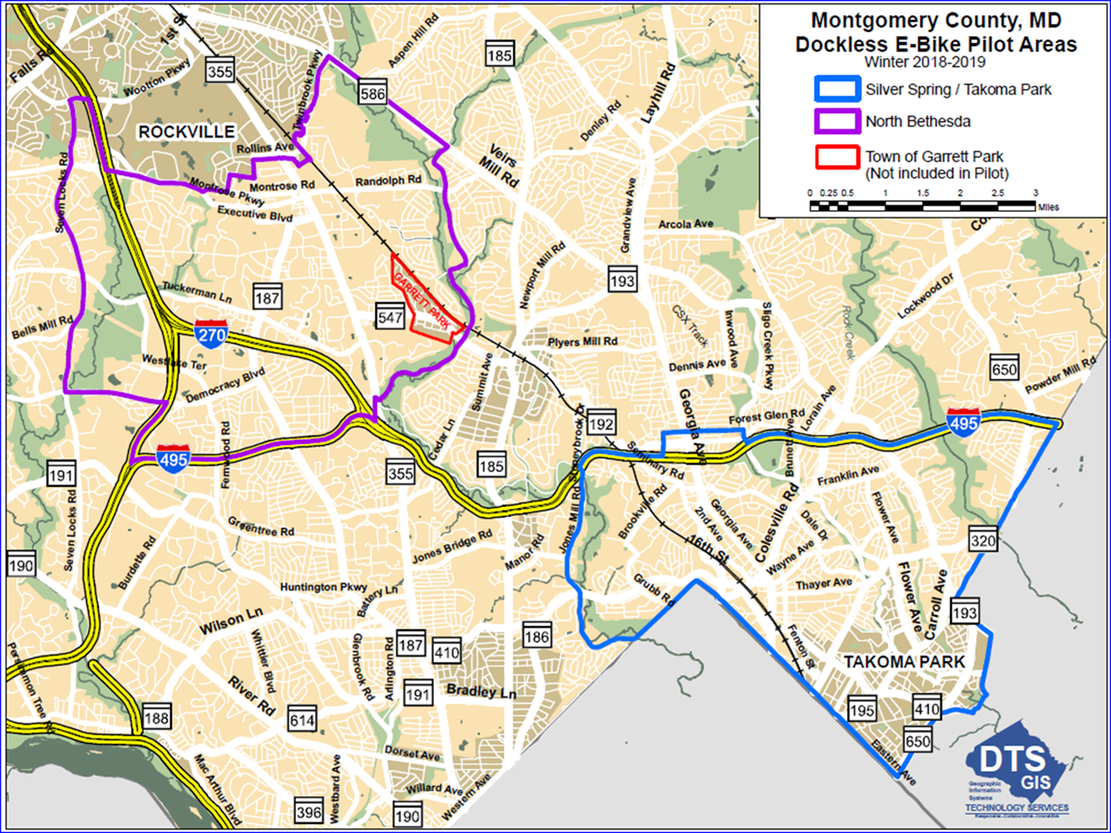
Dockless Vehicle Pilot Program Expansion Phase 2 – Fall/Winter 2018-19
Outreach conducted throughout Proposed Expansion Area
3 Open Houses
Presentations to many organizations, Chambers of Commerce, TMD Advisory Committees
Pilot Area expanded to include North Bethesda
E-bikes added

Slide 10
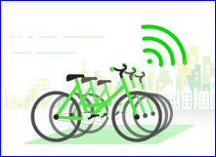
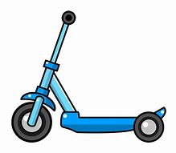
Dockless Vehicle Expansion Pilot Program – Phase 3 – Spring 2019
Adding e-Scooters, Expanding Pilot Area
6 month pilot – extendable for additional 6 months
Select 4 vendors from those submitting letters of interest
Permit e-bikes and e-scooters
Preference given to vendors offering both bikes & scooters
Expanded pilot area includes additional areas of the County except:
Agricultural Reserve
Non-participating jurisdictions are Geo-fenced out
Vehicles not allowed to end a trip or park in Cities, Villages and Towns that do not opt into the expanded program; penalties may be assessed by vendors

Slide 11
Safety Concerns and Plans
Scooter accidents similar to bicycle accidents
Dockless vehicle trips replacing car trips that are more dangerous
Public agencies can build safe infrastructure and fill potholes
Users must be over 16 to use rentals, should wear helmets, not drink and ride
Limit overnight operations: Crash risk may be higher late at night
Out of total of 4 fatalities nationwide, 3 took place between 1 am & 5 am
Centers for Disease Control evaluating Austin, Texas accident data
Results expected this spring
Portland, Oregon – City enforcement personnel issue warnings and fines to vendors for sidewalk riding or illegal parking.
$50 fine for sidewalk riding; $15 fine for illegal parking
Vendors responsible for transferring warning/fines to their riders/account holders

Slide 12
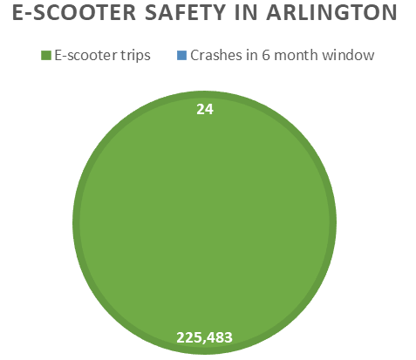
Regional Safety Data: Arlington
11,000 auto collisions and 280 bike/ped crashes in Montgomery County in similar period

Slide 13
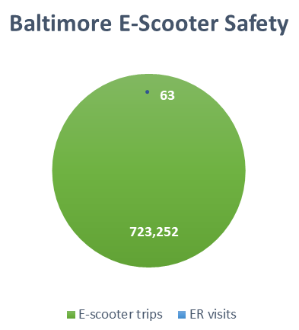
Other Regional Safety Data
Washington DC
1 fatality -- September 2018
Operational data not available
Bird reports nationally
1 incident resulting in injury
for every 27,000 miles ridden
= less than 0.01% of trips
.087 e-scooter related ER visits per 1,000 e-scooter rides
(August 15, 2018 to February 6, 2019)

Slide 14
State e-Scooter Legislation
Add definition of e-scooters to State transportation law
“Vehicle Laws - Electric Low-Speed Scooter”
SB 770/HB 748 – Sponsored by Senator Will Smith & Delegate David Fraser-Hidalgo
Define as a type of bicycle (Note: e-bikes already defined in State code)
e-Scooters required to follow traffic laws
Controls types of roads on which they can operate
Requires adherence to traffic control devices
Maximum speed of 20 mph

Slide 15
County Regulation
Permits riding non-motorized bicycles on sidewalks
Prohibits motorized bicycles on sidewalks unless personal mobility device like motorized wheelchair
E-bikes and e-scooters are not permitted on sidewalks
E-bikes and e-scooters must follow all Maryland bicycle codes
County MOU regulates:
Vehicle safety
Parking
Operating speed
Contact information required

Slide 16
Dockless Vehicle Expansion Pilot Program – Phase 3
Proposed Policies
Minimum of 200 vehicles & maximum of 500 vehicles per company
May be adjusted according to size of area served
Permit increasing maximum if daily use warrants
Average weekly ridership: 1 trip/day for bikes, 3 trips/day for e-scooters
Note: Montgomery County Parks Department maintains separate vehicle program/regulations

Slide 17
Vendor Responsibilities
Operate in compliance with MOU
Draft posted on MCDOT website
Insurance, $10K Performance Bond
Monthly Reporting on use, complaints, accidents
Data to be provided to designated 3rd party vendor to consolidate & analyze info from all operators
Respond to calls within established time parameters
Responsible for customer and public information
Conduct regular training sessions and public education programs
Display visible/tactile logo, contact information, website and phone numbers on dockless vehicles
No more than 3 dockless vehicles per block face for each company
Subject to adjustment for block sizes, composition of area

Slide 18
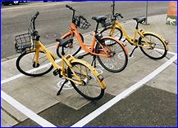
Dockless Vehicle Parking Policies
Only permitted in public ROW, bike parking areas, designated areas, sidewalks
May not impede pedestrian access, fire hydrants, street furniture, bus stops or interfere with traffic
MCDOT/vendor identify deployment & preferred parking areas
Vendor required to move improperly parked dockless vehicles
County can remove violating dockless vehicles at vendor expense if vendor fails to do so
Vendors required to ensure that dockless vehicles do not impede sidewalk snow removal
County can require removal of dockless vehicles for other special or emergency conditions

Slide 19
Customer Service
Vendors of dockless vehicles
Contact information on each dockless vehicle
Access from mobile app
Customer service phone number
Track, address and report complaints
County
County 311
Commuter Services

Slide 20
Questions?

