Slide 1
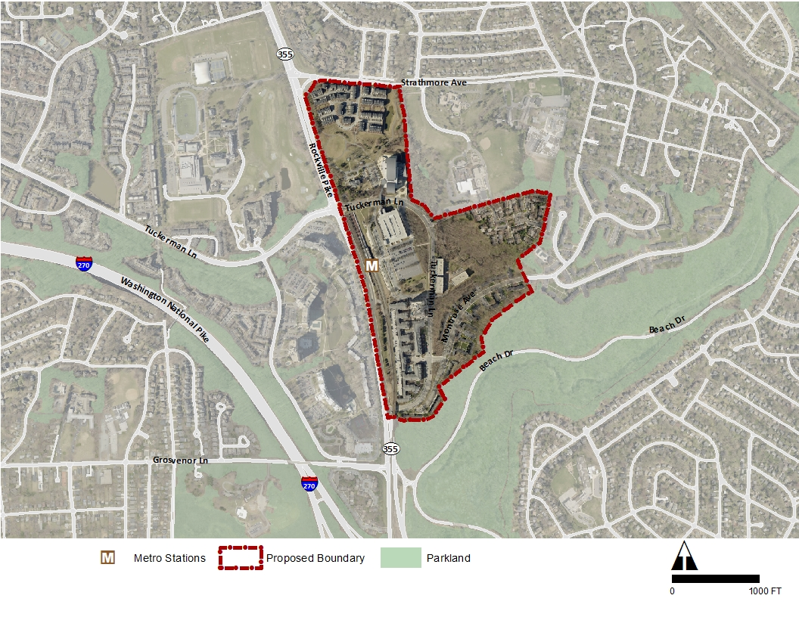
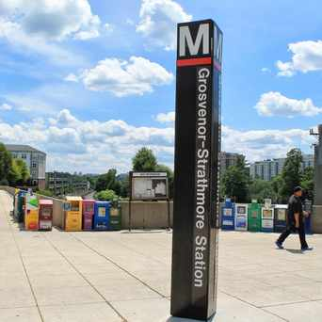
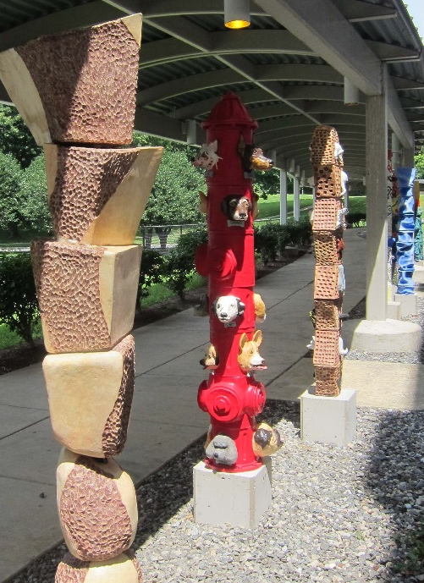
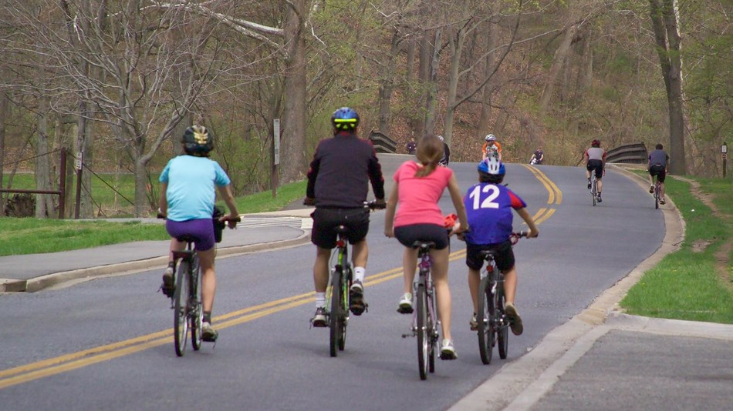
North Bethesda TMD Meeting| April 19th | 2017
Plan Boundary
Notes:
Hello my name is Maren Hill, I’m a Senior Planner with the Montgomery County Planning Department and I am lead planner for the Grosvenor-Strathmore Metro Area Minor Master Plan.

Slide 2
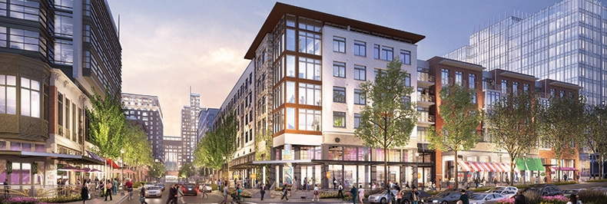
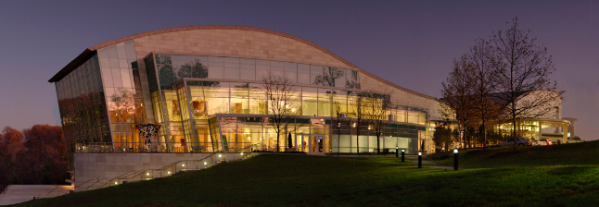
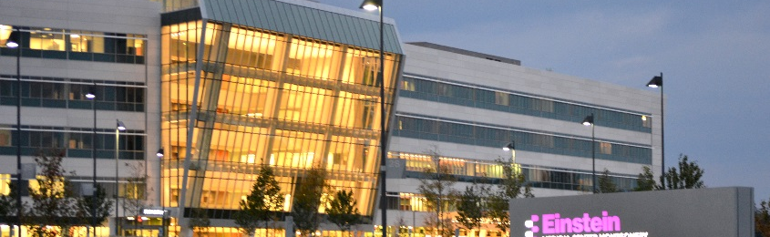
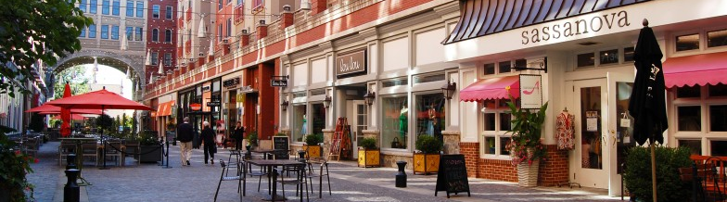
Regional Context
Twinbrook
White Flint
Grosvenor/
Strathmore
Medical
Center
Bethesda
Friendship
Heights
Notes:
The Grosvenor-Strathmore Plan area is situated on Rockville Pike (MD 355), framed by Strathmore Avenue to the north and Rock Creek Park to the south and east.

Slide 3
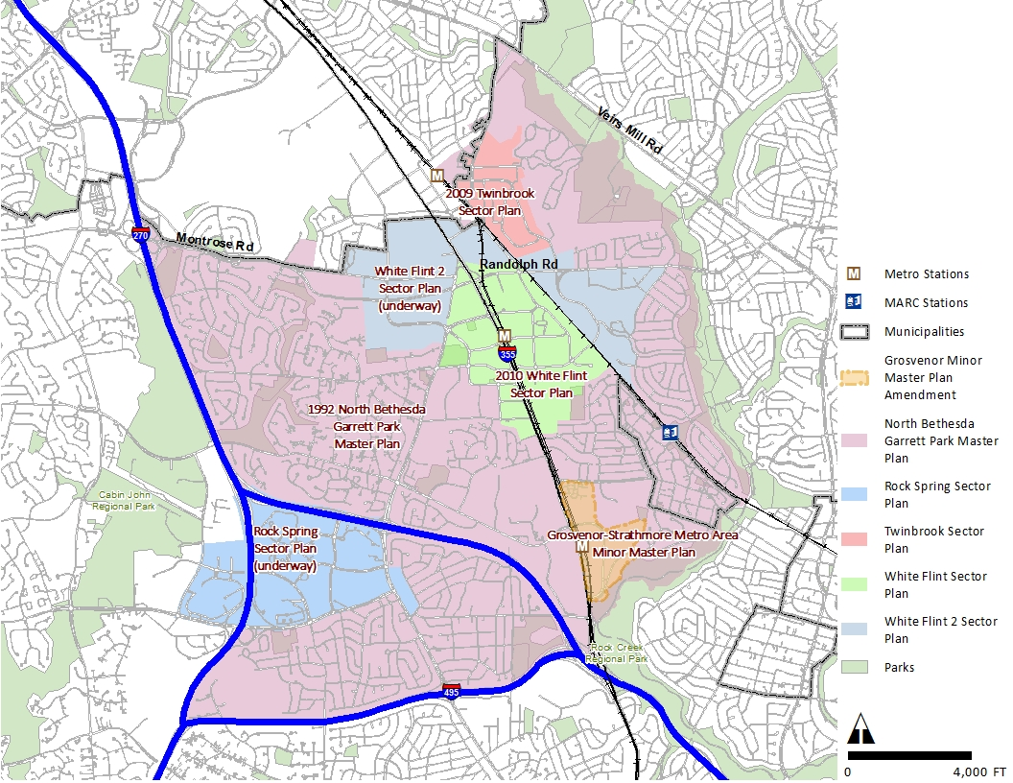
1992 North Bethesda/Garrett Park Master Plan
Notes:
This Minor Plan is an Amendment to the 1992 North Bethesda Garrett Park Master Plan, which is shown in the purple boundaries here. The Montgomery Planning Department has shifted Master Planning from these huge plan geographies to smaller, finer grain plans, as you can see with the boundaries for the Grosvenor-Strathmore minor master plan shown here in orange with the red border.
Communities that were previously part of the 1992 Master Plan are now the subject of other separate, smaller area plans, including the 2009 Twinbrook Sector Plan, the 2010 White Flint Sector Plan, and the Master Plans currently underway for White Flint 2 and Rock Spring, as well as this Plan.

Slide 4
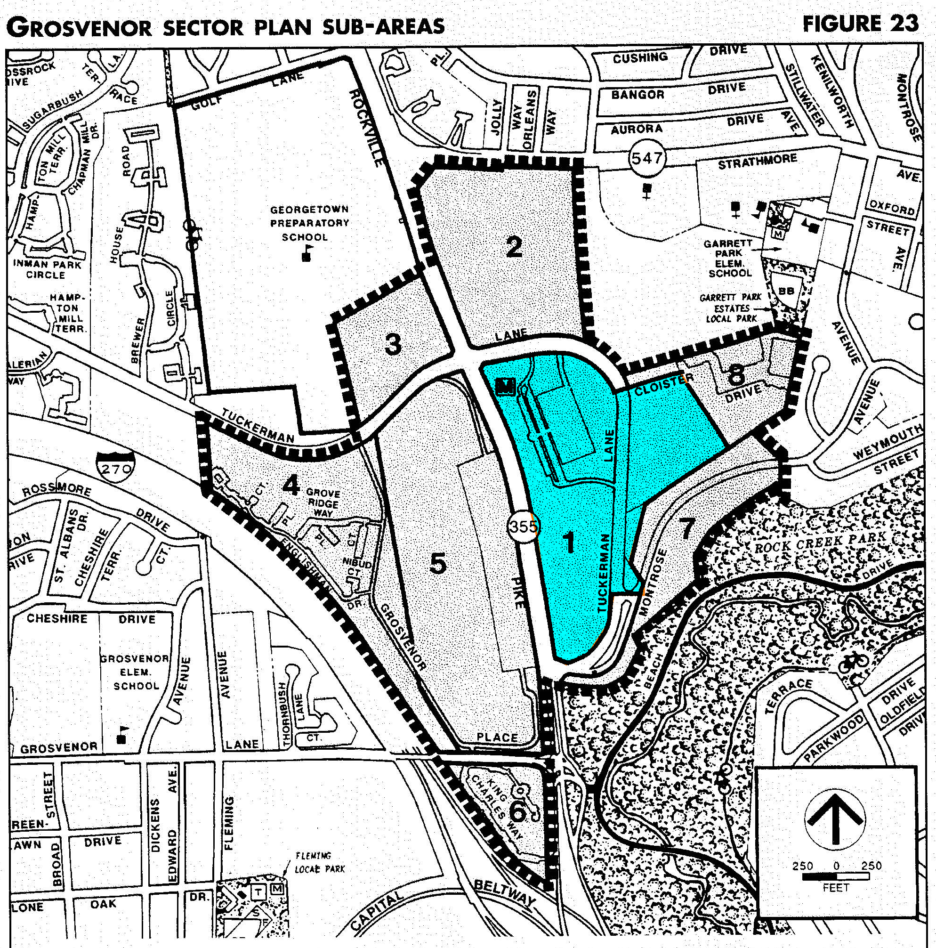
1992 Master Plan | Land Use and Zoning
Notes:
At the time of the 1992 Plan, WMATA owned 45 acres at the Grosvenor Metro Station and the agency was contemplating a joint development project with a private developer. Since that time Strathmore Park, Meridian at Grosvenor Station and Avalon at Grosvenor Metro. In 2013, WMATA released a Joint Development Solicitation for redevelopment of the remaining land at the Grosvenor-Strathmore Metro Station and chose Five Squares Development as its partner.

Slide 5
Minor Master Plan Area
Plan Boundary
Notes:
The Planning Department is initiated this plan to explore the potential for development that would advance the public policy goal of transit-oriented development at the Metro station.
The Plan area covers approximately 117 acres, which includes the Music Center at Strathmore, Grosvenor-Strathmore Metro Station, as well as the residential developments of Symphony Park, Stoneybrook, Parkside Condominiums, Strathmore Park at Grosvenor, Meridian at Grosvenor Station and Avalon at Grosvenor Metro.
The WMATA site is the only parcel of land within the boundaries of the Minor Master Plan area that is proposed for future development.

Slide 6
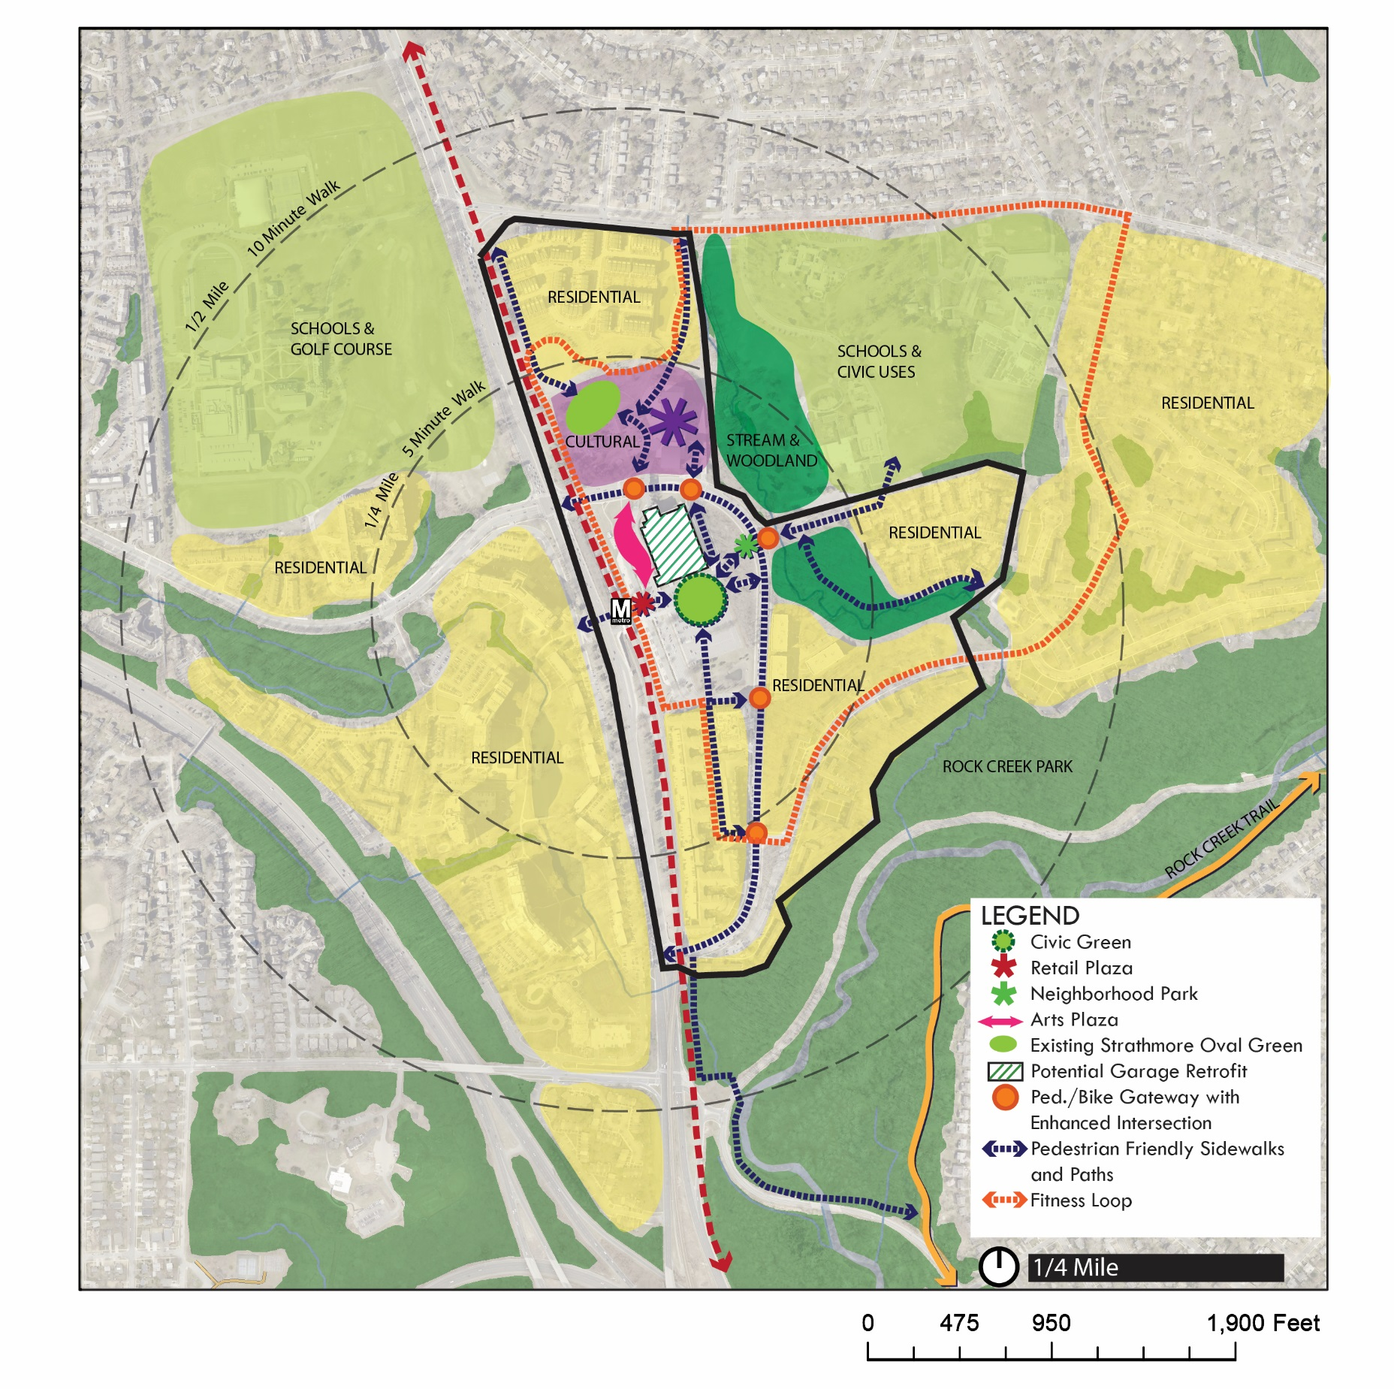
Plan Area
Notes:
The planning effort is exploring ways to enhance visibility and connectivity to the Strathmore Music Center, improve pedestrian linkages and create a shared identity for this community through public space and art.

Slide 7
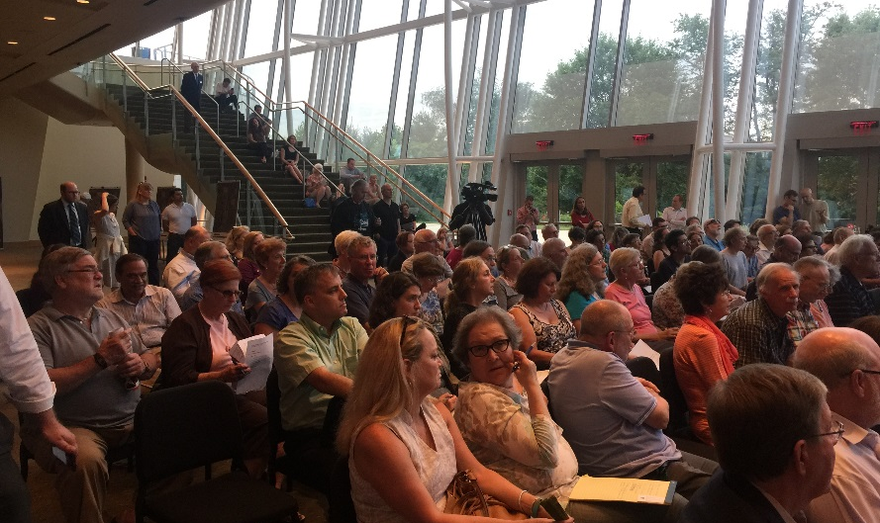
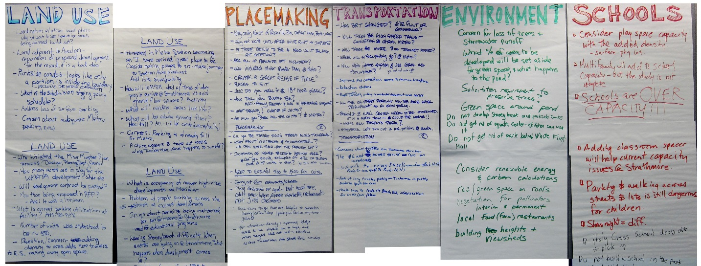
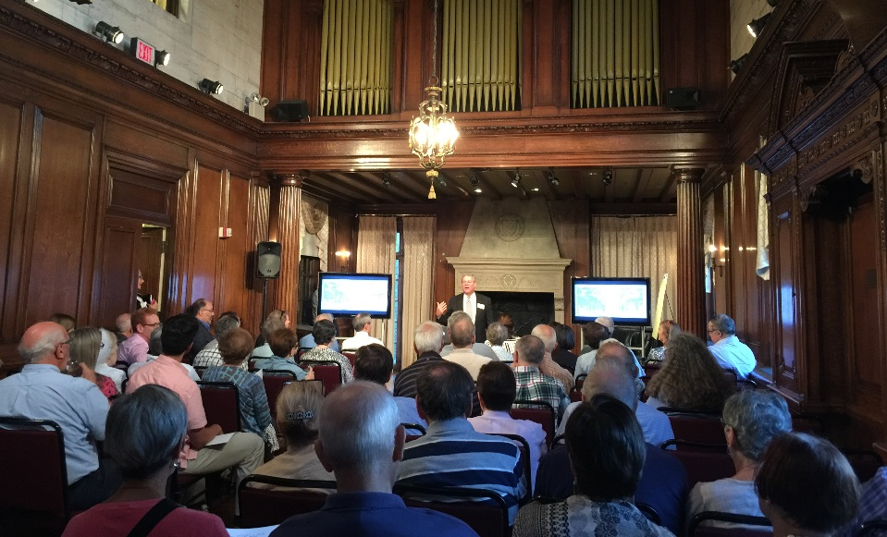
Community Input | Public Meetings
July 7, 2016: Grosvenor-Strathmore Metro Area Minor Master Plan Kickoff
June 20, 2016: Strathmore Park | COA Meeting
Sept. 27, 2016: Grosvenor Park | Condo Meeting
Sept. 14, 2016: FiveSquares Development Workshop
Notes:
So far we’ve held a kick-off meeting in July, participated in a workshop hosted by FiveSquares Development in September, and held meetings with HOAs and small groups as requested. We will host our final community meeting on Thursday April 27th from 7-9 PM at Garrett Park Elementary School.

Slide 8
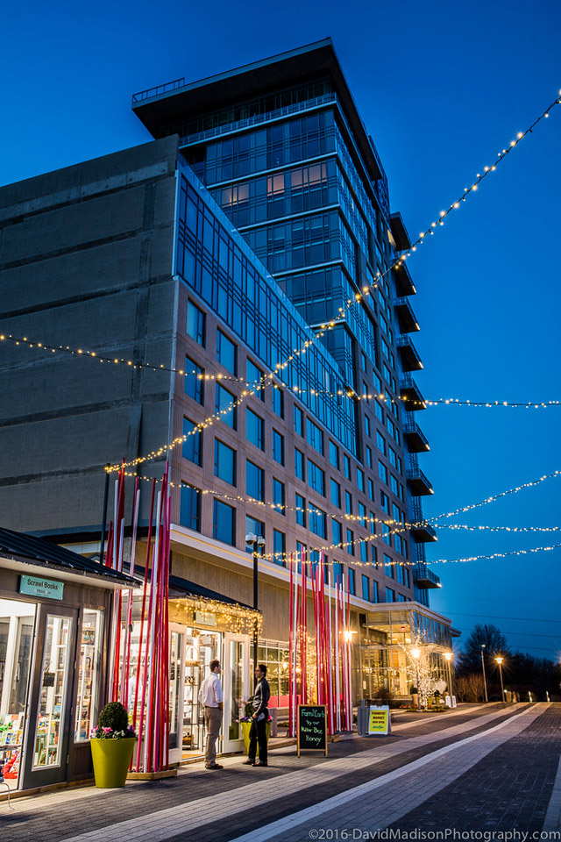
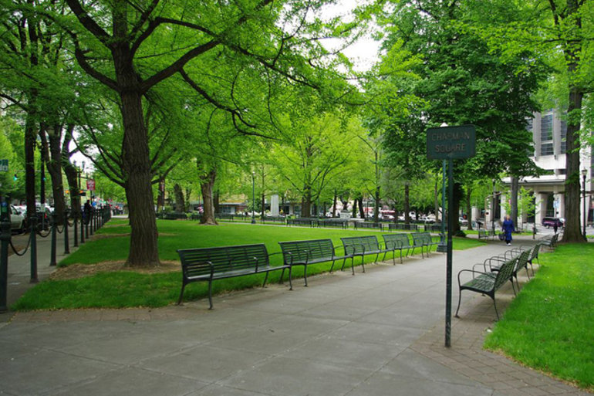
Community Input
Provide more open spaces
Improve pedestrian connections and safety
Provide convenience retail and neighborhood services
Create a sense of place at the Metro site
Notes:
At these meetings we’ve heard that residents and community members want to:
Provide more open spaces
Improve pedestrian connections and safety
Provide convenience retail and neighborhood services
Create a sense of place at the Metro site

Slide 9
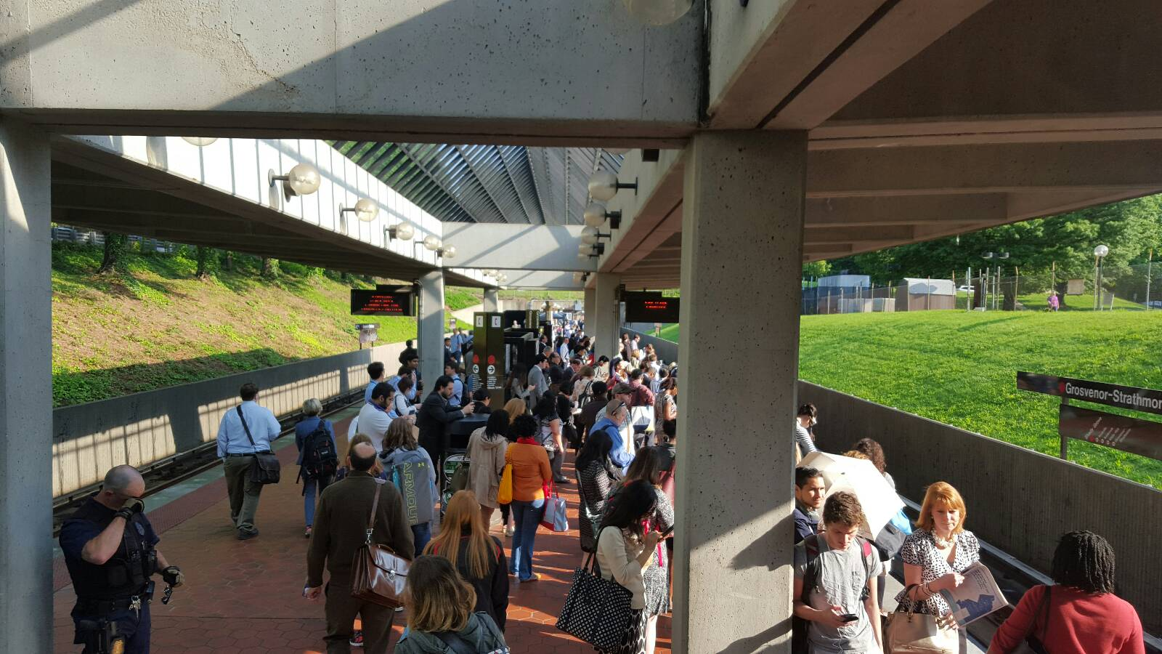
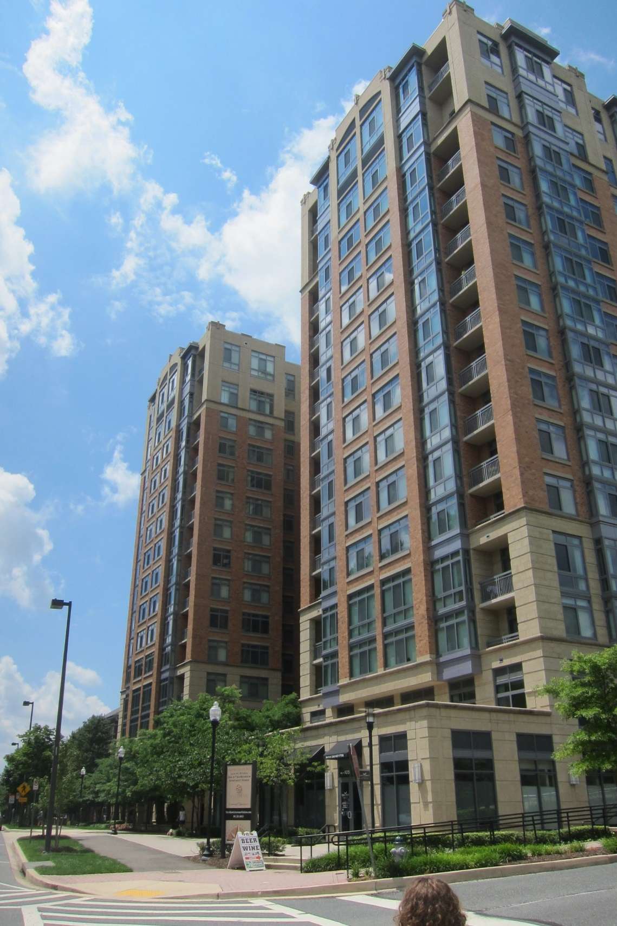
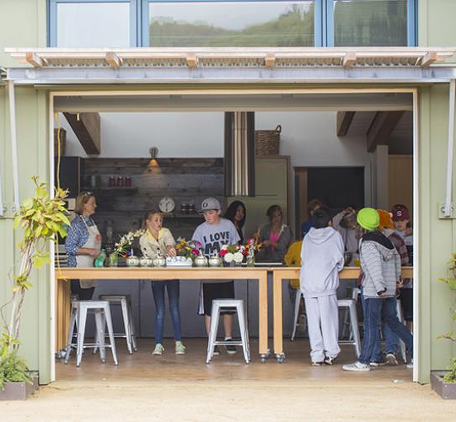
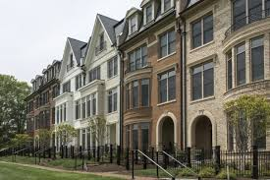
Community Input
Protect the residential character of the community
Maintain views and access to sunlight
Plan for parking and traffic impacts of any new developments
Uphold the high quality of our schools and plan to meet needs
Notes:
At these meetings we’ve heard that residents and community members want to:
Provide more open spaces
Improve pedestrian connections and safety
Provide convenience retail and neighborhood services
Create a sense of place at the Metro site

Slide 10
Land Use Scenarios
Scenarios | Residential | Approximate Number of Dwelling Units based on 1,250 gross sq. ft.
Alternative 1 (FAR 2.0) | 1,111,250 sf | 890
Alternative 2 (FAR 2.5) | 1,431,250 sf | 1,145
Alternative 3 (FAR 3.0) | 1,746,250 sf | 1,400
Alternative 4 (FAR 3.5) | 2,061,250 sf | 1,650
Notes:
We see the Grosvenor-Strathmore Metro area as a suburban residential center that will continue to be primarily residential.
For our plan area we are analyzing land use scenarios, that range between 2 FAR and 3.5 FAR. We’ve given our traffic modelers the number of units approximated here to analyze the impact of new development.

Slide 11
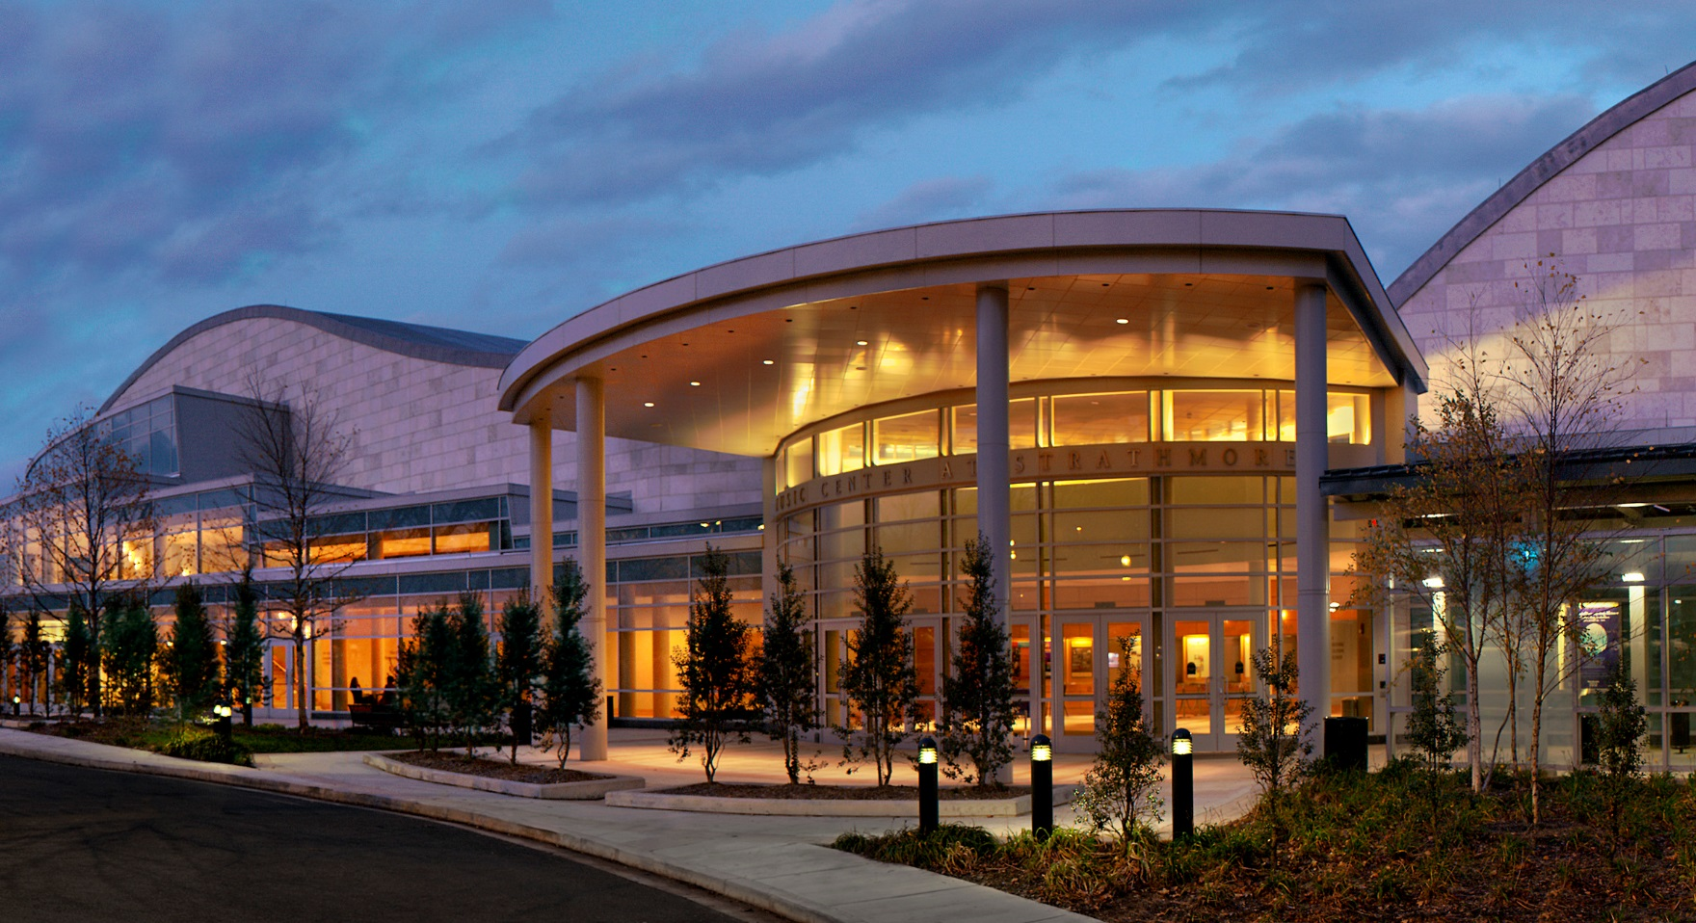
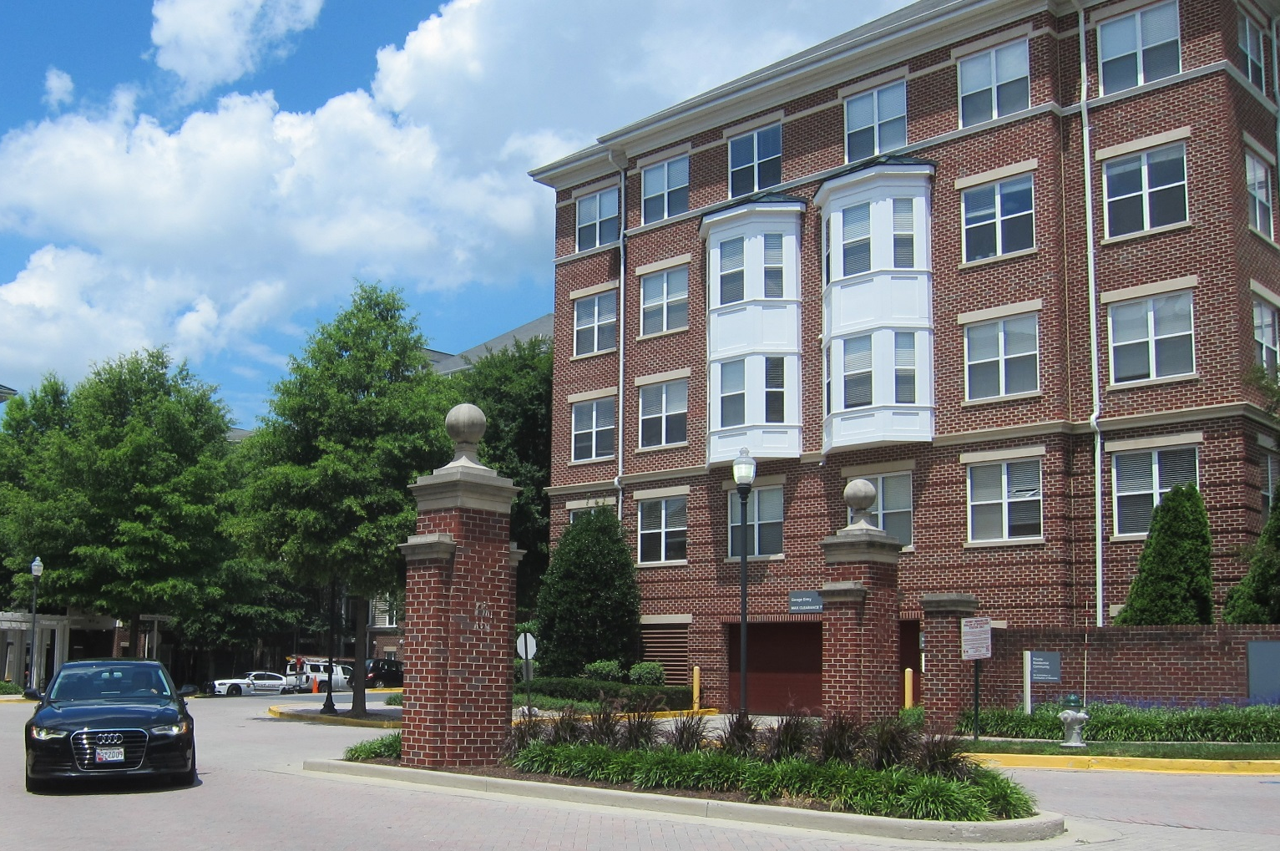
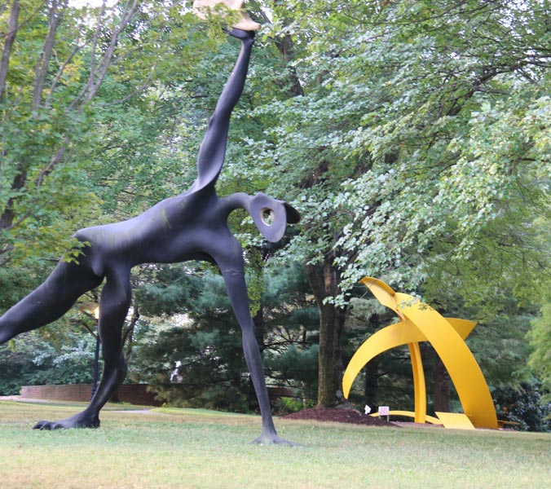
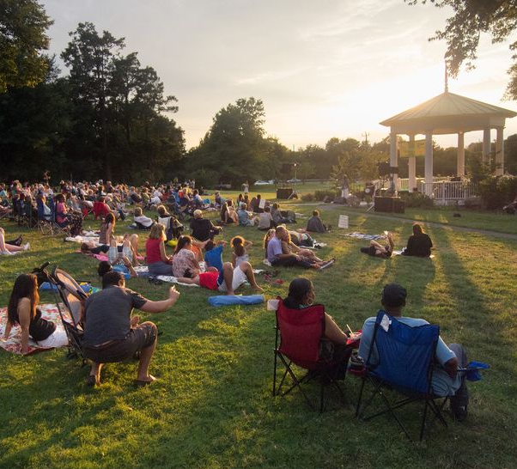
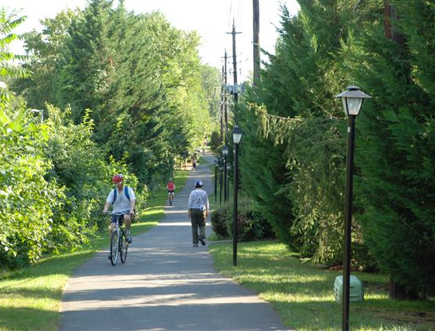
Embrace a Unique Identity
Residential neighborhood
Cultural arts destination
Recreation location
RECREATION
Music Center
@ Strathmore
CULTURE
Rock Creek Trail
Sculpture Garden
@ Strathmore
Bethesda
Trolley Trail
Free Concerts
@ Strathmore
Totem Art
Notes:
Grosvenor-Strathmore has its own identity, distinct from other areas along the Redline. It is not a downtown like Bethesda or an employment center like Medical Center. The Grosvenor-Strathmore Metro area is:
A residential neighborhood
A cultural arts destination centered on Strathmore
A natural recreation location with Rock Creek Park and the Bethesda Trolley trail near by

Slide 12
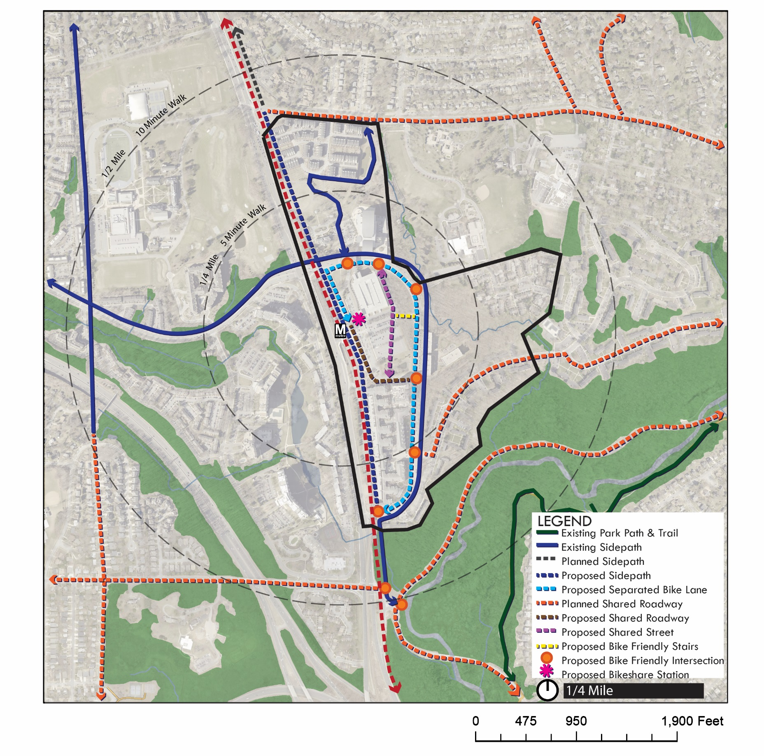
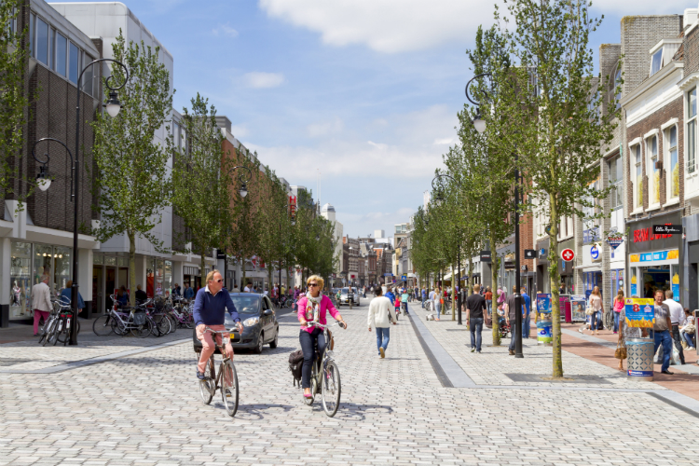
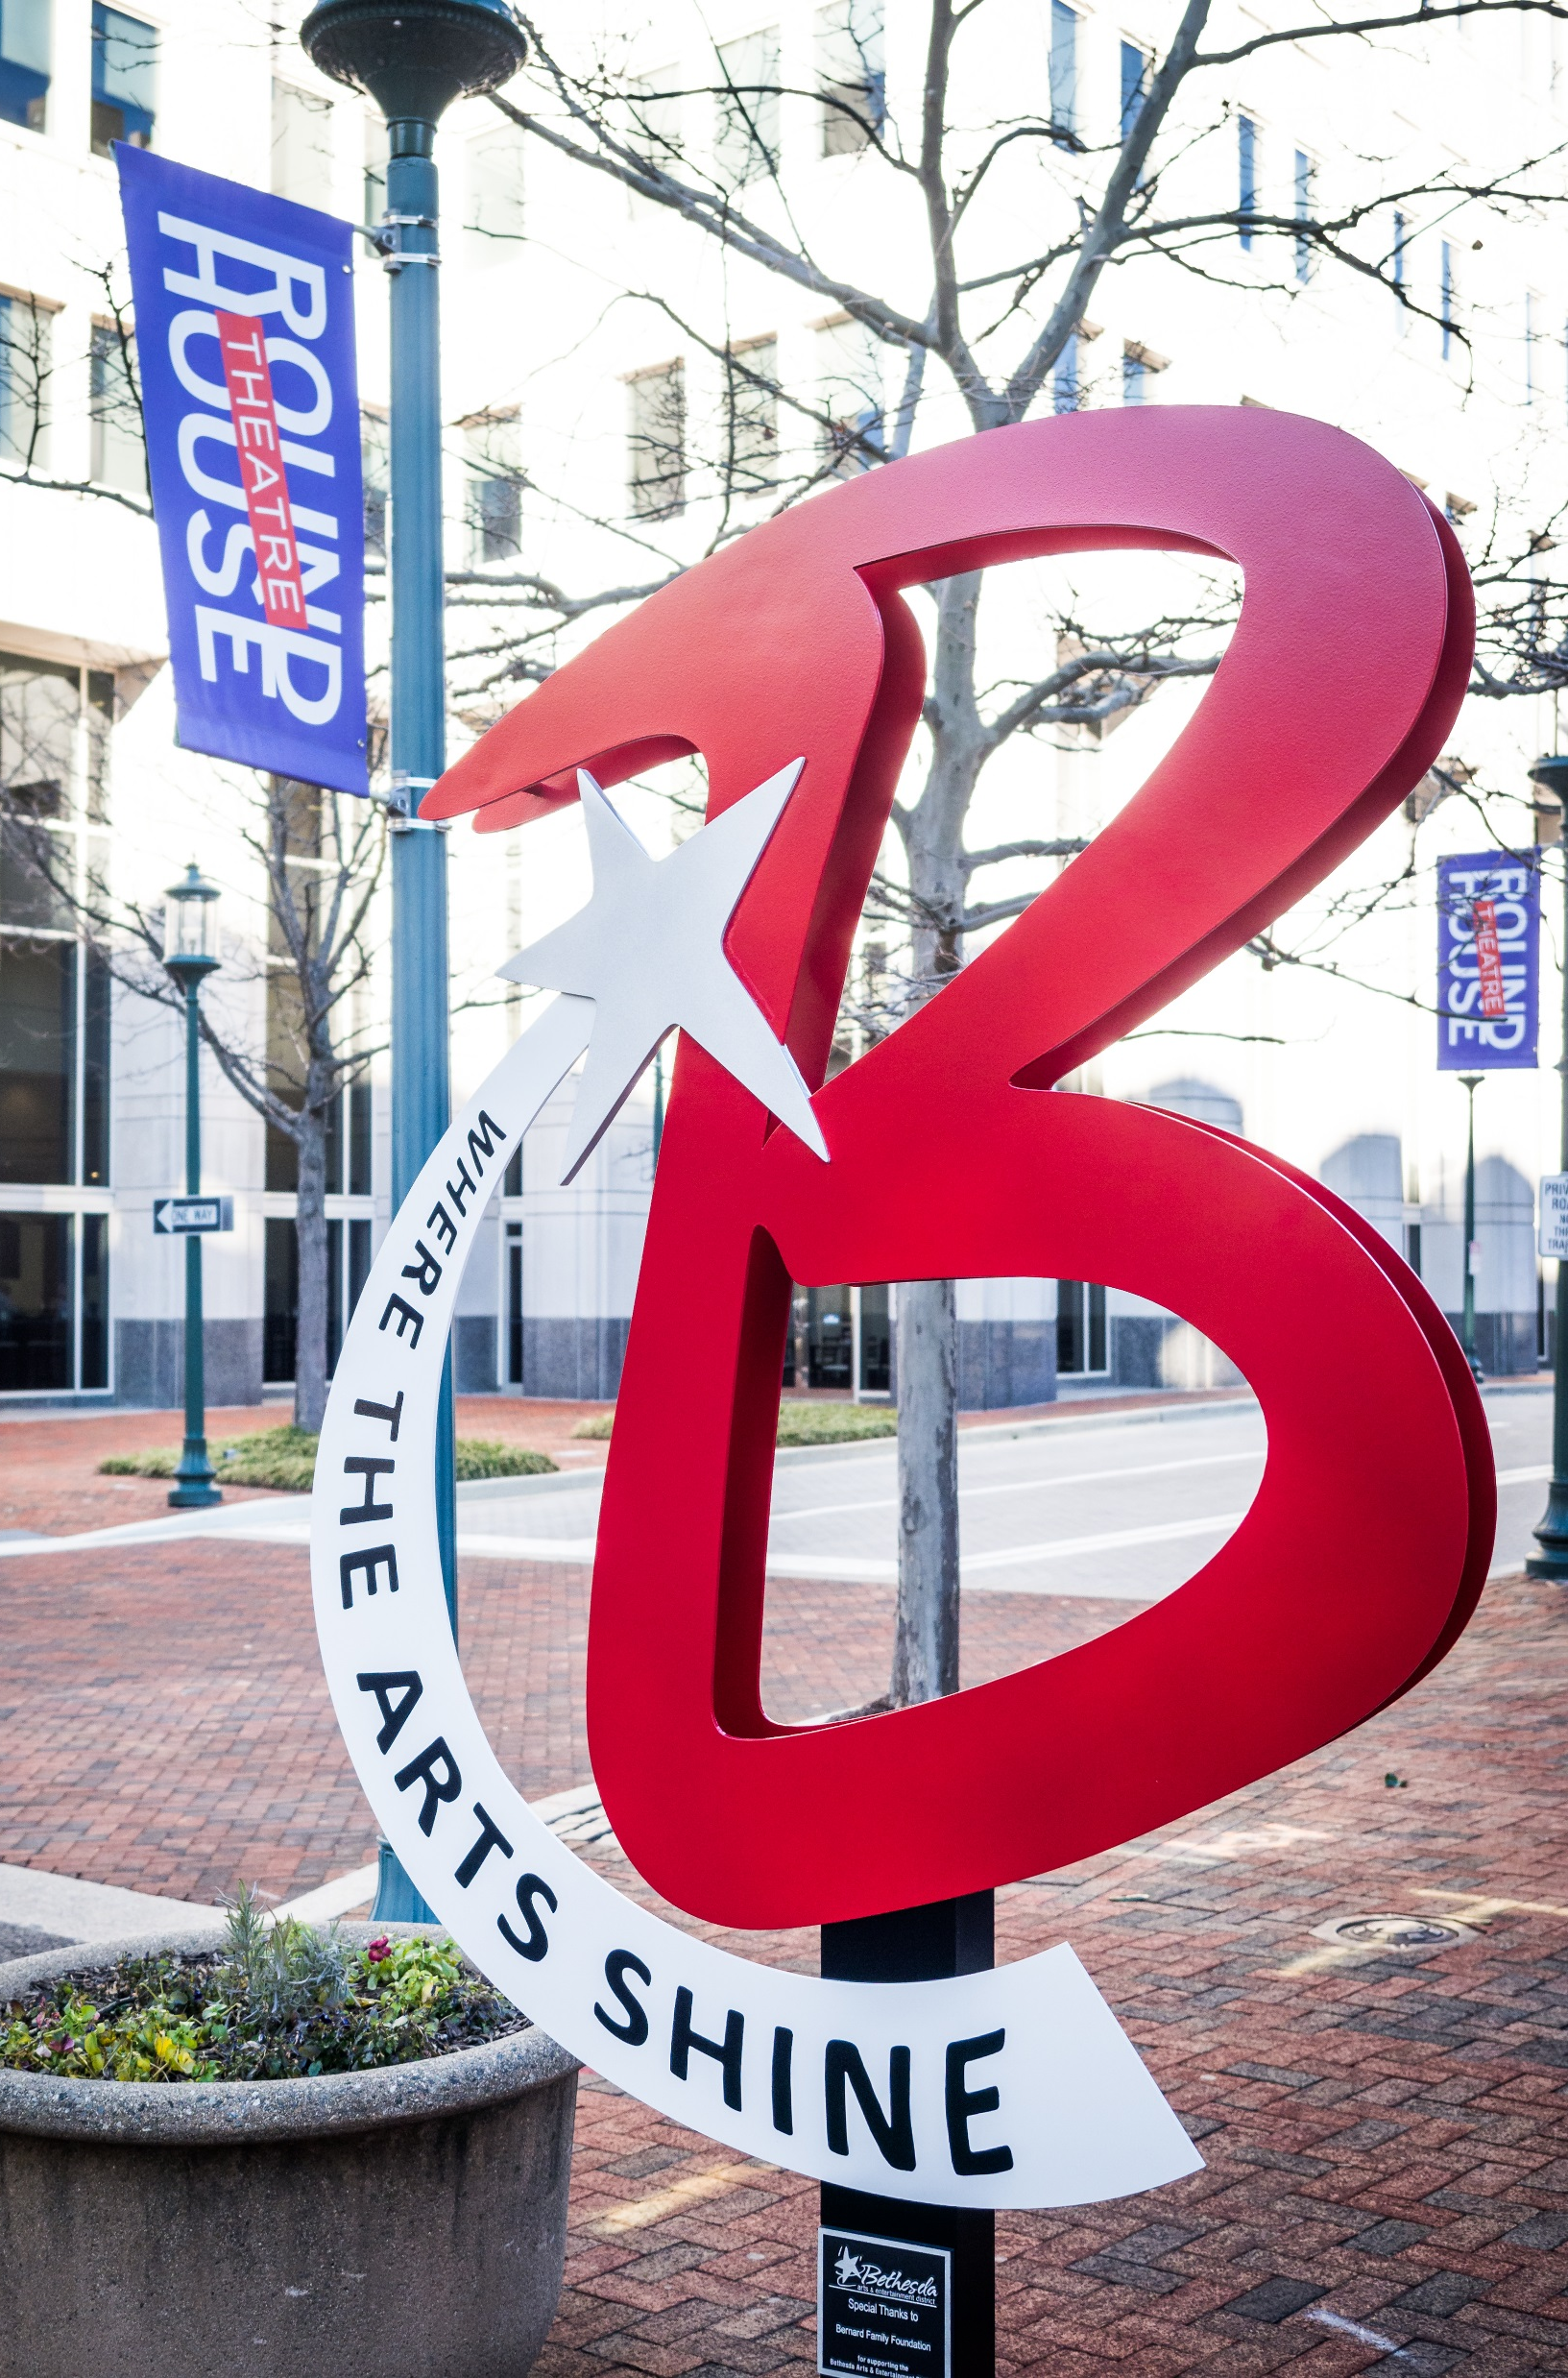
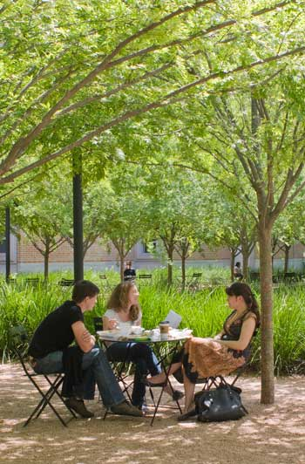
RECREATION
Music Center
@ Strathmore
CULTURE
Rock Creek Trail
Sculpture Garden
@ Strathmore
Bethesda
Trolley Trail
Totem Art
Notes:
Grosvenor-Strathmore has its own identity, distinct from other areas along the Redline. It is not a downtown like Bethesda or an employment center like Medical Center. The Grosvenor-Strathmore Metro area is:
A residential neighborhood
A cultural arts destination centered on Strathmore
A natural recreation location with Rock Creek Park and the Bethesda Trolley trail near by

Slide 13
Next Steps
Complete transportation analysis
Hold community meeting April 27th
Present preliminary recommendations to the Planning Board

Slide 14
Montgomery County Planning Department
Maren Hill, AICP
Senior Planner, 301-650-5613
Maren.Hill@montgomeryplanning.org
http://www.montgomeryplanning.org/community/grosvenor-strathmore/

