Slide 2
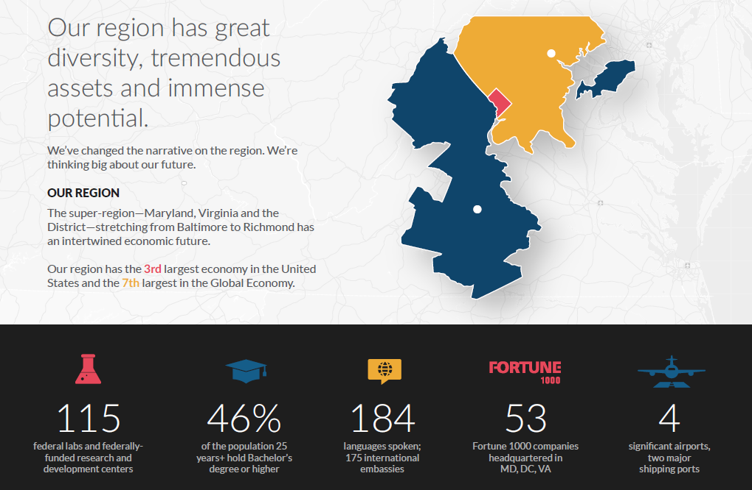
The Capital Region

Slide 3
The Partnerships Origins
REGION NOT LIVING UP TO ITS FULL POTENTIAL
Political and geographic barriers have previously prevented collaboration, growth and unity.

Slide 4
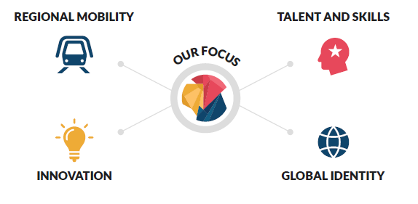
WHO WE ARE
The Greater Washington Partnership is a team of civic-minded CEOs, drawing from the leading employers and entrepreneurs, who are committed to making the Capital Region from Baltimore to Richmond one of the world’s best place to live, work and build a business.
We are leveraging our unique strengths, our diversity and the power of commerce to tackle issues holding us back. We bring long-term perspectives and fact-based solutions to drive our impact.
OUR BOARD COMPANIES
Representing 200,000+ employees in the Capital Region

Slide 5
Why Transportation?
A successful transportation system
Connects the region's economy
Strengthens talent retention and attraction
Diversifies and deepens labor pool
150%+
Roadway congestion growth by 2040
66%
Of millennials would consider leaving region, with 80% citing horrendous traffic as a cause
50%
Of commuters in region cross county border to access jobs; 20% cross state borders
20%
Projected population growth by 2040 placing additional constraints on an already constrained system

Slide 6
Taking Action on Regional Mobility
In partnership with regional business and advocacy leaders, created coalition to secure $500M in annual dedicated funding for Metro – the largest transit system without a dedicated funding source.
Developed the Capital Region’s first CEO-led Blueprint for Regional Mobility, an action plan that prioritizes investments and policies to bind the region

Slide 7
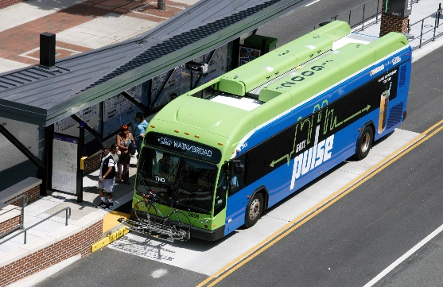
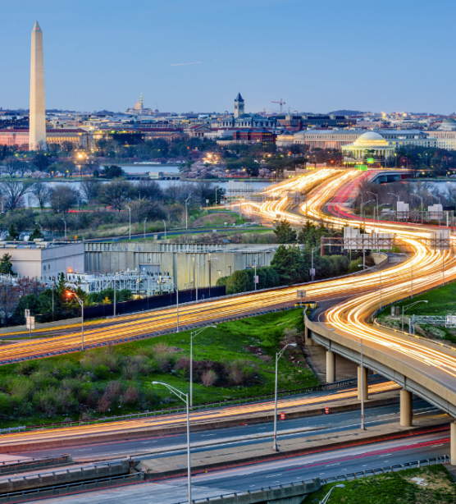
Key Focus Areas
Action: Advocate to Public Sector
Action: Employer-led
Public Transportation
Capital Region Employer Mobility Challenge
Performance-Driven Tolling
What: Challenge employers to adopt best-in-class employer mobility solutions at worksites throughout the region.
Why: (1) key amenities for employee attraction
(2) cost savings from limiting parking expense
(3) when adopted at scale, employers can collectively reduce regional congestion levels in the near-term
Intercity & Commuter Rail

Slide 8
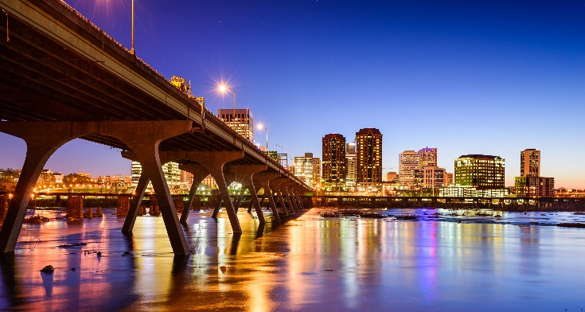
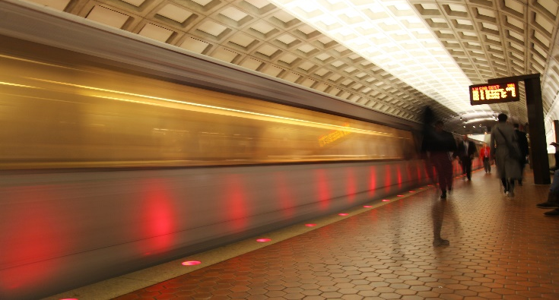
Implementation: Driving Outcomes from blueprint for regional mobility
Plans don’t deliver results, people do when they come together and act. The next phase of this work is going to be fun and exciting and we look forward to partnering with you and others to deliver results.
The Blueprint development process was a collaborative, regional effort. To make forward progress, the Greater Washington Partnership plans to work with the public, government, private businesses, and advocates to achieve the vision for our region’s transportation system presented in the Blueprint.

Slide 9
Thank You

