Slide 1
Bus Transformation project
Project Overview

Slide 2

The Bus Transformation Project will create a bold, new vision and a collaborative action plan for the future of buses in the region

Slide 3
Together we will identify the role of bus, regardless of who operates them, in our region’s future and a roadmap to get there
Sample list – not exhaustive
Local leaders
Transit providers
Governments
Regionally-developed mobility strategy
Transit advocates
Businesses
Customers & Non-customers

Slide 4

Buses carry 600,000 people every day in our region
Reducing emissions
Reducing congestion
Providing affordable transportation
P
Delivering access throughout the region
Using roadway space efficiently
Reducing space devoted to parking

Slide 5
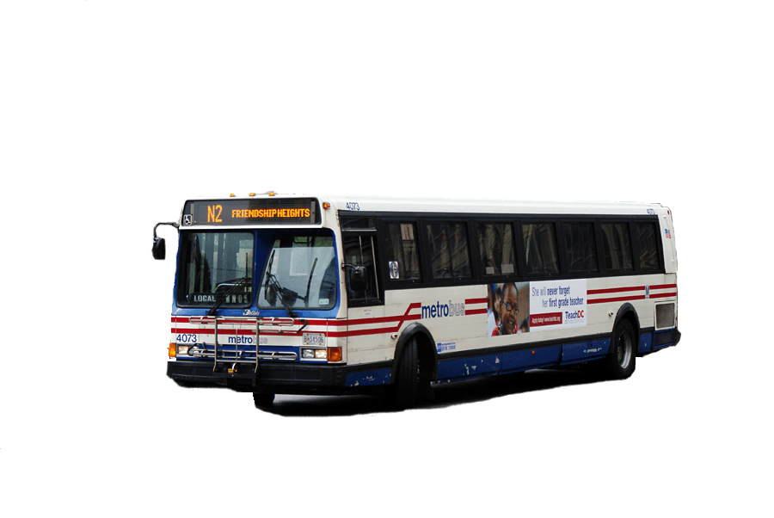
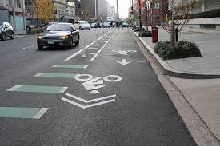

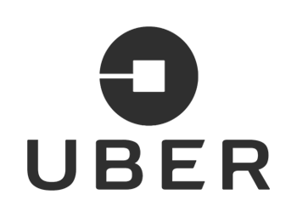
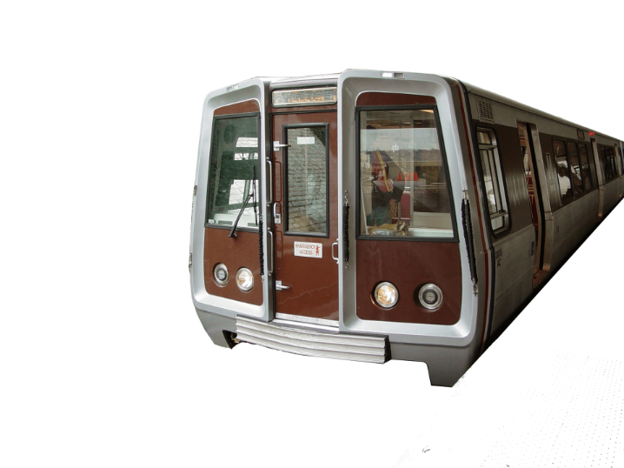
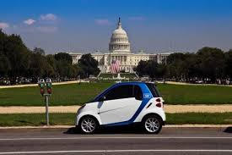
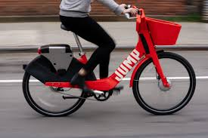
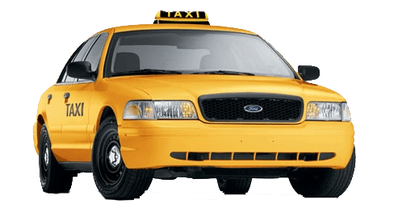
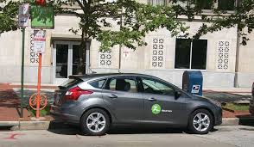
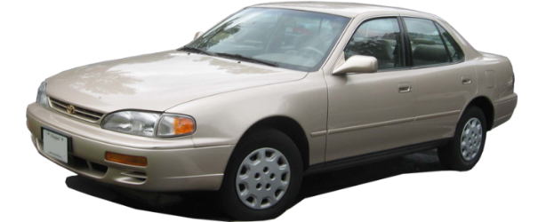
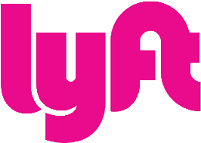
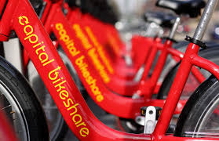
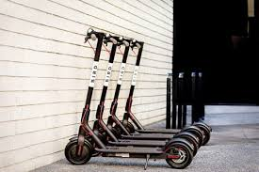

Regional
Mobility now has many aspects

Slide 6
Our region and mobility options continue to evolve, but the bus system has largely stayed the same.

Slide 7
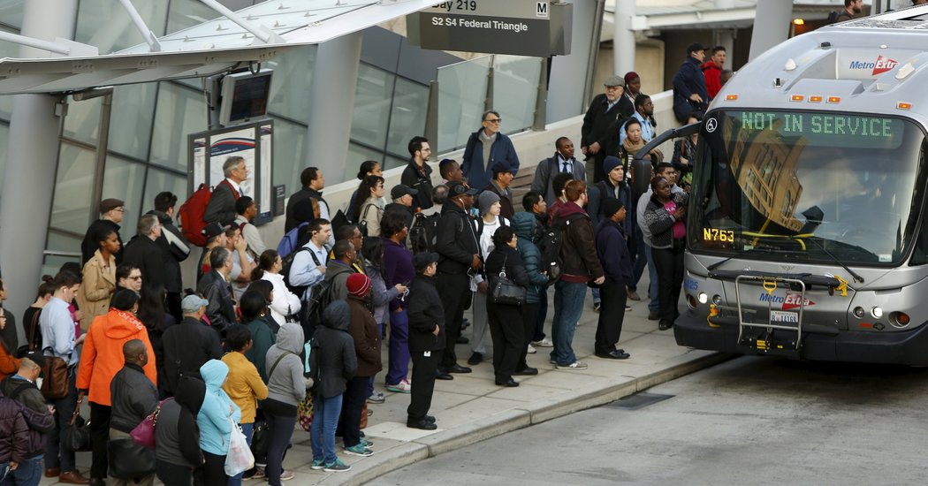
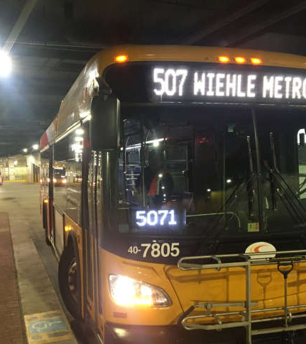
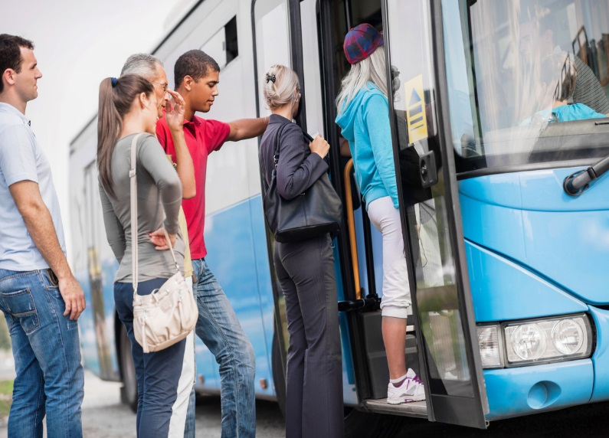
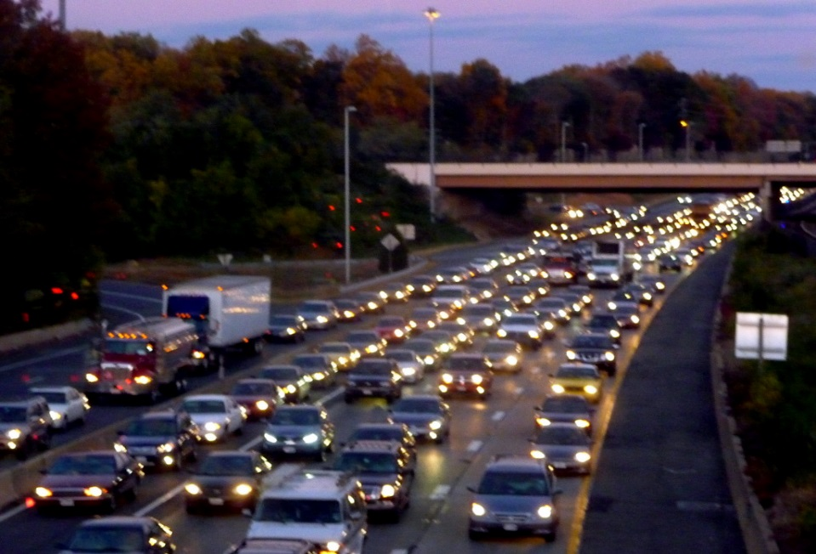
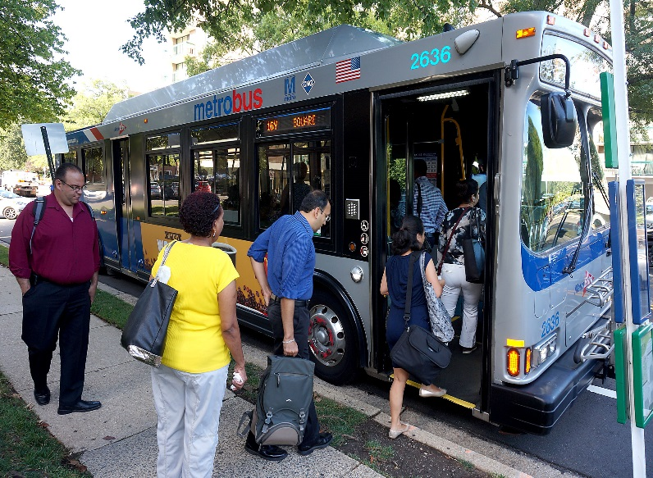
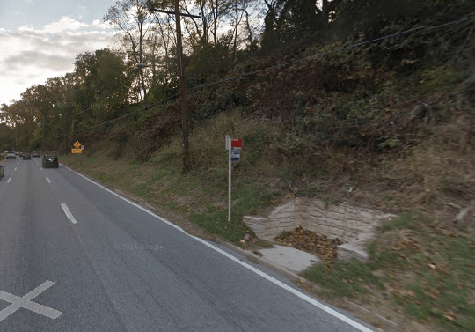
The Challenges
Buses are slow and getting slower.
  Causing $30 M increase in expenses
Fewer people are riding the bus.
  13% decline in the past 5 years
Operating model is not sustainable.
  Rising costs + declining ridership revenues = operating loss increases
  These challenges require a regional solution.
Photos courtesy of (clockwise from top left) NYTimes.com, WTOP, Joe Wolf, usa.streetsblog.com, army.mil, MCDOT

Slide 8
It is time to re-think the region’s approach to buses and the role of Metrobus in the system.

Slide 9
Bus faces five core challenges that will continue to grow unless changes are made
Meet changing customer needs
Keep up with changing technology
Coordinating across region
Maintain sustainable cost structure
Deciding how service is paid for
Notes:
Meeting changing customer needs – Increasingly, the region’s residents want shorter wait times, inexpensive service, faster and more direct trips, better waiting conditions, and better reliability. Meeting these needs will be important to maintaining and growing bus ridership.
Keep up with changing technology – Transportation Network Companies, or TNCs, such as Uber and Lyft, have seen their ridership grow quickly over the last 5 years – nationally, TNC ridership has increase over ten-fold since 2013. While this is not the only cause of declining bus ridership, it is likely contributing to the trend. In addition, we have to consider the role traffic management technologies, user-centric design, automated mobility, and electric vehicles are playing, and will play in the future, as we consider the role for local bus in this new mobility landscape.
Coordinating across region – Dispersion of responsibilities for public transportation makes it difficult to coordinate change in the region. With the federal government, three state DOTs, 10 public bus service providers, and many other governmental agencies involved in transportation in this region, the implementation process for improvements can be slowed significantly. Compared to other regions, implementing cross-jurisdictional technologies such as bus priority lanes can take longer.
Maintaining sustainable cost structure – As bus ridership has declined, total revenues, despite fare increases, are declining. In addition, the 3 percent subsidy growth cap was implemented as part of the dedicated capital funding provided to WMATA by the Maryland and Virginia state legislatures. WMATA is required to maintain a 3 percent cap on the growth of its operating subsidy, which is not possible under current financial conditions. Rather, it will require some combination of ridership increases, cost reductions, changes to service levels, and/or fare increases.
Deciding how service is paid for – Right now, a set of definitions for regional and non-regional routes that was set about 20 years ago still governs how expenses for Metrobus services are split between jurisdictions. There is a need to consider whether these definitions still make sense

Slide 10
Public and Stakeholder Engagement for the Bus Transformation Project

Slide 11
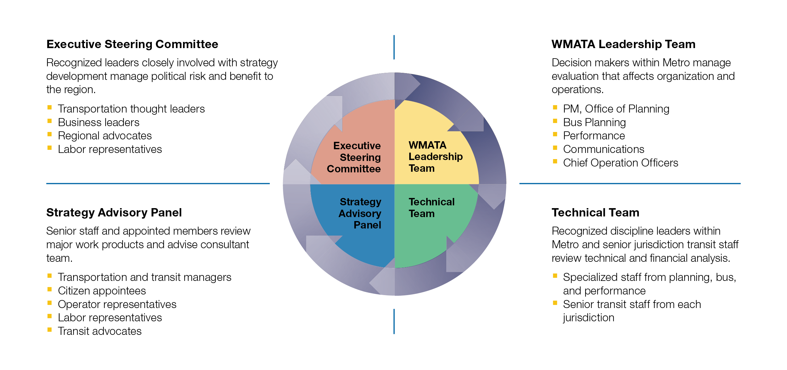
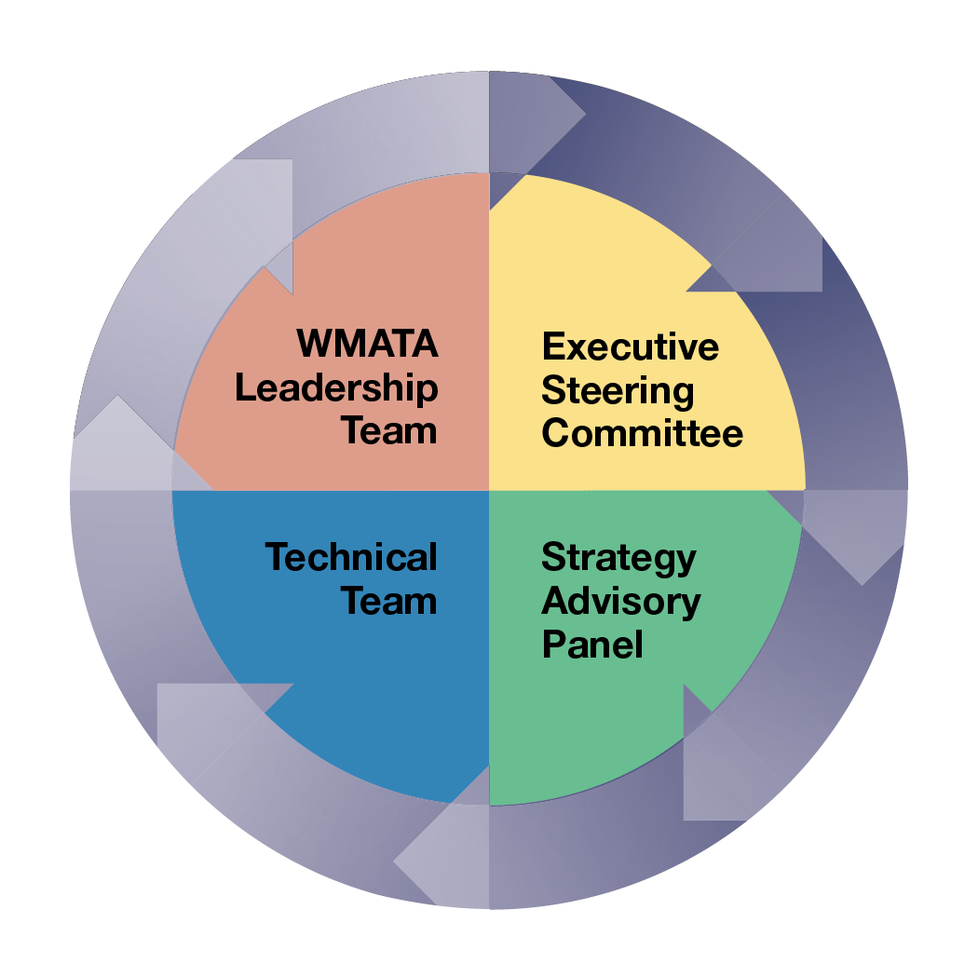
Stakeholder Engagement
Notes:
Explain committee structure and roles of each committee. Note that committees are the foundation of stakeholder engagement, but are not the extent of it.
So far, the project team has held over 80 engagement events, with many more scheduled for the following months. These events have included a project kick-off summit with over 140 participants, over 30 stakeholder interviews, 13 events with bus operators and operations supervisors, 20 public pop-up events, 14 meetings with project committees, 3 focus groups to get input from the disability and aging community and community-based organizations, and 3 briefings to elected officials or key stakeholders.

Slide 12
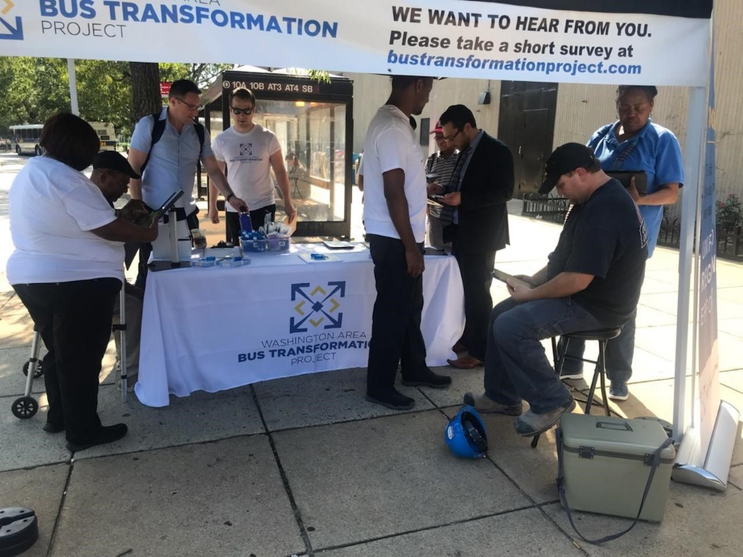
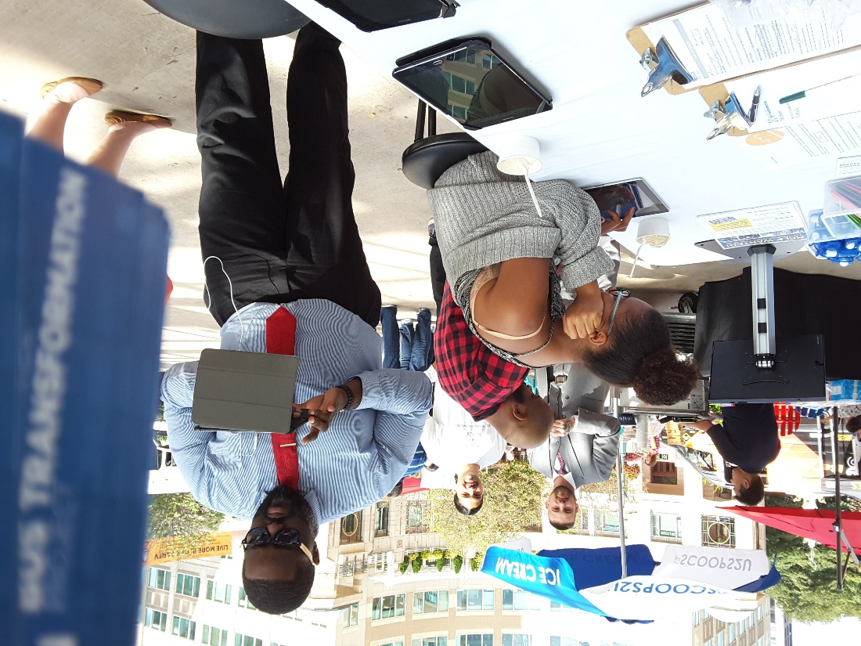
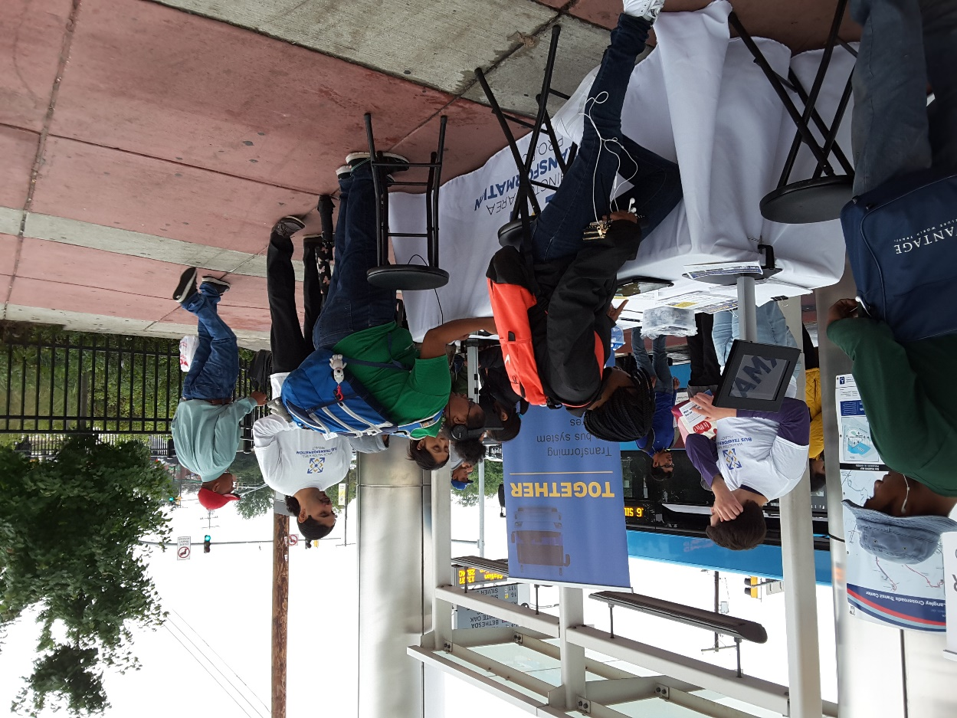
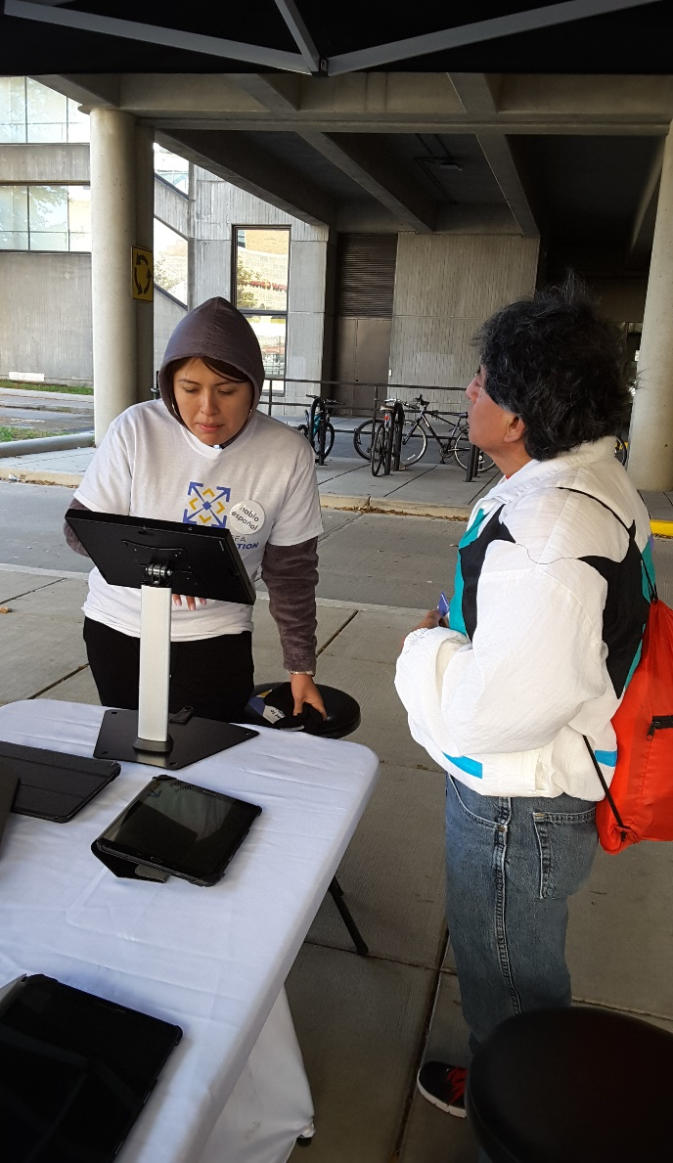
Engagement to Date
5,679 responses to survey
20 regional pop-up events
1 summit (140+ participants)
14 committee meetings
13 operator listening sessions
35+ stakeholder interviews
11 project briefings/meetings
Over 696,000 social media impressions and 2,450 clicks

Slide 13
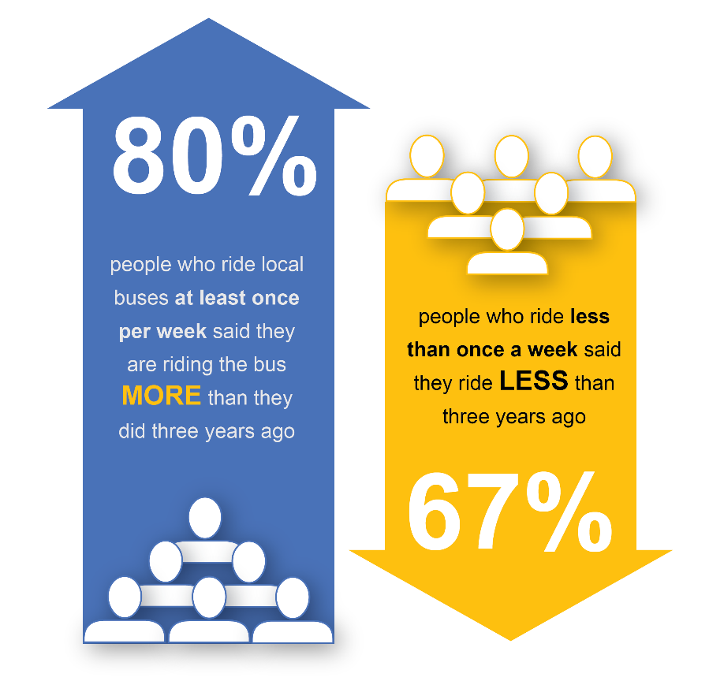
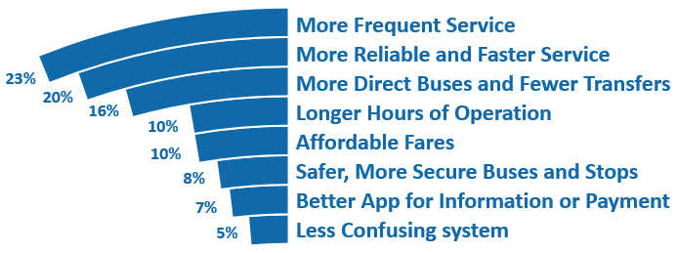
Key Public Mobility Survey Findings
Ridership Trends Respondents’ Top Priorities for Bus Improvements

Slide 14
Current Work and Next Steps

Slide 15
Questions under Consideration
What should the role of local bus be in the region?
  Accessible to all people for all trips? Focus on key corridors?
What is the level of regional commitment to speeding up local buses?
What is the best role of Metrobus in the region’s bus network?
  Should it operate all routes in the region? Regional routes only?
Notes:
The questions on the slide are the key questions the project team has focused on in its discussions with the project committees thus far in the project. We have a clear sense of where these groups want us to go with respect to these questions. In some cases, such as regional commitment to speeding up local bus, there is strong consensus for a strong commitment.
Centralized functions could include: procurement, marketing, and fare system management.

Slide 16
Next Steps
Complete analysis surrounding the key questions
Meetings with stakeholders
Public workshops in spring 2019

Slide 17
Q&A and Discussion

Slide 18
APPENDIX

Slide 19
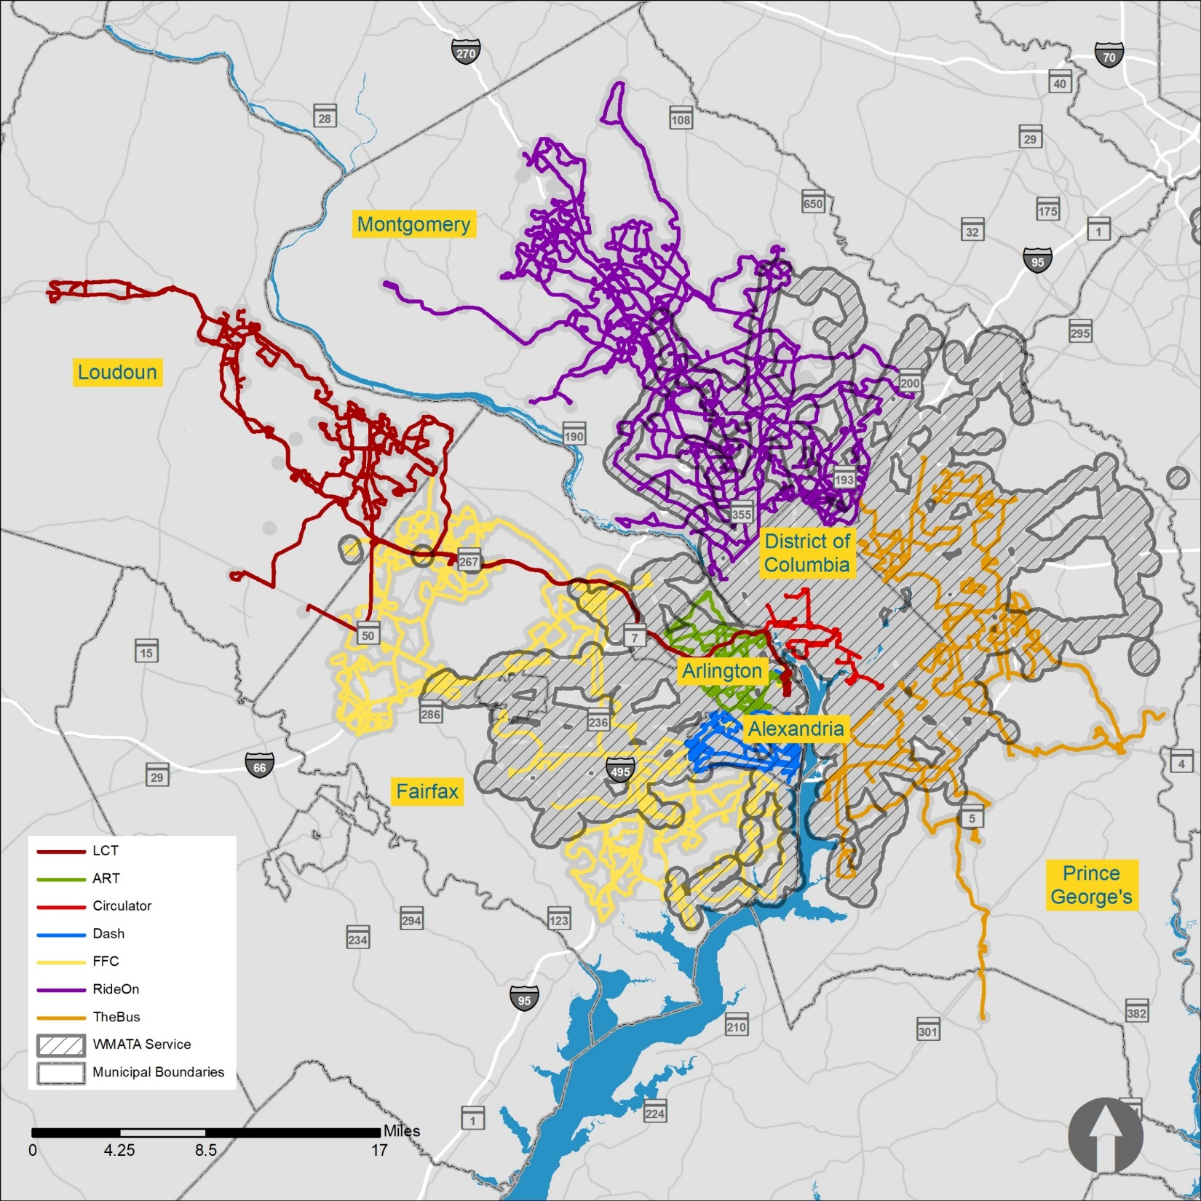
Transit is accessible to most people in the region
81% of people within the region
can access bus

Slide 20

1
Shared mobility platforms: Allowing riders to connect with transport options when it is most convenient
2
Connectivity-enabled traffic management: Leveraging big data and IoT to reduce congestion and improve travel time
  Technology Trends
3
User-centric design: Increasing customers’ expectations that systems will adapt to their individual needs and habits
4
Automated mobility: Allowing vehicles to navigate roadways without human intervention
5
Electric propulsion: Enabling vehicles to reduce CO2 emissions and ongoing operating cost of vehicles

Slide 21
Shared Mobility
Bus and Ride-Hailing ridership in the US
Ride-hailing services have grown to over 4B trips per year over the past five years, while bus ridership has declined
Billions of trips
Ride-Hailing
Bus
4.6¹
4.2²
0.4
0.1
2012
2013
2014
2015
2016
2017
2018E
based
on trend
Does not include taxi services.
1. BCG Analysis; Back to the Future, 2015.
2. Schaller Consulting Estimate; The New Automobility: Lyft, Uber and the Future of American Cities, 2018

Slide 22
Dispersion of responsibilities makes it difficult to coordinate change

Slide 23

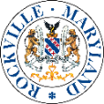

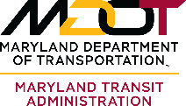
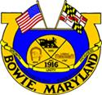
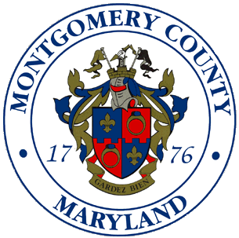

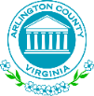

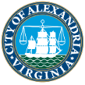

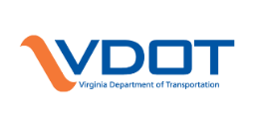
Complex set of stakeholders driving decisions about bus…
Sample list – not exhaustive
City
County
State/Regional
-----
-----
District of Columbia
Maryland
Virginia

Slide 24
…which can slow the implementation process
      Example: 16TH Street Bus Lane will take ~17 years to implement
Agencies with oversight or involvement: WMATA, National Capital Planning Commission, National Park Service, DDOT, DC Office of Planning, DC Historic Preservation Office, Maryland DOT, Maryland State Highway Agency, DC Advisory Neighborhood Commissions, citizens advisory groups and other
2003
2009
2013
2016
2018
2020?
Regional Bus Study (WMATA)
16th Street Line Study (WMATA & DDOT)
16th Street NW
Safety & Mobility Study (DDOT)
16th Street
Transit Priority Study (DDOT)
16th Street Bus
Lanes Projects (DDOT)
Possible implementation of improvements
Identified opportunity to improve 16th Street bus traffic through signal prioritization (TSP), intersection improvements, enhanced bus stops and better rider information
New S9 Express bus, more articulated buses, and bus shelter improvements.
Action delayed on
TSP, transit-only
lanes or other infrastructure improvements
Technical review of physical and operational improvements to mobility on 16th
Street that recommended peak-hour peak-direction bus-only lane
Recommended implementation of
TSP, peak-hour
peak-direction bus-only lanes, off-board fare payment, all-door boarding and consolidating bus stops
Corridor design unveiled for
peak-direction
bus-only lane, TSP
and queue jumps
Current target timeframe to implement bus-only lane, TSP and other corridor improvements – subject to review and approval by multiple local and federal agencies
Source: WMATA Regional Bus Study (2003), 16th Street Lane Study (2009), 16th Street NW Safety & Mobility Study (2013), 16th Street Transit Priority Study (2016), 16th Street Bus Lanes Projects (2018).

Slide 25
WMATA cannot achieve the 3% cap on operating subsidy growth with the current bus operating model

Slide 26

What is the subsidy?
What is the subsidy cap?
The subsidy is the financial contributions from state and local governments to supplement operating revenues from fares, parking, advertising, and other sources
Limits annual subsidy growth to 3% as part of long-term financial sustainability plan
Applies to subsidy for Metrorail and Metrobus operations
Mandated by Maryland and Virginia state legislatures as part of the agreement for dedicated capital funding

Slide 27
Metrobus ridership has fallen by 9% in the last year alone…
Metrobus Annual Ridership
Millions of passenger trips
-18%
FY14
FY15
FY16
FY17
FY18
Source: WMATA data

Slide 28
…while fare increases have only partially offset revenue decline
Passenger Revenue¹ ($M)
Fares: $1.60
$1.75
$2.00
142
134
FY13A
FY14A
FY15A
FY16A
FY17A
FY18 est.
1. Excludes non-passenger revenue, e.g., advertising.
Source: WMATA FY12-19 budget books

Slide 29
Metrobus covers almost 24% of operating costs directly from fares…
…in line with other large transit agencies
Operating Costs covered by Fare Revenue
Source: National Transit Database, 2016. These numbers do not include revenues from advertising, parking and other non-fare revenue sources.

Slide 30
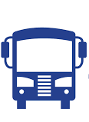



Meeting the 3% subsidy cap will require some combination of ridership increases, cost reductions, changes to service levels, and/or fare increases
Service Levels
Fares
Ridership
Cost Savings

Slide 31
Existing structures and formulas determine how services are paid for

Slide 32

Metrobus service is divided into Regional and Non-Regional services
  Definitions of “Regional” and “Non-Regional” routes are widely shared, including through the annual budget documents
Regional Routes | Non-Regional Routes
 | Any routes that do not meet the criteria of a regional route
Interjurisdictional Connection (at least ½ mile in each jurisdiction) | OR | Serves at least 1 COG Regional Activity Center Travels significant distance/regional artery Achieves cost efficiency
Funding allocation process allows for negotiation of Regional and
Non-Regional route designation

Slide 33
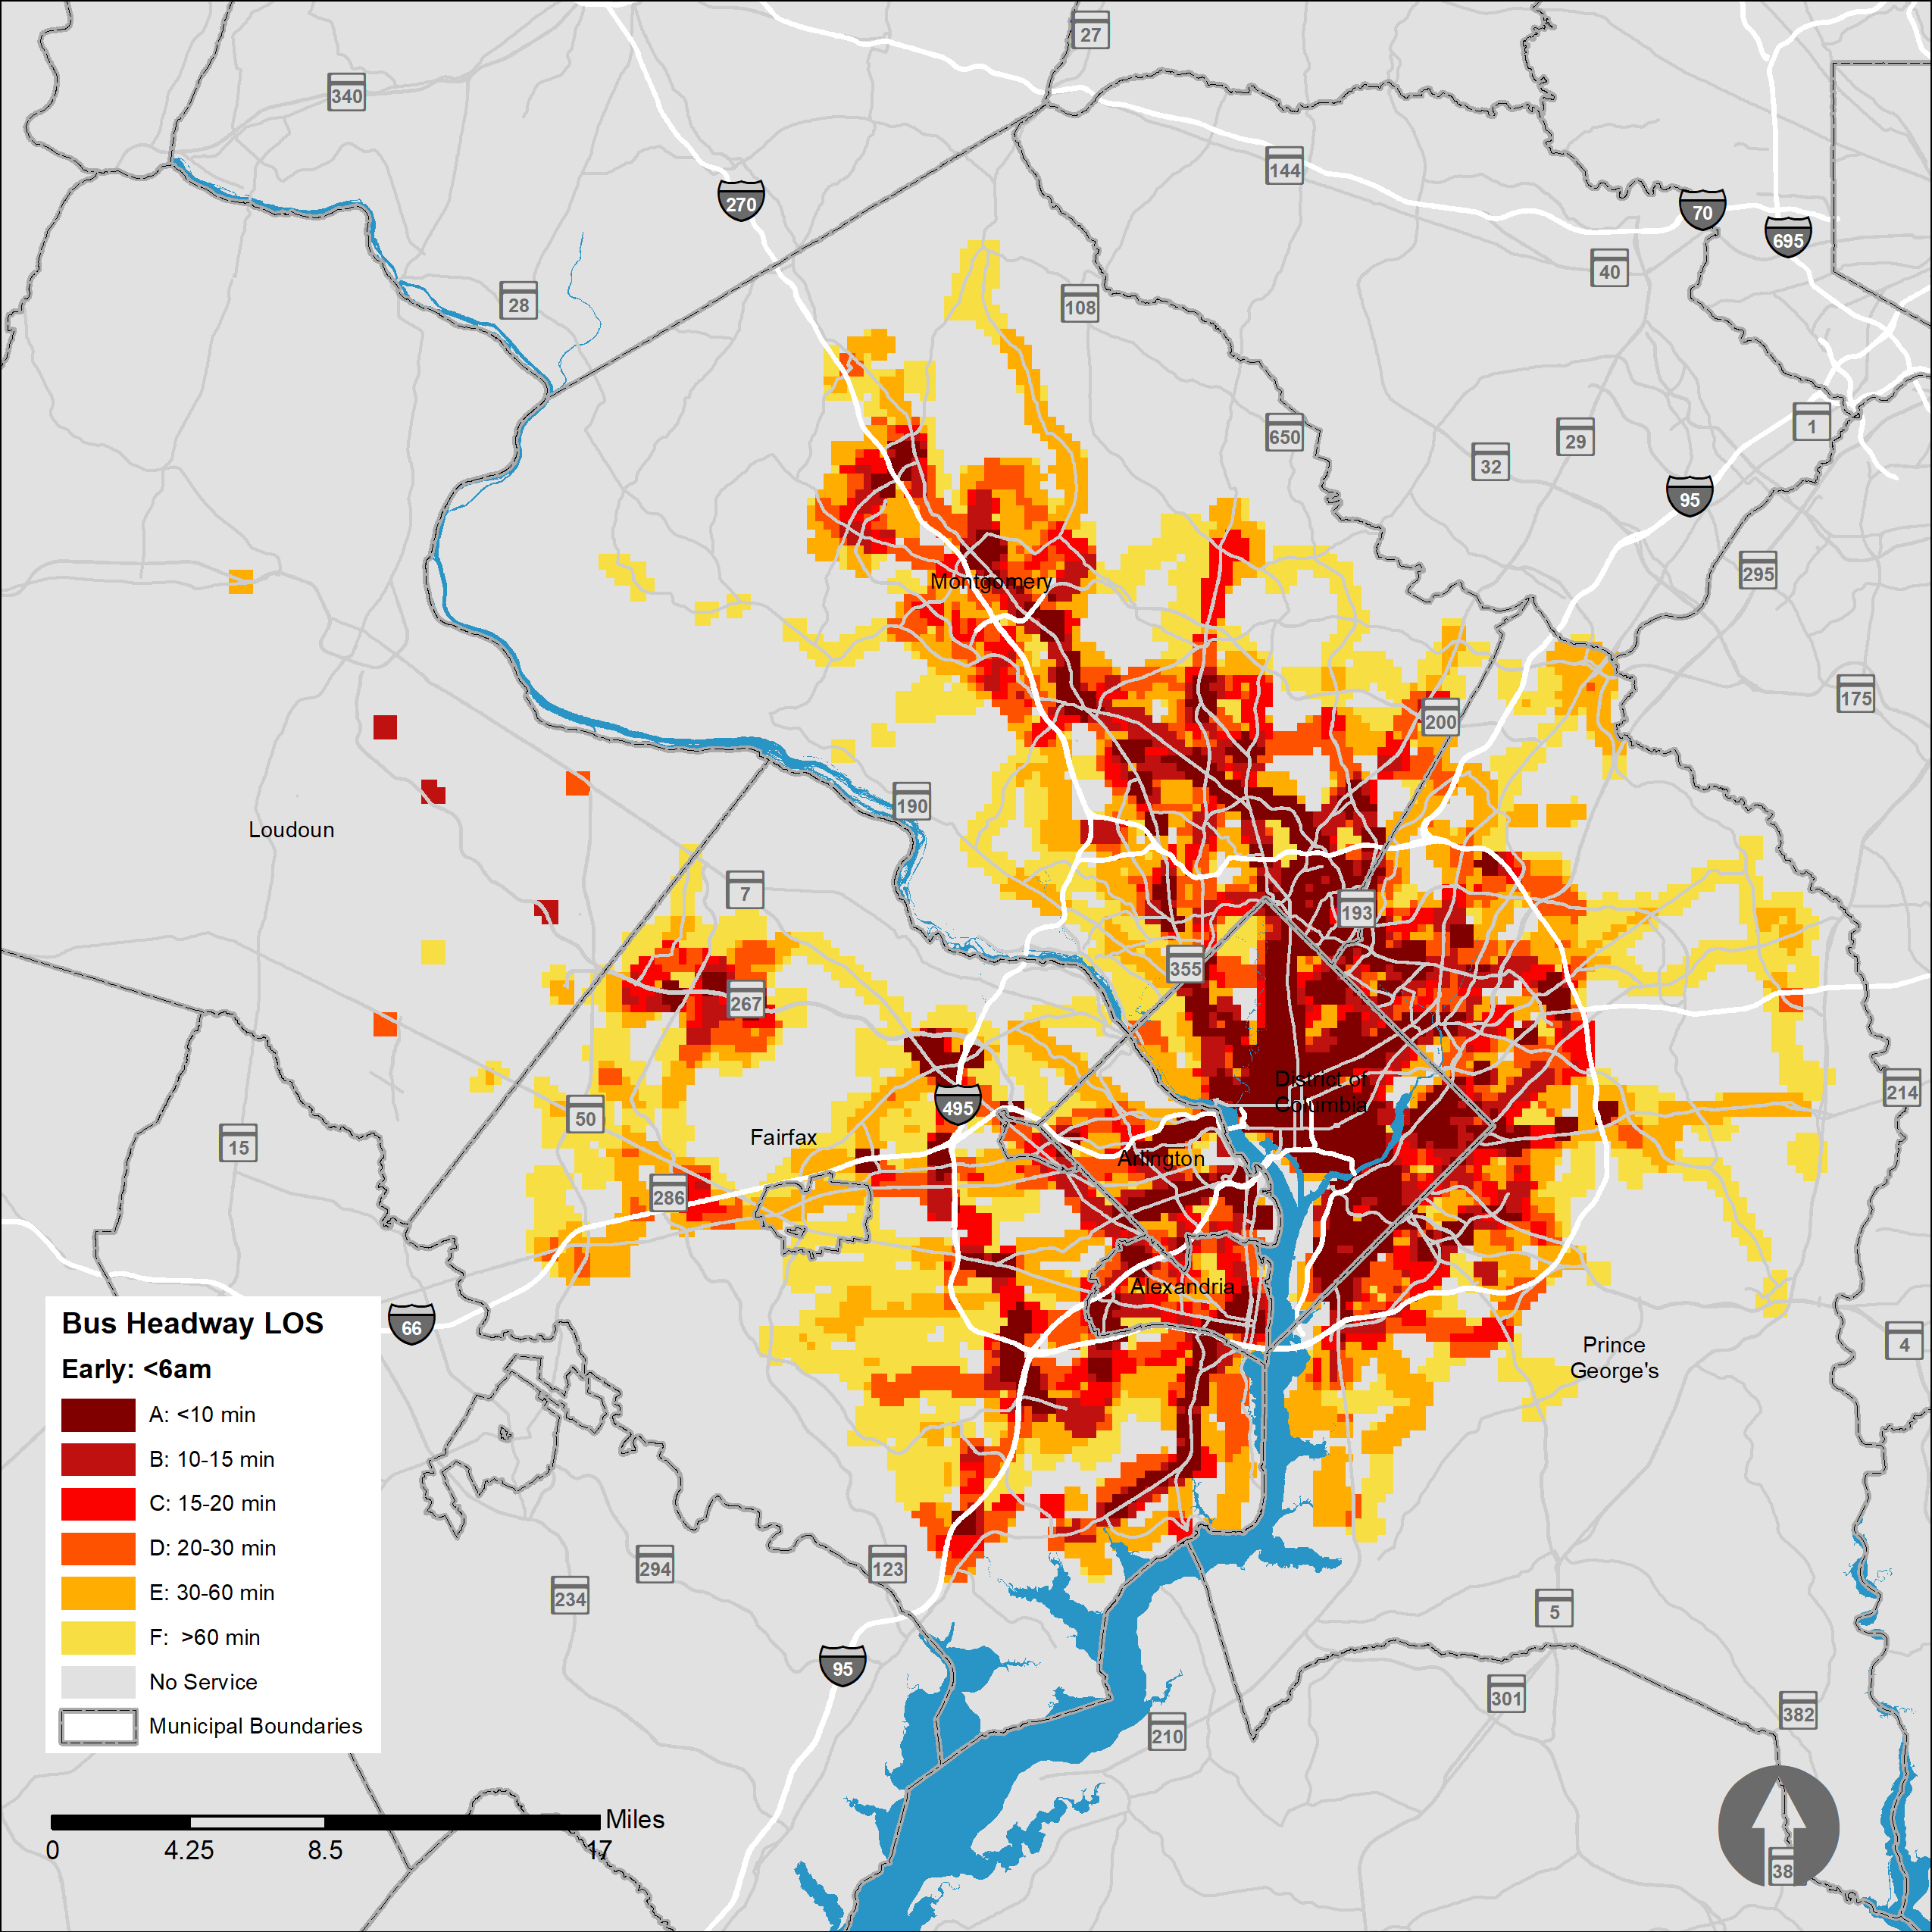
Transit is accessible to most people in the region
81% of people within the region
can access bus
48% of people within the region
have access to high-frequency transit during the peak periods
(15-mins or better)

Slide 34
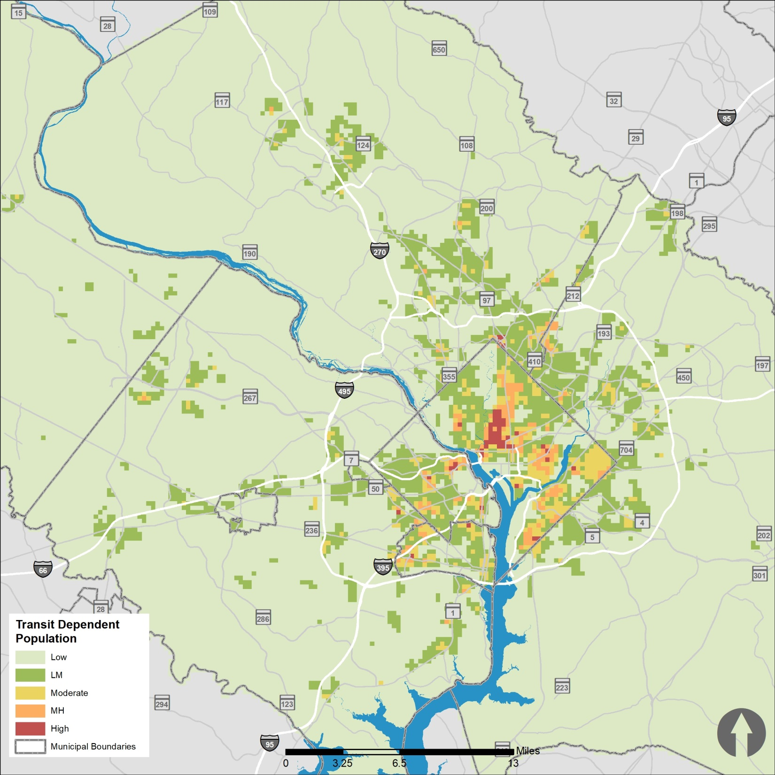
Transit is accessible to most people in the region
81% of people within the region
can access bus
48% of people within the region
have access to high-frequency transit during the peak periods
(15-mins or better)
77% of the transit-dependent population has access to high-frequency bus service bus during
the peak periods

