Slide 1
MD 355 FLASH
Phase 2 Study Results
Briefing to the North Bethesda TMD
July 31, 2019

Slide 2
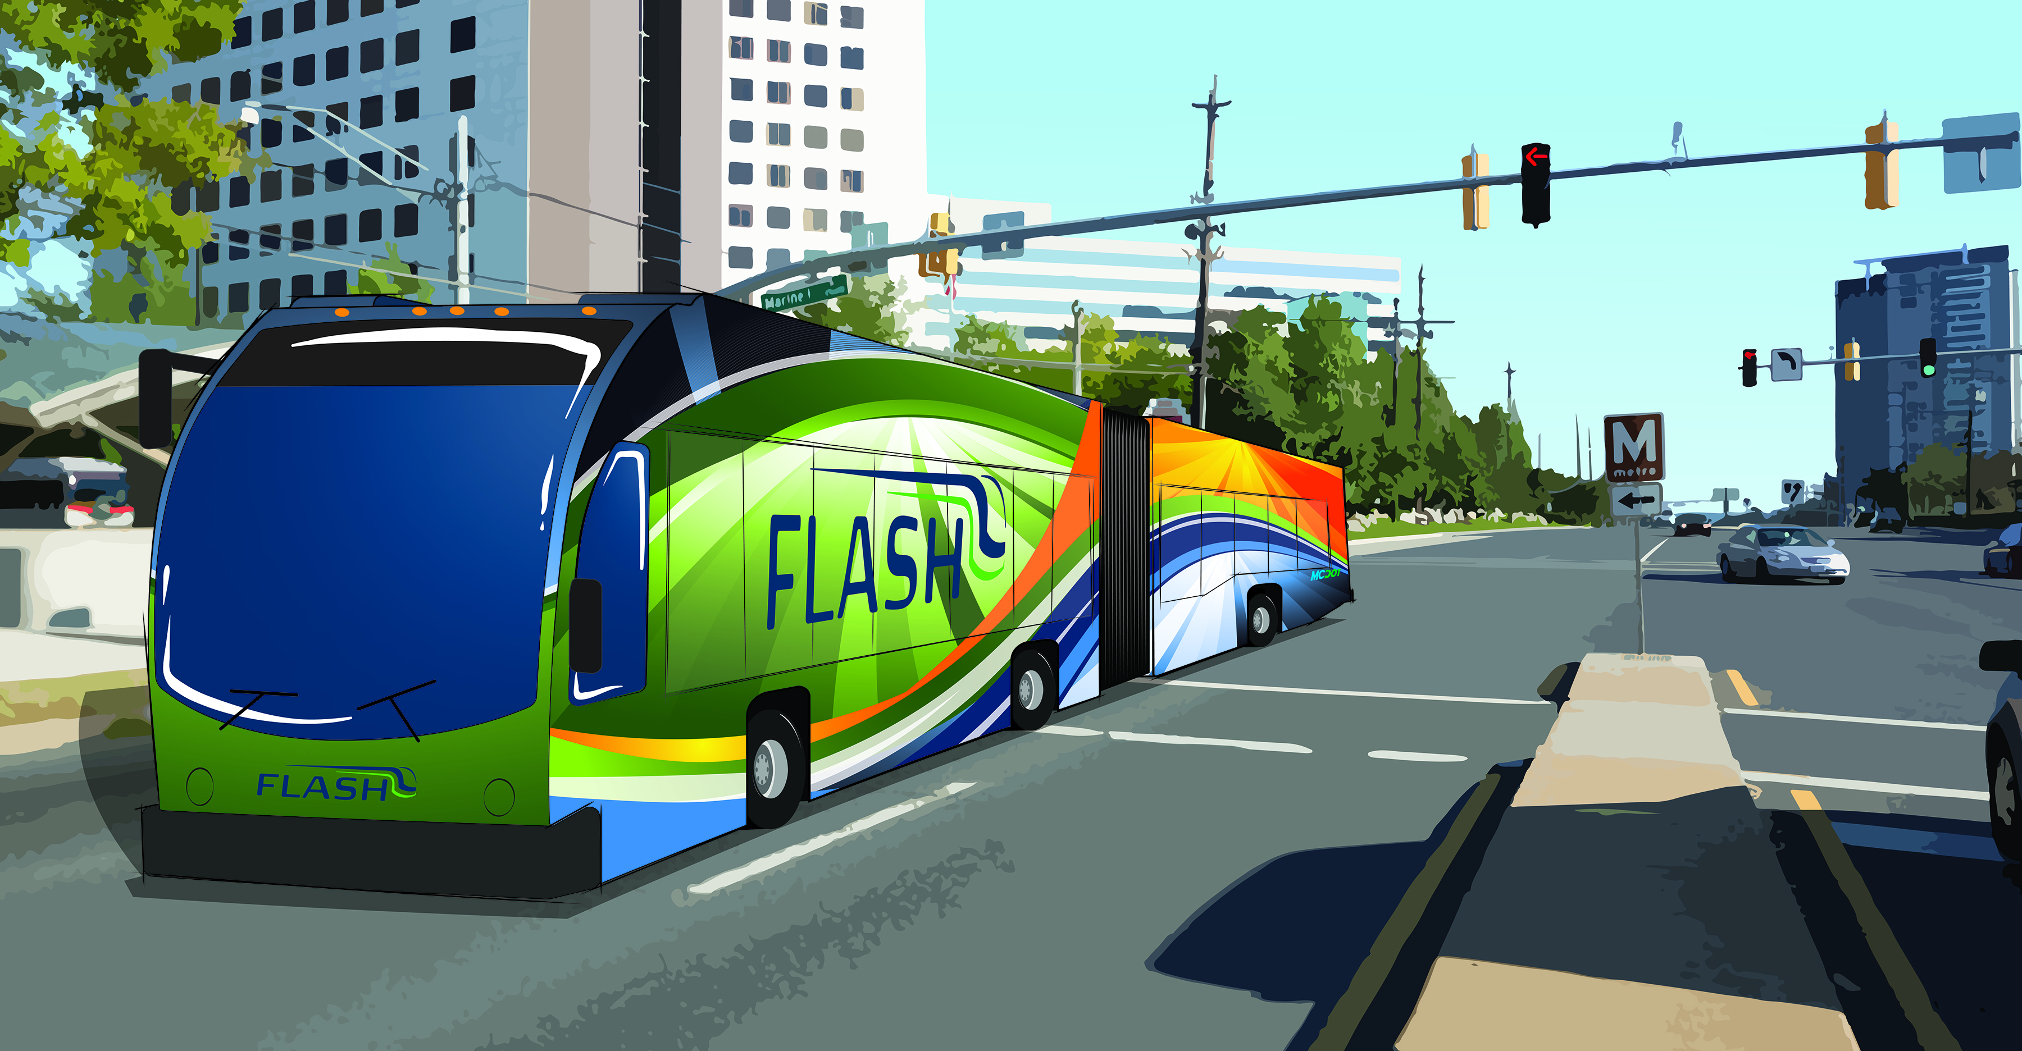
Agenda
Project Overview
Alternatives Review
Summary of Results
Discussion

Slide 3
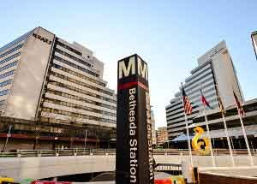
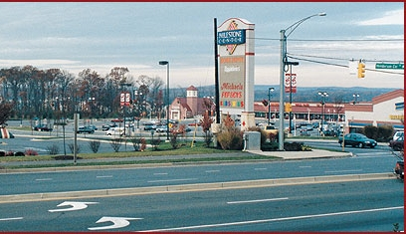
Project Overview
Identify the recommended alternative for BRT on MD 355
  Bethesda to Clarksburg
  (22 miles)
Supporting Documents
  Countywide Transit Corridors Functional Master Plan (2013)
  City of Rockville Bus Rapid Transit Town Center Integration Study (2015)
  City of Gaithersburg MD 355 Bus Rapid Transit Study (2015)
  MD 355 Conceptual Alternatives Report (2017)
  Various small area master plans and other studies

Slide 4
Project Purpose
Enhance transit connectivity and multimodal integration
Improve bus mobility
Address current and future bus ridership demands
Attract new riders and provide improved service for existing riders
Support approved Master Planned growth
Improve transit access to major employment and activity centers
Achieve Master Planned non-auto driver modal share
Provide a sustainable and cost-effective transit service
Improve safety for all
The purpose of the project is to provide a new transit service with greater travel speed and frequency along MD 355 between Bethesda and Clarksburg that will help accomplish the following:

Slide 5
MD 355 BRT Project Process
We are here
Facility Planning Phase 1 (Planning & Conceptual Engineering)
Facility Planning Phase 2 (Preliminary Engineering)
Final Design
Existing Conditions
Modeling
Purpose & Need
Conceptual Alternatives
Preliminary Impacts
Identify Recommended Alternative
Physical investigations
Surveys
Right-of-way
Traffic studies
Environmental assessments
Final concepts
Detailed Scope, Schedule, and Cost Estimate
Construction
Corridor Advisory Committee Input
Public Input
Stakeholder Input
Funding Decision

Slide 6
MD355 BRT Phase 2
Public Outreach
Corridor Advisory Committee meetings (9)
Stakeholder meetings with Rockville, Gaithersburg, M-NCPPC, MDOT, and WMATA (15)
Briefings to the Mayor & Council of Rockville & Gaithersburg (3)
Briefings to other interested groups (22)
Open Houses (229 total attendees)
Virtual Open House (71 visits)
Community Survey (246 responses)

Slide 7
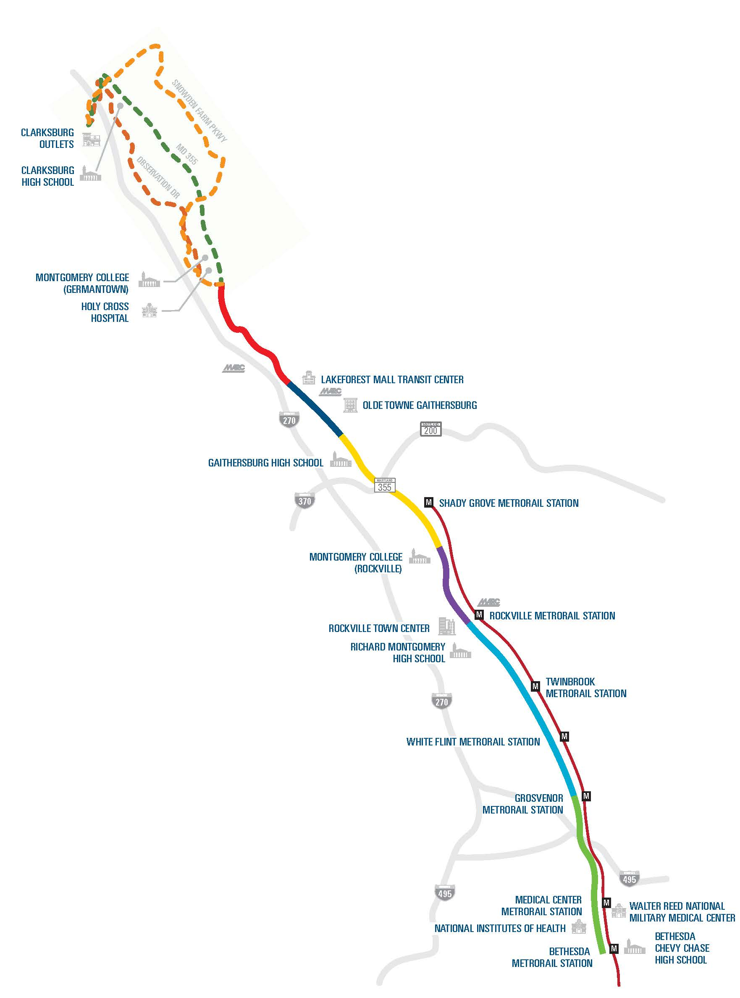


Project Design Segments
Segment | Geographic Description
7 | Clarksburg to Middlebrook Road
6 | Middlebrook Road to MD 124
5 | MD 124 to Summit Avenue
4 | Summit Avenue to College Parkway
3 | College Parkway to Dodge Street
2 | Dodge Street to Grosvenor Metrorail
1 | Grosvenor Metrorail to Bethesda Metrorail
7
6
5
4
3
2
1

Slide 8
MD 355 BRT Alternatives
Alternative | Features
No-Build Alternative
TSM Alternative | Expansion of existing Ride On extRa service
Alternative A | FLASH with queue jumps and mixed traffic operations
Alternative B | FLASH in dedicated median lanes where feasible
Alternative B Modified | FLASH in dedicated median lanes where feasible (Segment 4, 5, & 6 in single, reversible lane)
Alternative C | FLASH in dedicated curb lanes where feasible

Slide 9
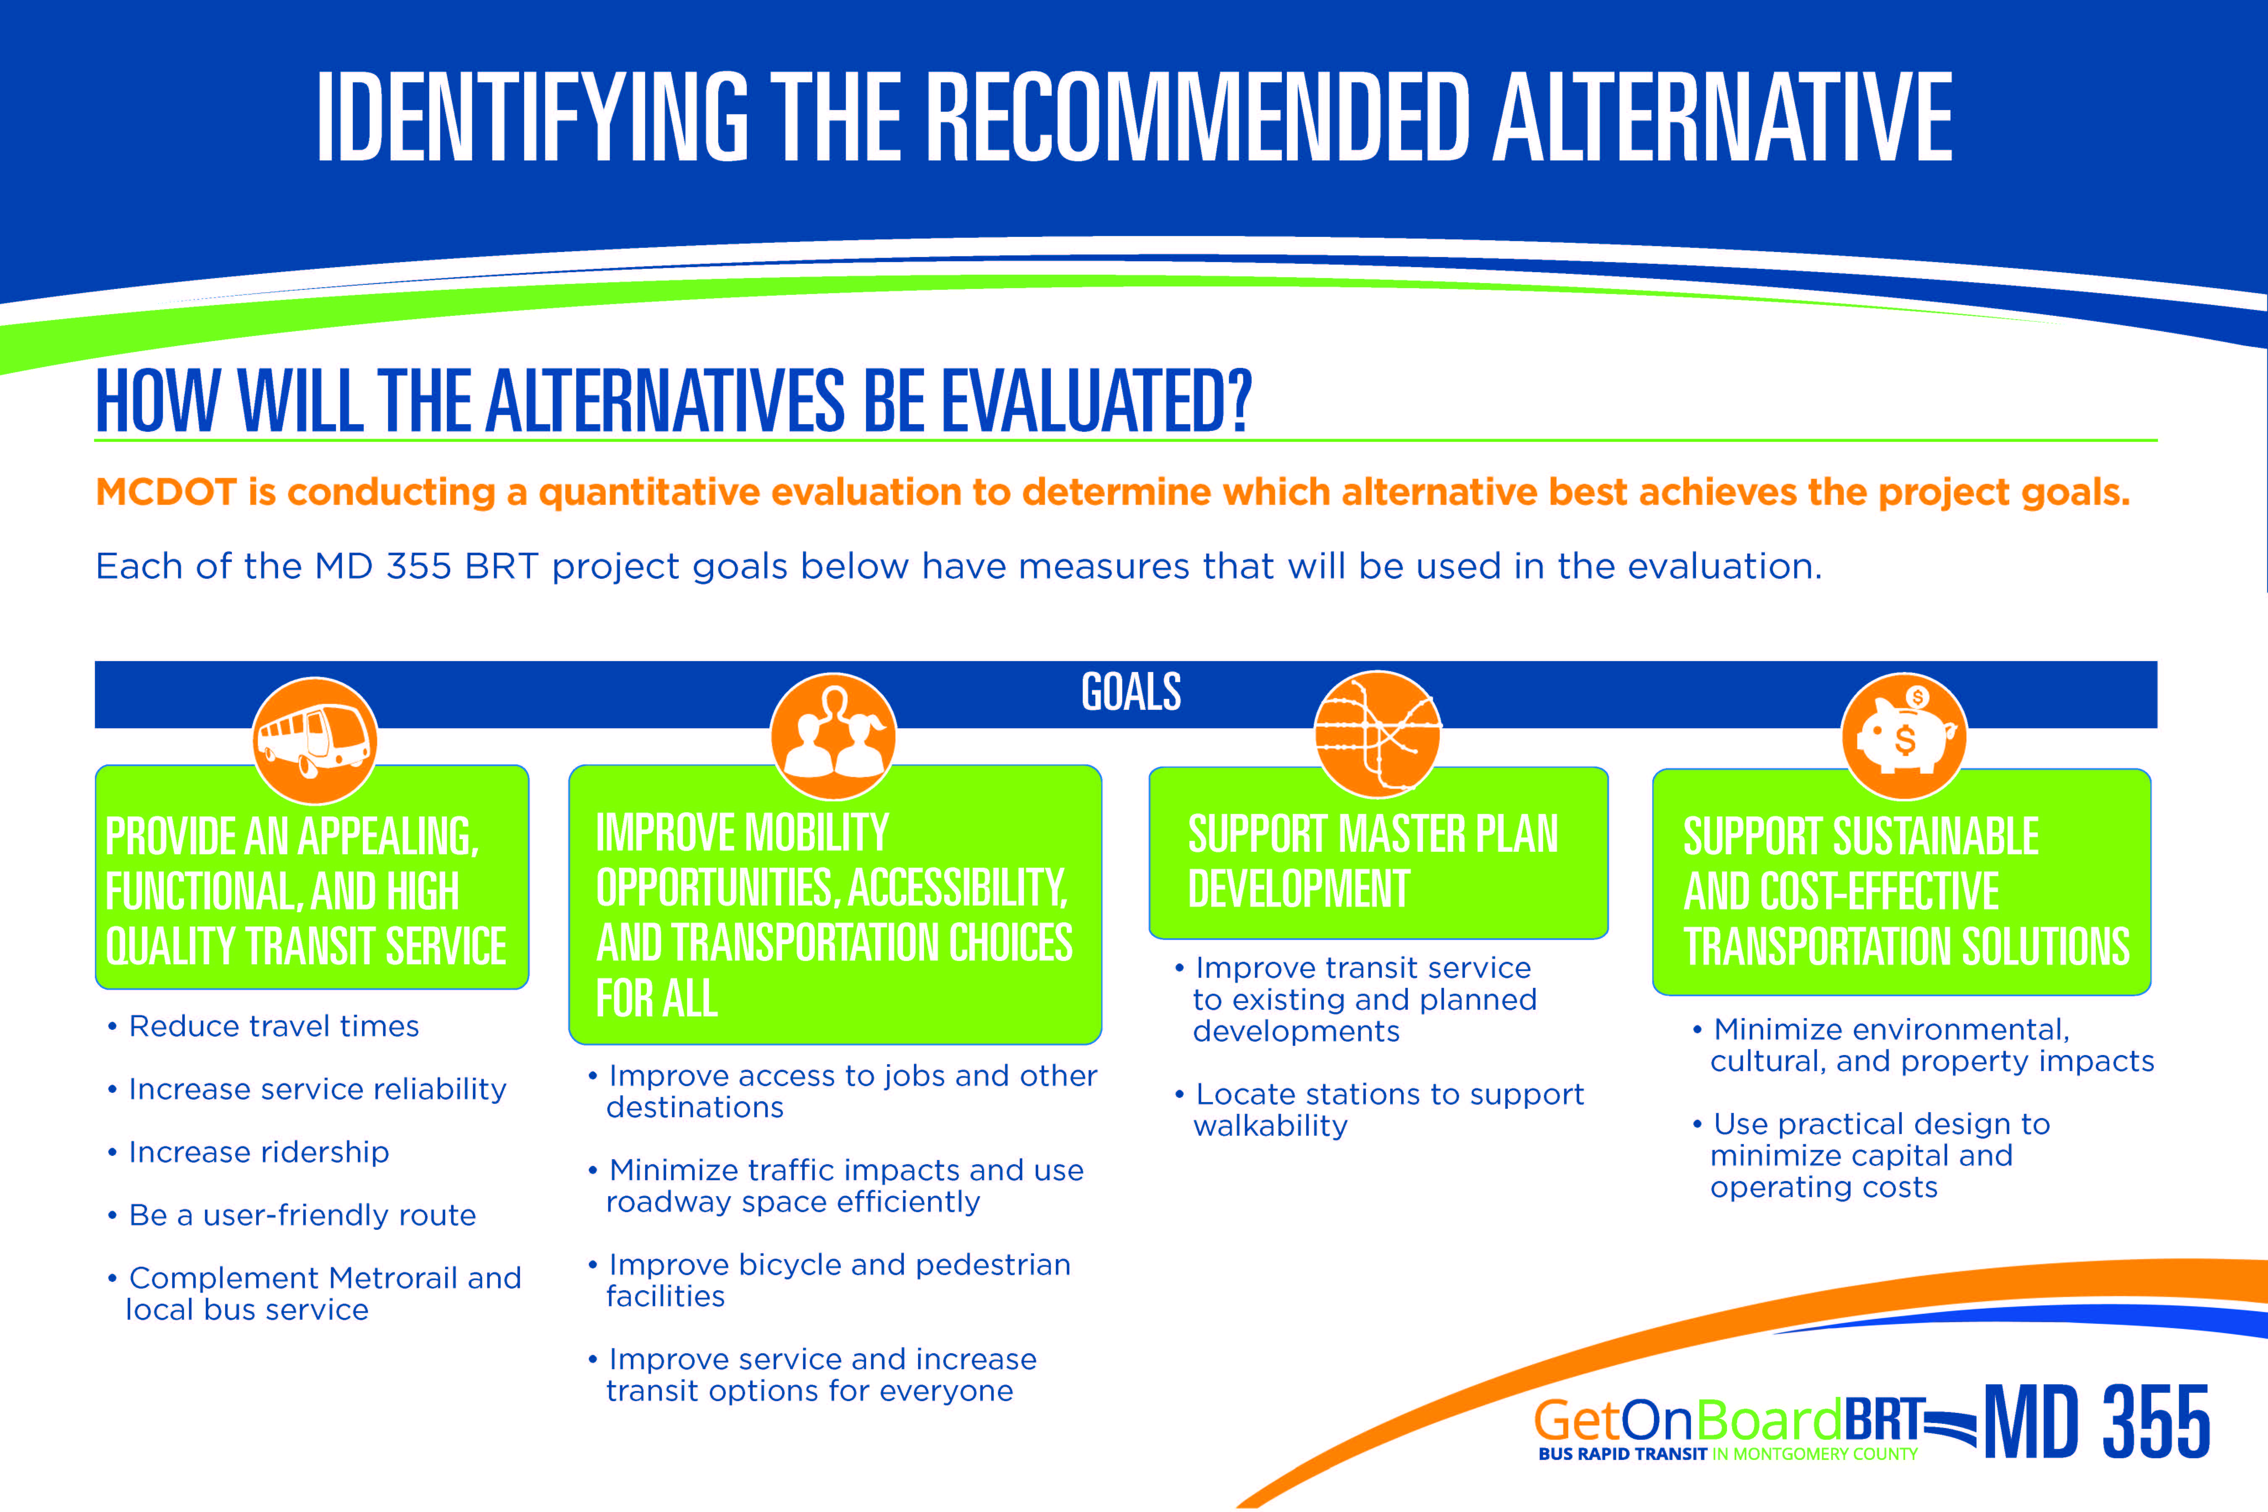
How Will The Alternatives Be Evaluated?
Improve transit service to existing and planned developments
Locate stations to support walkability
Reduce travel times
Increase service reliability
Increase ridership
Be a user-friendly route
Complement Metrorail and local bus service
Minimize environmental, cultural, and property impacts
Use practical design to minimize capital and operating costs
Improve access to jobs and other destinations
Minimize traffic impacts and use roadway space efficiently
Improve bicycle and pedestrian facilities
Improve service and increase transit options for everyone

Slide 10
Objective – Increase Transit Ridership
All three build alternatives perform better than the TSM
The Median alternative is double the No Build
Approximately 9,000 new transit riders with the BRT alternatives

Slide 11

Objective – Make bus trips faster and more competitive
Alternatives B and C provide a travel time savings over the No Build, TSM, and Alternative A
  Nearly 30% time savings over the No Build
Alternative C provides a travel time benefit to local bus

Slide 12
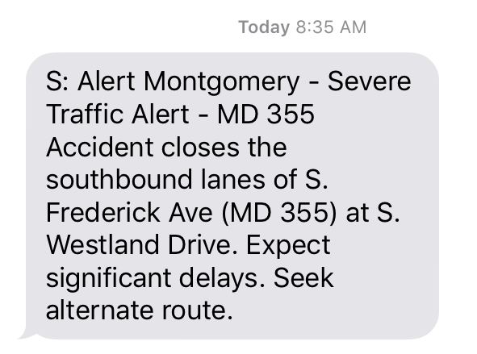
MD 355 Reliability
Along the MD 355 corridor, Metrobus and Ride On bus both suffer from service reliability
  Metrobus on-time performance is 77.6% (goal of 79 percent)
  Ride On on-time performance is 71-74% (goal of 90 percent)
Reliability can be impacted by many factors
  Traffic fluctuations
  Bottlenecks
  Traffic incidents (crashes, breakdowns, debris)
  Work zones
  Weather
  Special events

Slide 13
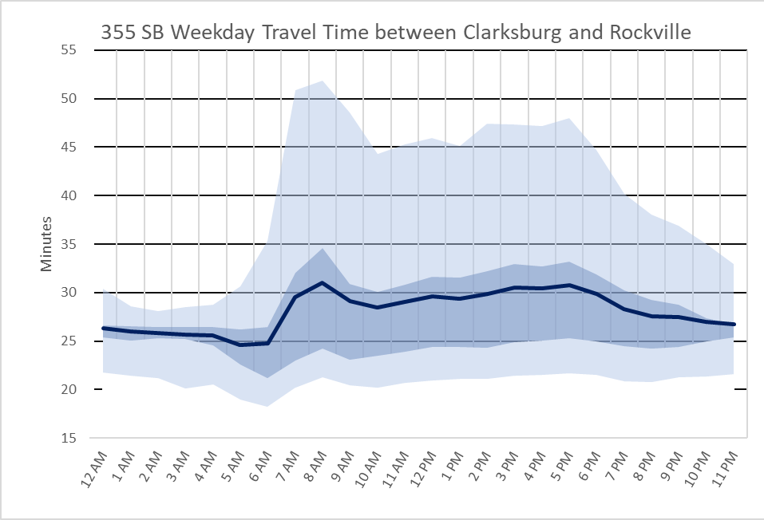
Objective – Improve transit quality
Generally Alternative B (median) shows better reliability under modeled conditions
However, non-recurring congestion can require 11 to 21 minutes additional “planning” time to arrive on time
Alternative B should perform more consistently in line with the average travel time due to its physical separation from traffic

Slide 14


Objective – Improve access
All Build Alternatives increase accessibility to high frequency transit for key demographic groups along the corridor
Improvements in travel speed result in greater access (travelshed) for transit users coming from the corridor as well as traveling to the corridor

Slide 15
Objective – Balance the mobility needs of all users
Most alternatives show an increase in miles of LOS E/F
Average person delay only increases a small amount (half a minute or less) compared to the No Build for each alternative
AM Peak Intersection LOS remains relatively unchanged compared to the No Build except for Alternative B
PM Peak intersection LOS degrades for Alternatives B and C
  All Alternatives experienced some localized reductions in delay
Further refinement may address impacts

Slide 16
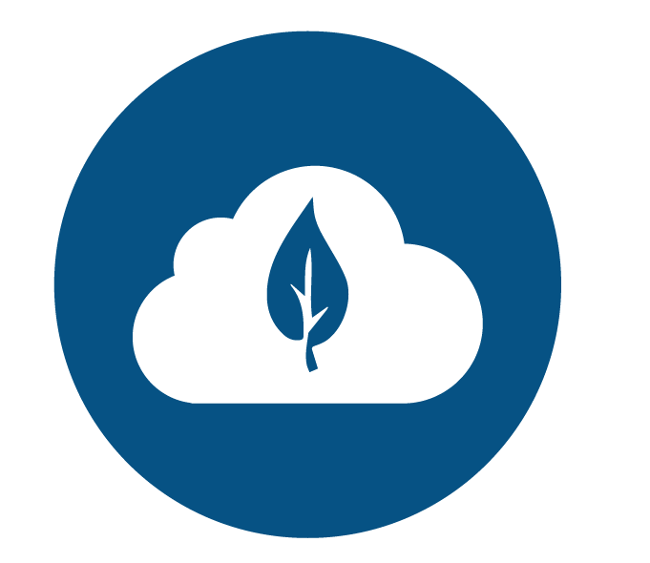
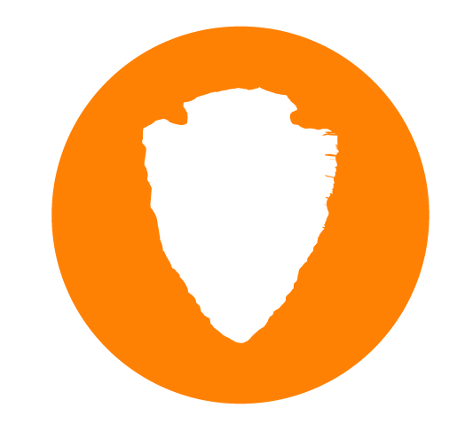
Objective – Minimize environmental impacts
Build alternatives results in greater reductions in CO₂ equivalent emissions
Build alternatives have no impact on Streams of Forests
Build alternatives have minimal (less than 1 acre) impact on Wetlands, Parks, and Floodplains
Additional assessment required to determine impacts on Architectural and Archeological sites

Slide 17
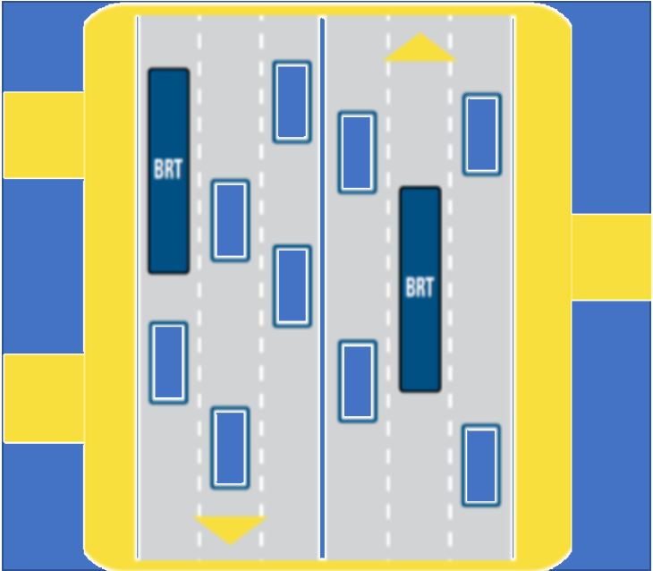
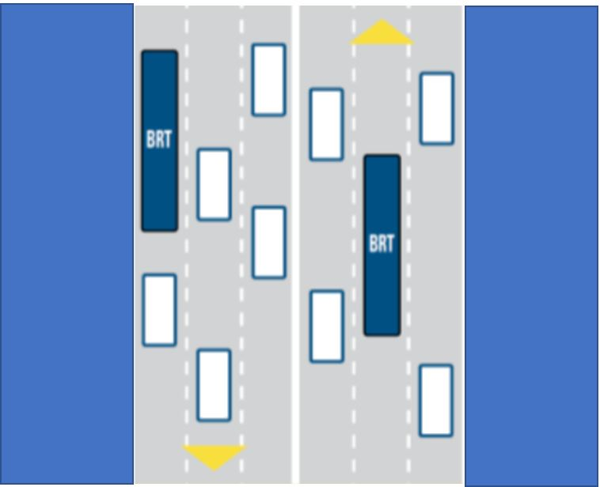
Objective – Minimize impacts to private and public property
The conceptual design fits within the Master Plan right of way
  Much of this right of way is not currently available
As properties come before the up for development/redevelopment the Master Plan ROW can be acquired
  Relying on this process to acquire all the ROW could take decades
Master Plan ROW
Existing ROW

Slide 18
Objective – Minimize impacts to private and public property
Conceptual design has sought to reduce the right of way needs as much as possible at this early stage of design
  Reducing buffers, where necessary
  Reducing lane widths
  Including retaining walls
Work will continue to reduce right of way needs as design advances
All alternatives require some degree of right of way beyond what currently exists in certain locations
Most of the right of way needs are partial and along the roadway frontage of properties along MD 355
  Alternative B - 61 acres
  Alternative B Modified - 54 acres
  Alternative C - 39 acres
  Alternative A - 13 acres
  TSM - less than 1 acre

Slide 19
Objective – Minimize the cost of transportation services
 | TSM | Alternative A | Alternative B | Alternative B Modified | Alternative C
Total Project Capital Cost | $15 Million | $184 Million | $886 Million | $820 Million | $534 Million
Capital Cost per Mile | $634,000 | $7 Million | $37 Million | $34 Million | $23 Million
Costs are comparably low to other major regional transportation projects
  Purple Line - $163M per mile
  Silver Line - $248M per mile
  I495/I270 Managed Lanes - $200M per mile
 | TSM | Alternative A | Alternative B | Alternative B Modified | Alternative C
Annualized Operating & Capital Cost | $3.39 | $4.36 | $5.64 | $4.43 | $4.74

Slide 20
Summary of Outreach Results
Dedicated lanes are preferred over mixed traffic and TSM
  Median lanes are favorable over curb lanes
  Preference for dedicated lanes in both directions
Clarksburg alignment should be selected based on where the people are
Project priorities should be travel time, reliability and improving walkability/livability
Majority of people feel BRT will have a positive impact on their community

Slide 21
Planning Board Feedback
Advance Alternative B, Median Transitway
Consider increasing two-lane median transitways
Consider converting general purpose traffic lanes to transit only lanes

Slide 22
City of Rockville Feedback
Mayor and Council support Alternative B in City of Rockville
If ROW needs are too great north of College Parkway, would support reduction to a single lane
City of Gaithersburg Feedback
Mayor and Council support Alternative C in City of Gaithersburg
Decision driven by concerns about impacts and cost

Slide 23
Council Feedback and Action
T & E Committee stated preference for Alt B / B Modified (median)
Did not select a preferred alternative at this time; concurred with the Executive's approach to advance a project along the lines of Alt B / B Modified that refines project impacts and incorporates potential innovative concepts received from industry
Council approved supplemental appropriation to FY20 CIP budget for MD 355 BRT and Veirs Mill Road

Slide 24
Next Steps
Move forward with preliminary design on MD 355 and Veirs Mill Road
Informal solicitation of ideas from private sector via Request for Information (RFI)
Exploring options for financing and funding

Slide 25
Questions

Slide 26
Contact Info
Darcy Buckley
Senior Transportation Planner
Montgomery County Department of Transportation
Darcy.Buckley@montgomerycountymd.gov
(240) 777-7166

Slide 27
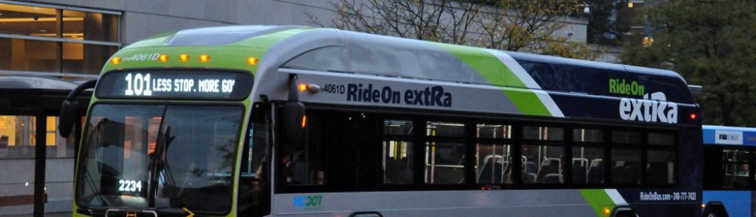
MD 355 BRT Alternatives
No Build
Transportation Systems Management (TSM) Alternative
Ride On extRa service, including Transit Signal Priority (TSP), implemented in October 2017
Ride On extRa service extended to Bethesda to Clarksburg
Extension of TSP
Additional stops
All-day service

Slide 28
MD 355 BRT Alternatives
Queue Jump and Mixed Traffic Alternative (A)
FLASH in mixed traffic
Queue jumps (20)
Additional TSP
Upgraded stations
  Off-board fare collection
  Level boarding
FLASH vehicles and branding

Slide 29
MD 355 BRT Alternatives
Median Alternative (B)
FLASH in dedicated Median lanes where feasible
Additional TSP
Upgraded stations
  Off-board fare collection
  Level boarding
FLASH vehicles and branding
Segment 1: BRT in mixed traffic
Segment 3: BRT in single, southbound median lane
Segment 5: BRT in single, reversible median lane

Slide 30
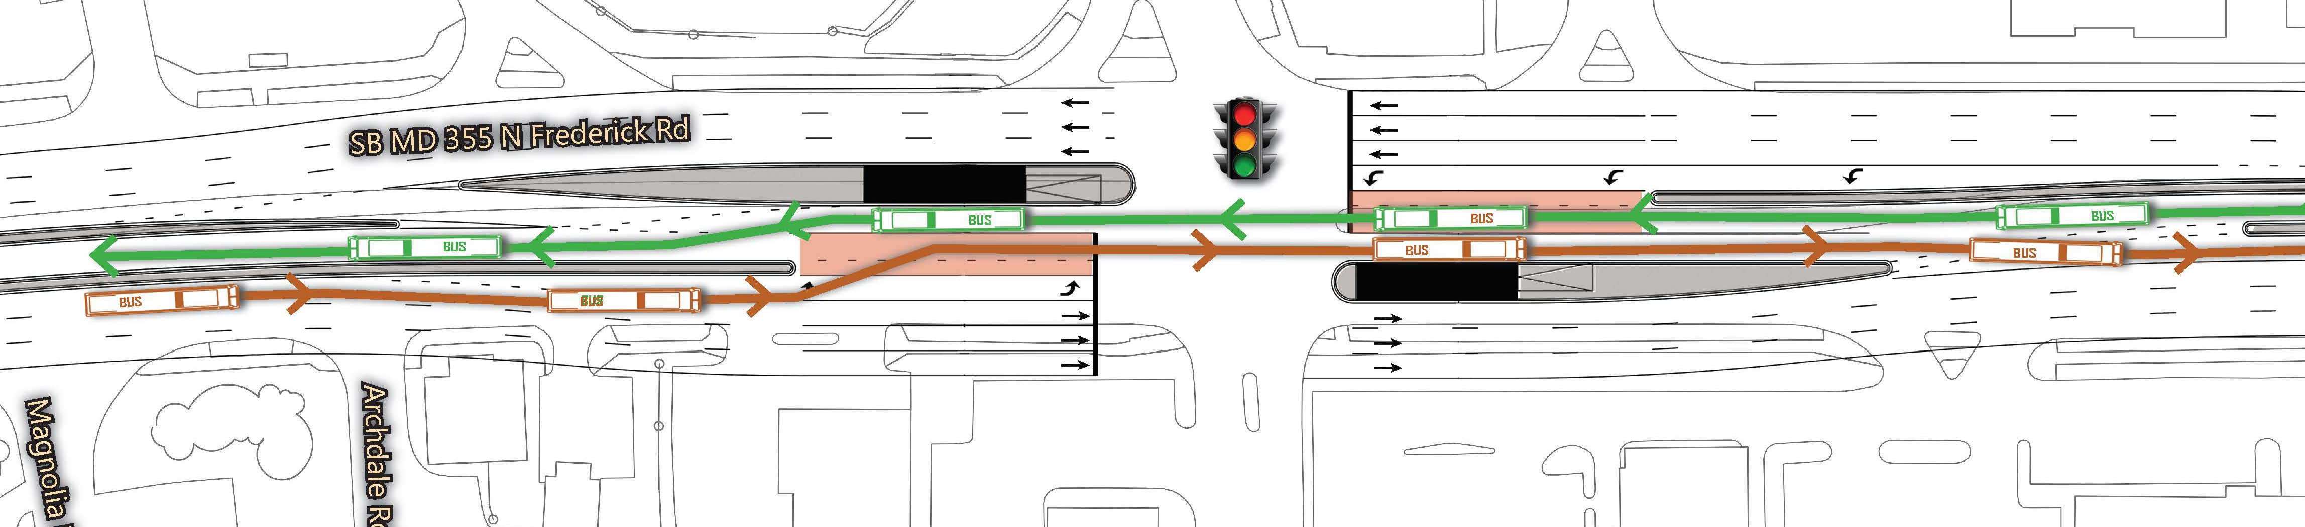
MD 355 BRT Alternatives
Median Alternative Modified (B Modified)
FLASH in dedicated Median lanes where feasible
  Single, reversible, peak direction dedicated lane north of Rockville (Segments 4-6)

Slide 31
MD 355 BRT Alternatives
Curb Alternative (C)
FLASH in dedicated Curb lanes where feasible
Queue jumps
Additional TSP
Upgraded stations
  Off-board fare collection
  Level boarding
FLASH vehicles and branding
Segment 1: BRT in peak-direction curb lane
Segment 3: BRT in single, southbound curb lane
Segment 5: BRT in mixed traffic

Slide 32
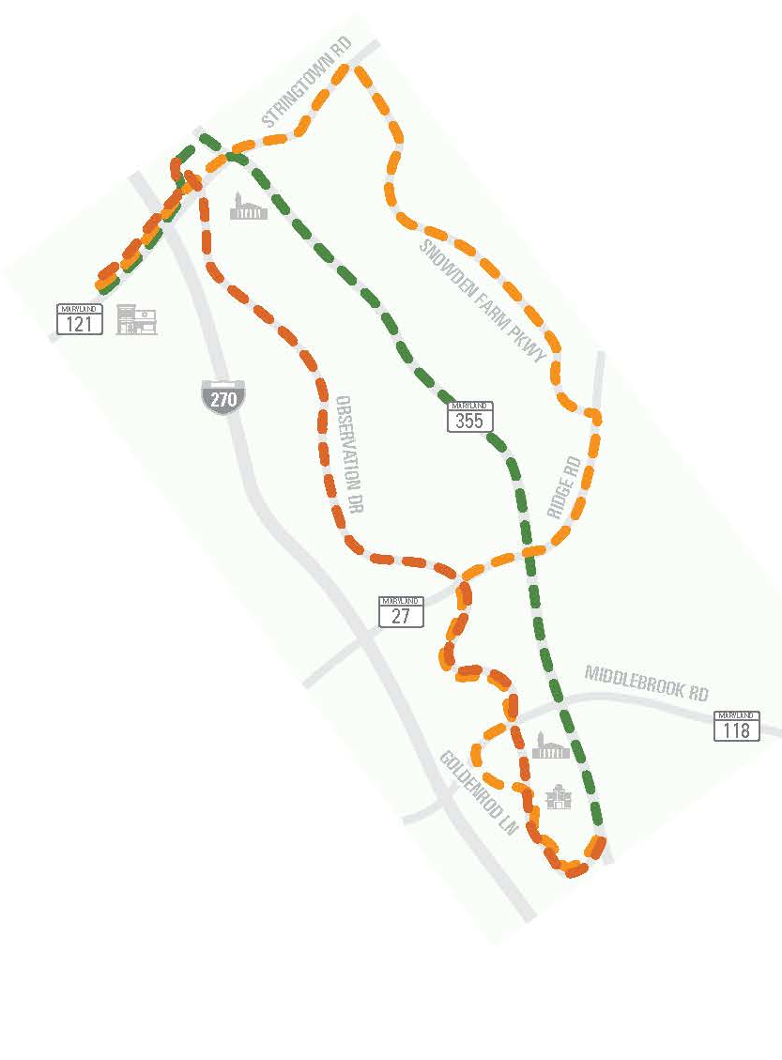
MD 355 BRT Alignments
Three different alignments studied for Segment 7 (Middlebrook Rd. to Clarksburg)
  MD 355
    Assumes future widening by MDOT SHA
  Observation Drive
    Assumes future extension by MCDOT
  Snowden Farm Parkway
    Only alignment that does not require extension or widening
    Current “center” of Clarksburg
Snowden Farm
Parkway
MD 355
Observation
Drive

Slide 33
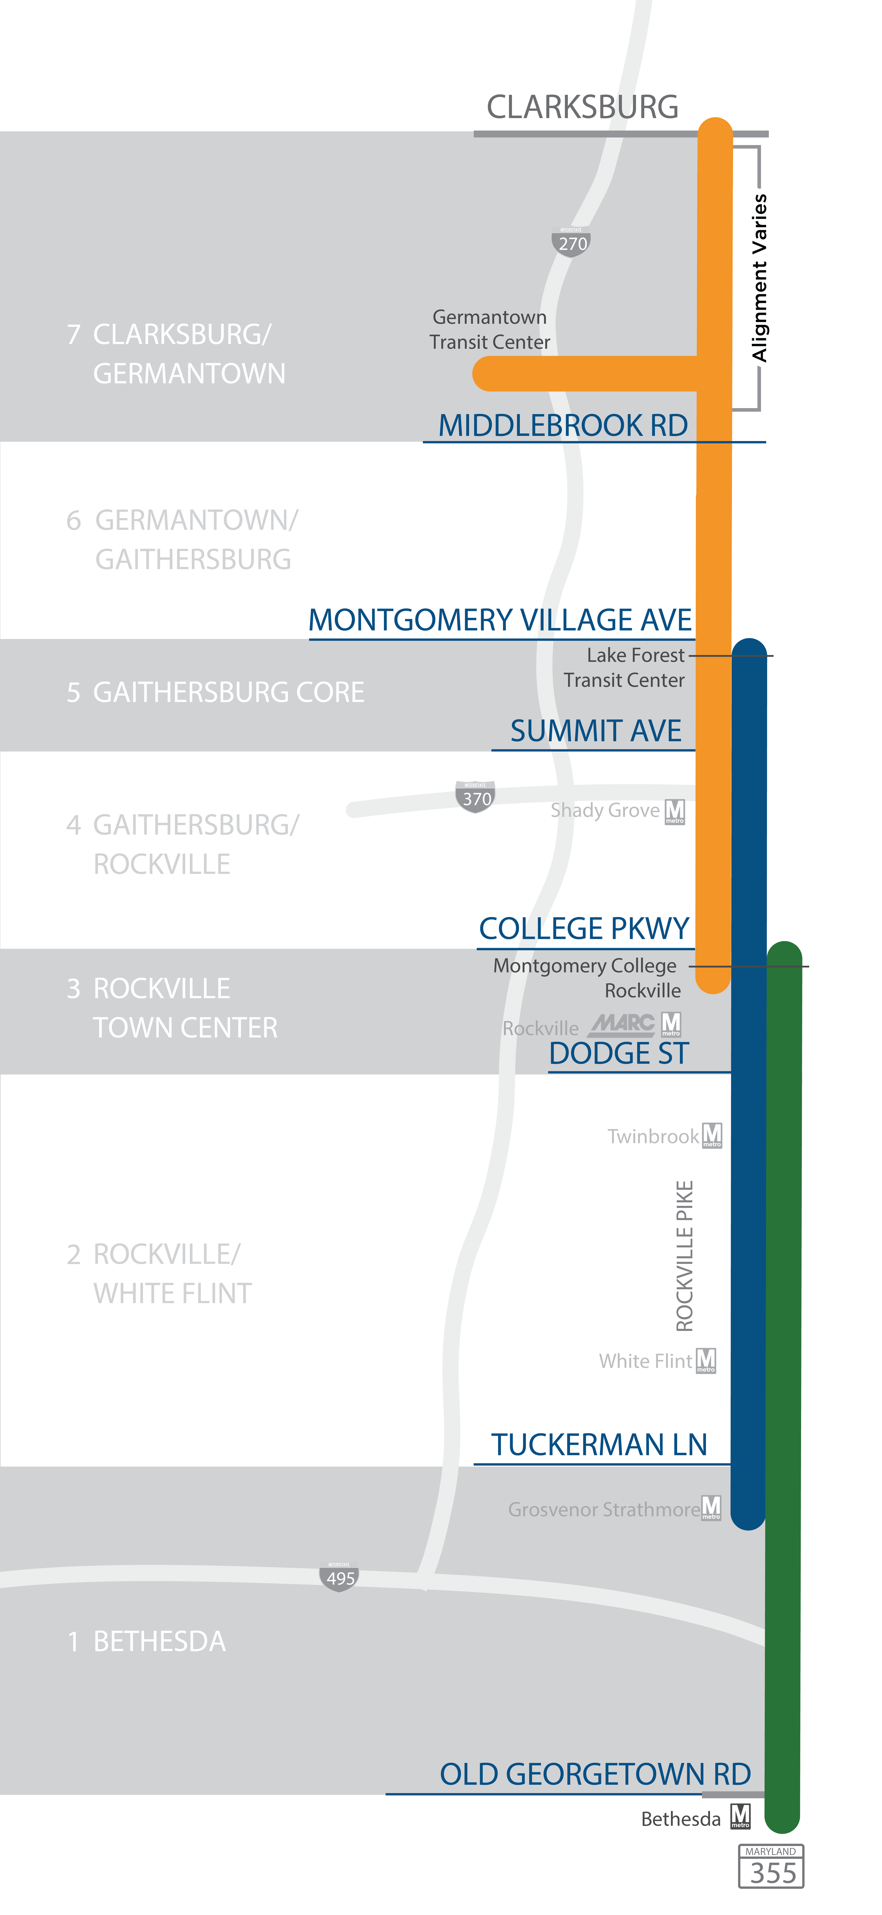
BRT Operations on
MD 355
10 minutes
5 minutes
There are four route patterns
  Clarksburg to Montgomery College – Rockville
  Germantown to Montgomery College – Rockville
  Lakeforest Transit Center to Grosvenor Metro
  Montgomery College – Rockville to Bethesda
Each service pattern would operate every 10 minutes
3.3 minutes
5 minutes
10 minutes

Slide 34
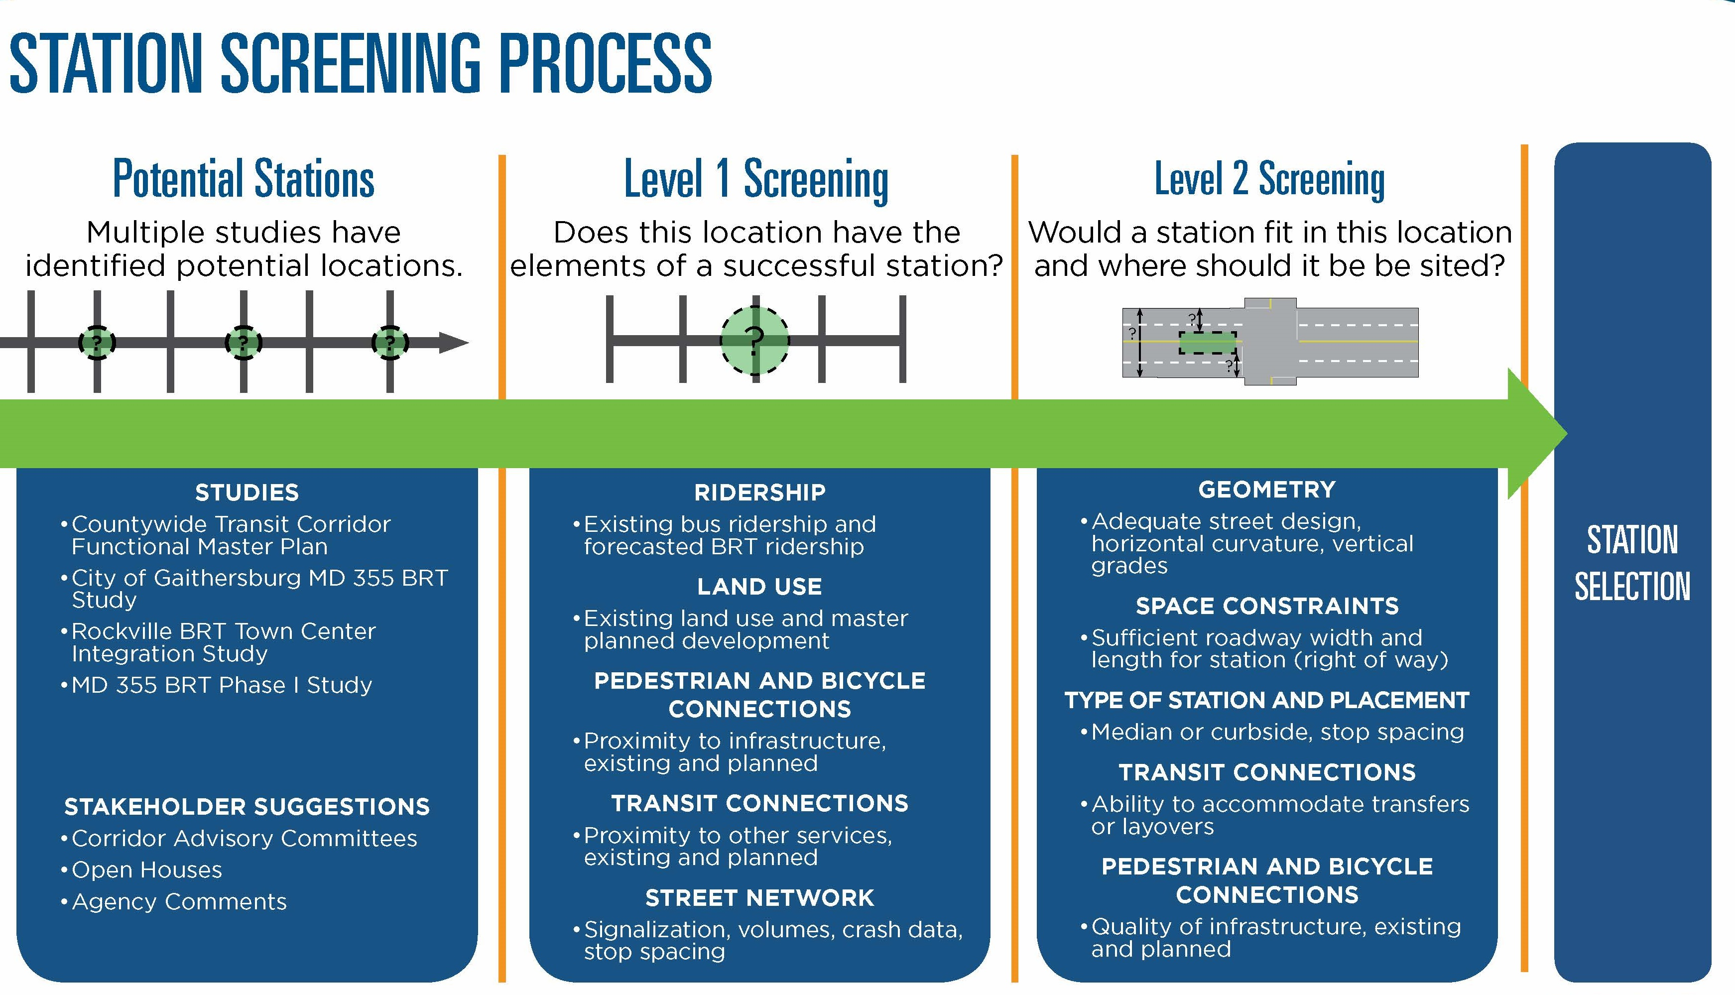

Slide 35
Which alternative do you prefer in Segment 1?
(Bethesda Metro – Grosvenor Metro)
Additional comments: There should be dedicated lanes in this segment

Slide 36
Which alternative do you prefer in Segment 2?
(Grosvenor Metro to Dodge Street)

Slide 37
Which alternative do you prefer in Segment 3?
(Dodge Street to College Parkway)
Additional comments: Would be good to have dedicated lanes in both directions

Slide 38
Which alternative do you prefer in
Segments 4 and 6?
(College Parkway to Summit Avenue & MD 124 to Middlebrook Road)

Slide 39
Which alternative do you prefer in Segment 5?
(Summit Avenue to MD 124)
Additional comments: Would be good to have dedicated lanes in both directions

Slide 40
Which route would you like the BRT to take in the Clarksburg area?
Additional comments: Route should be selected based on where people are, and BRT should be in dedicated lanes

Slide 41
Number of Times a Segment Was Identified as a Phasing Priority
Additional comments: Focus on the north, there is a lack of transit options and the south already had Metrorail

Slide 42
In thinking about BRT on MD 355, which factors matter most to you?
(Select your top three priorities)

Slide 43
Do you think BRT on MD 355 would have a positive impact on your community?

Slide 44
Other Community Feedback
Numerous emails/letters from the Crest of Wickford community regarding ROW needs, not opposed to the project
Project needs dedicated lanes
Concerns voiced about property/business and traffic impacts
Various comments about overlap with Metro in the south, “makes sense in the north” and service is needed in the north
Comments from the White Flint “community” that BRT is needed to achieve the vision
Can we look at repurposing lanes to minimize impacts?
Comments supporting BRT as a part of addressing the climate goals and supporting smart growth

