Slide 1
Update on Pedestrian Safety Initiative
North Bethesda Transportation Management District
January 29, 2014

Slide 2
Pedestrian Collisions and Fatalities
Approximately how many pedestrians are hit each year in Montgomery County?
400
In 2012, how many pedestrian fatalities were there?
6
How many were killed in 2013?
13

Slide 3
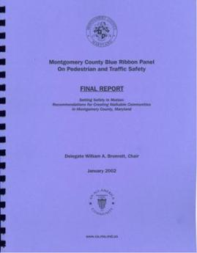
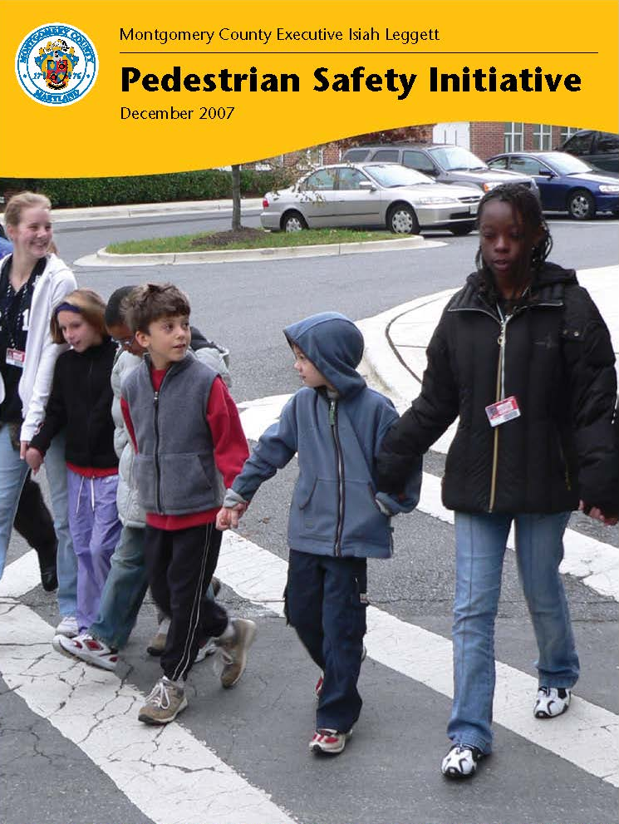
History of Pedestrian Safety in Montgomery County
2000 – Blue Ribbon Panel Assembled by County Executive
2002 – Blue Ribbon Panel Final Report
2007 – Pedestrian Safety Initiative, a Strategic Plan

Slide 4
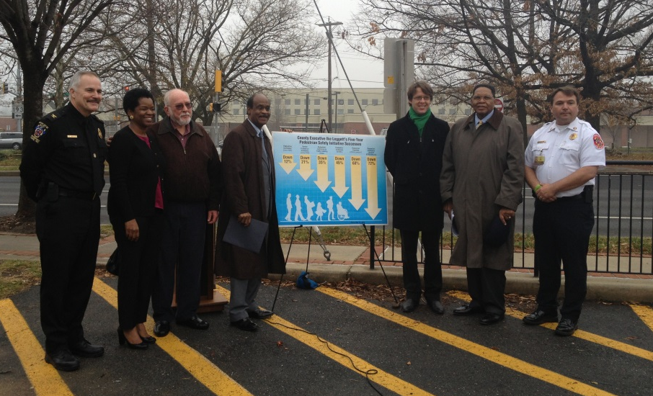
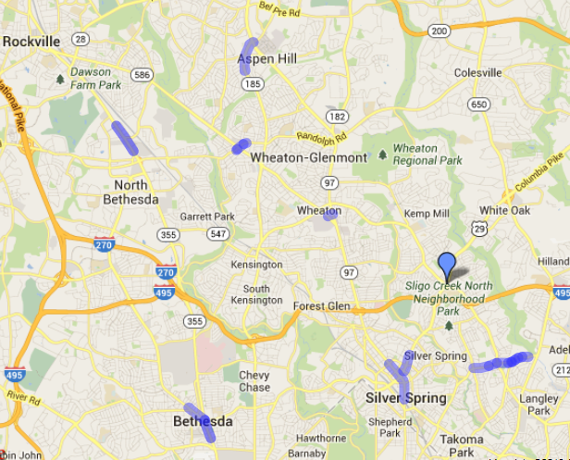
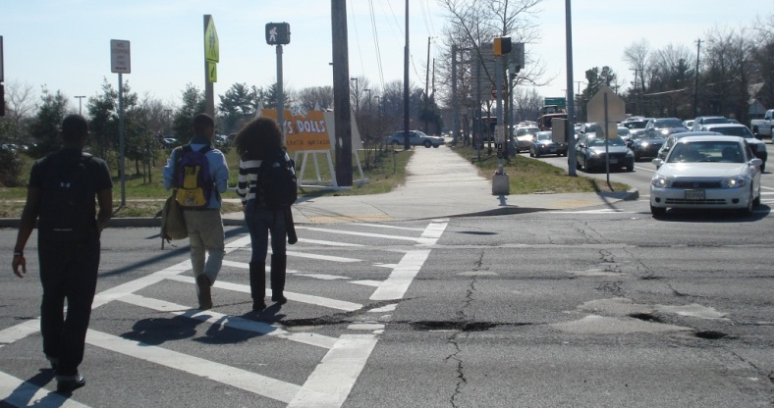
Montgomery County’s Pedestrian Safety Initiative
Seven Strategies
Targeted
Data Driven
Resources:
  Budget
  Personnel

Slide 5
Pedestrian Collision Annual Trends
% Change | -2% | -5% | +6% | 0% | -4% | -10% | +6%
% Change | +9% | -16% | -3% | +14% | -14% | -8% | -18%
Total collisions per 100,000 population increased in 2012 , attributed to an increase in the number of collisions occurring in parking lots. The 2012 total remains below the pre-initiative average (2005 – 2009.)
The number of severe collisions (level 4-5) have dropped by 21% from the pre-initiative average (2005-2009.)

Slide 6
PIO Parking Lot Pedestrian Safety Education Campaign
95% occurred in a surface parking lots – not garages, 75% were fault of the driver, and 31% involved a vehicle backing out of a parking stall or travel lane
18% of collisions were Level 4, resulting in incapacitating injury - - the same percentage as roadways
Inter-agency work group formed last year – developing strategic plan and targeted education campaign
$50,000 approved for PIO to reactivate the 2009 education campaign eliminated under County’s savings plan.
County Executive assembles “kitchen cabinet” of private property owners and managers operating parking lots
In 2012, there was a 39% increase in the number of pedestrian collisions occurring in parking lots/garages; these incidents represented 30% of all pedestrian collisions. The increase in pedestrian collisions in 2012 is attributed to the increase in parking lots.
6

Slide 7
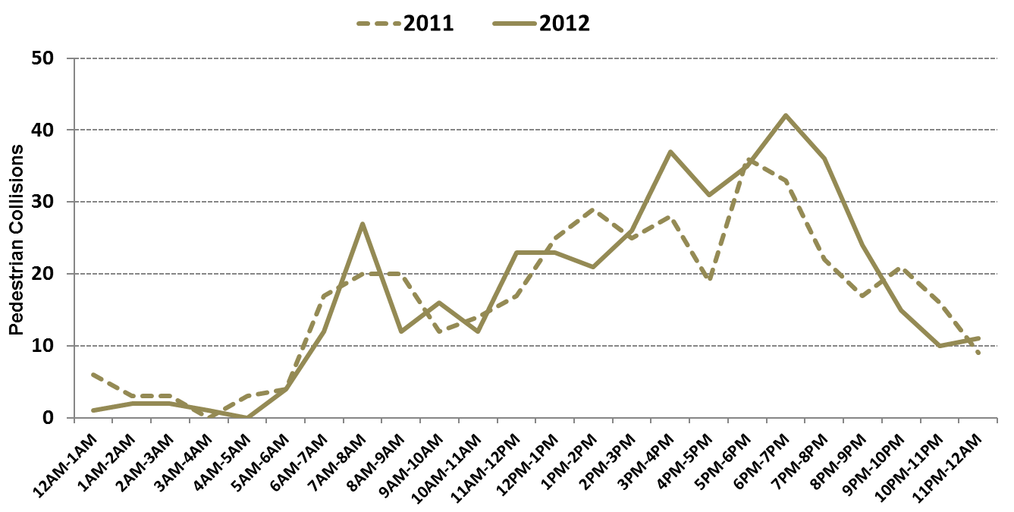
Pedestrian Collision Trends
There is an increase in pedestrian collisions in Fall and early Winter. There is an elevated number of pedestrian collisions during the morning and evening peak hours, and during the mid-day period (when schools get out.)

Slide 8
Pedestrian Collisions by Fault
Since 2008 there has been an increase in the percentage of collisions in which the driver was determined to be at fault.

Slide 9
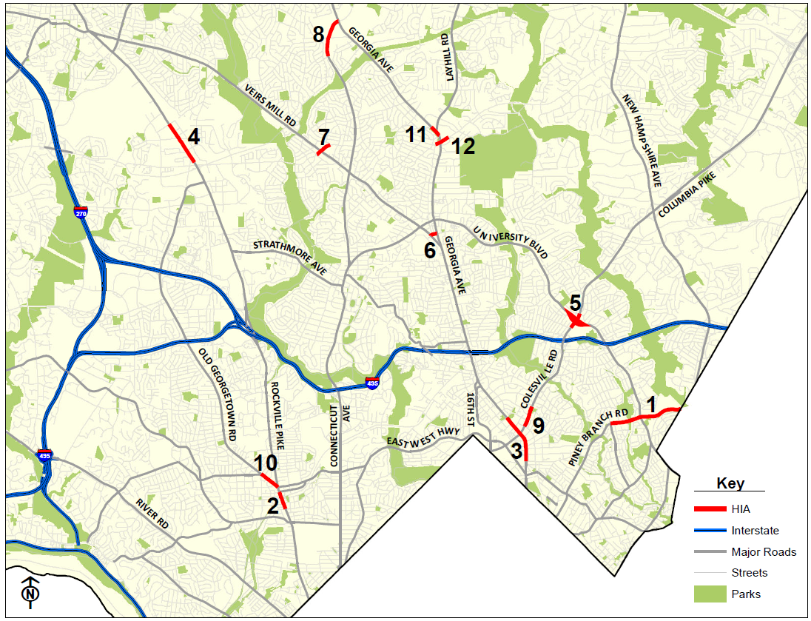
High Incidence Areas – Targeted Strategy
Targets funding for engineering, education, and enforcement (the 3 E’s) where it can have the greatest effect on reducing pedestrian collisions
The highest rate of pedestrian collisions has been along State roads, so this strategy engages the State in targeting pedestrian safety activities within the County where the rate of collisions and severity are highest
Creates opportunities to leverage multiple projects in target areas with cost-sharing between multiple agencies
Maryland SHA is now using the same targeted approach, modeled on Montgomery County’s success
Piney Branch Rd
Wisconsin Ave
Georgia Ave (Silver Spring)
Rockville Pike
Four Corners
Reedie Dr.
Randolph Rd@Veirs Mill
Connecticut Ave
Colesville Rd
Old Georgetown Rd
Georgia Ave (Wheaton)*
Randolph Rd (Wheaton)*
* Georgia Avenue and Randolph Road Safety Audits Modified Plans for Future Construction
Notes:
9

Slide 10
Collisions in High Incidence Areas: Annual Trend
Since implementing pedestrian safety improvements, pedestrian collisions in High Incidence Areas have declined 43%. Before the Pedestrian Safety Initiative, 11% of all pedestrian crashes occurred in High Incidence Areas, comprising less than 1% of the County’s roadways.

Slide 11
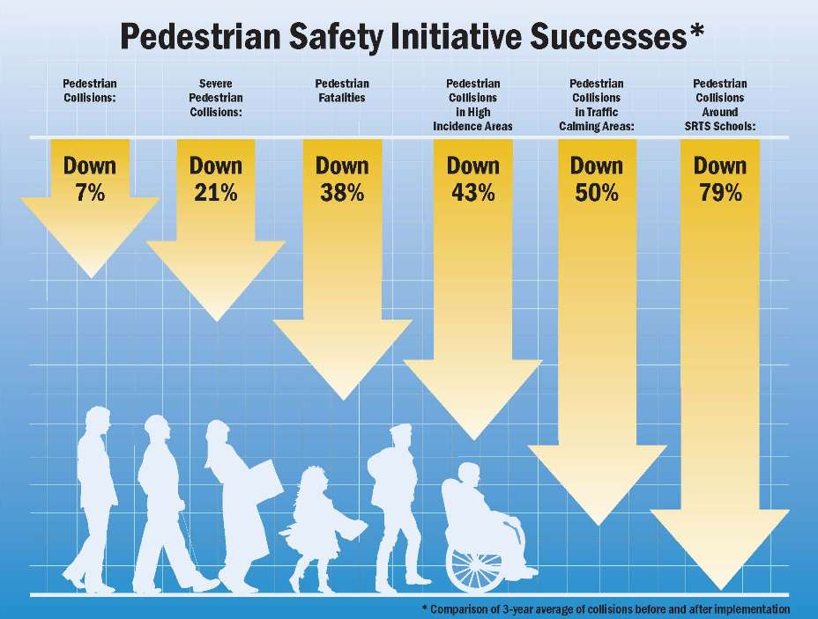
Pedestrian Safety Initiative - Results

Slide 12
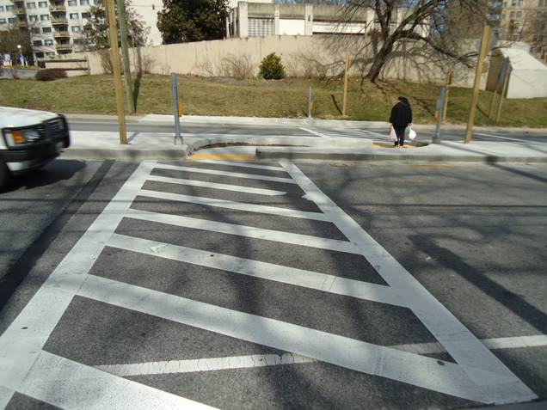
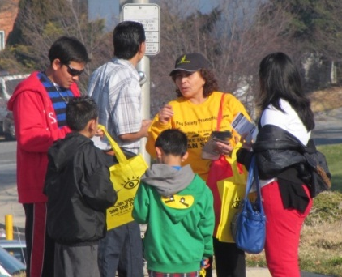
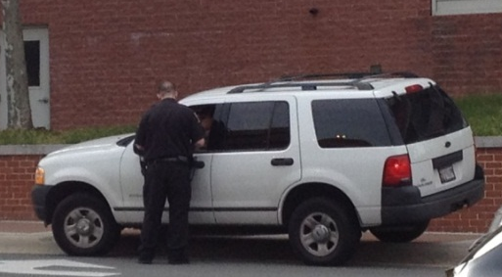
Close Coordination of Engineering, Education, and Enforcement
Engineering
Education
Enforcement
Changing Pedestrian and Driver Behavior

Slide 13
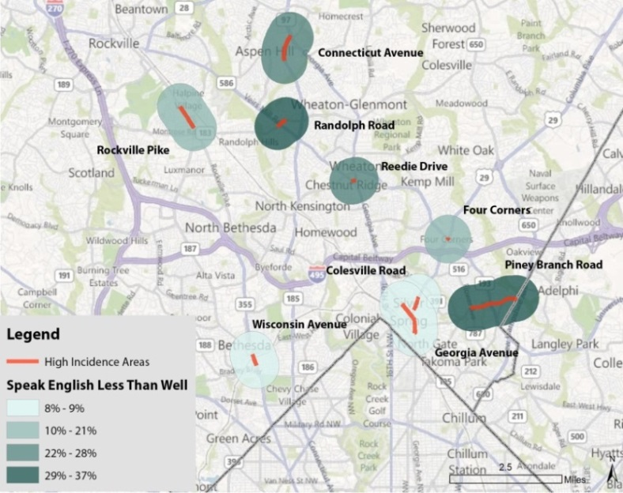
High Incidence Areas: Education
Grouping Similar HIAs
Data-driven approach to grouping HIAs using:
  Crash characteristics
  Demographics
  Land Use
Percent of Households that Speak English
“Less Than Well”
Group 1 (FY 2012-2013)
  Piney Branch
  Randolph Road
  Reedie Drive
  Connecticut Avenue
  Four Corners
Group 2 (FY 2014-2015)
  Wisconsin Avenue
  Rockville Pike
  Colesville Road
  Georgia Avenue
  Old Georgetown Road

Slide 14
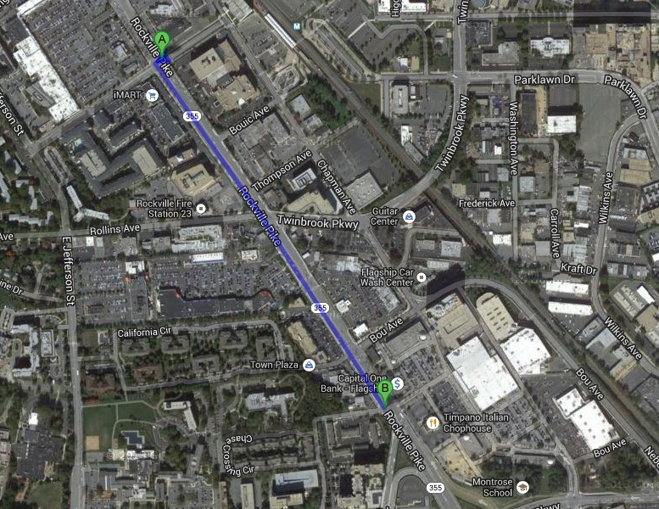
High Incidence Areas: Rockville Pike
Halpine Road to Hubbard Drive
2006 | 2007 | 2008 | 2009 | 2010 | 2011 | 2012 | Total
4 | 3 | 9 | 8 | 2 | 3 | 2 | 31

Slide 15
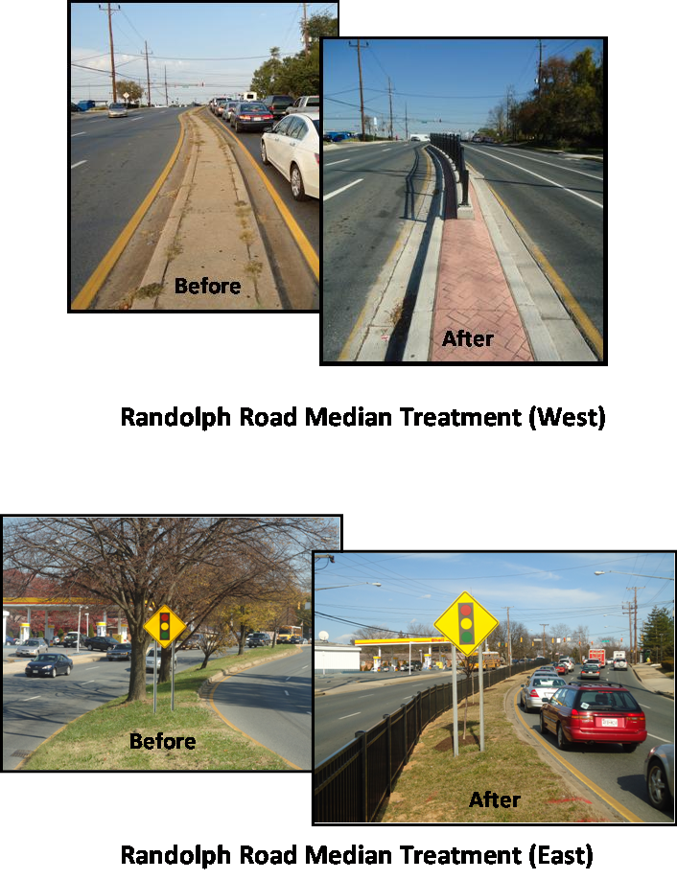
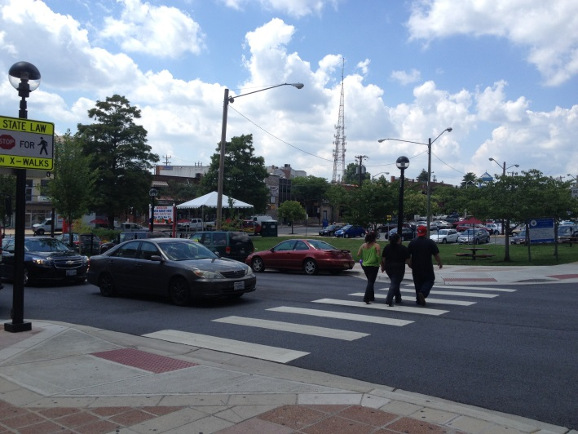
Engineering Improvement in High Incidence Areas
Improve and Widen Sidewalks
Reconstruct Intersections and Signals
Install Enhanced Pedestrian Crossings with Pedestrian Refuge Islands and Beacons
Upgrade Street Lighting
Construct Median Fencing and Landscaping to Channelize Pedestrians to Crosswalks
Upgrade Pedestrian Signals with Countdown Ped Heads and Accessible Pedestrian Signals
Improve Signage and Pavement Markings
Reedie Drive Streetscape Project

Slide 16
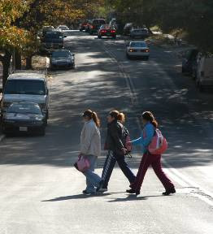
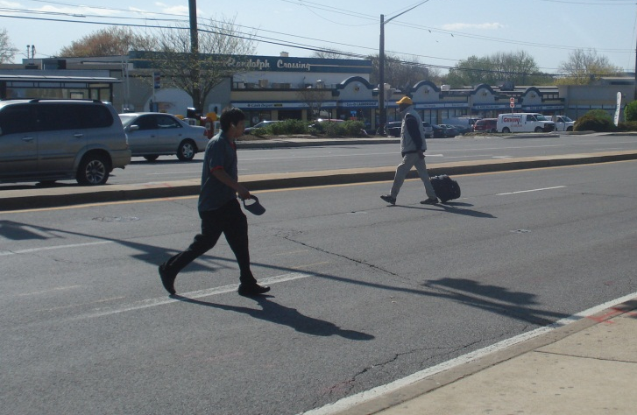
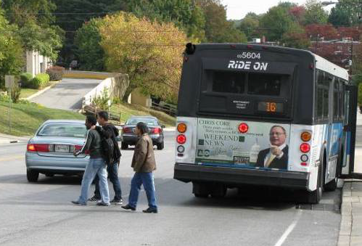
HIA Issues Identified: Uncontrolled mid-block crossings

Slide 17
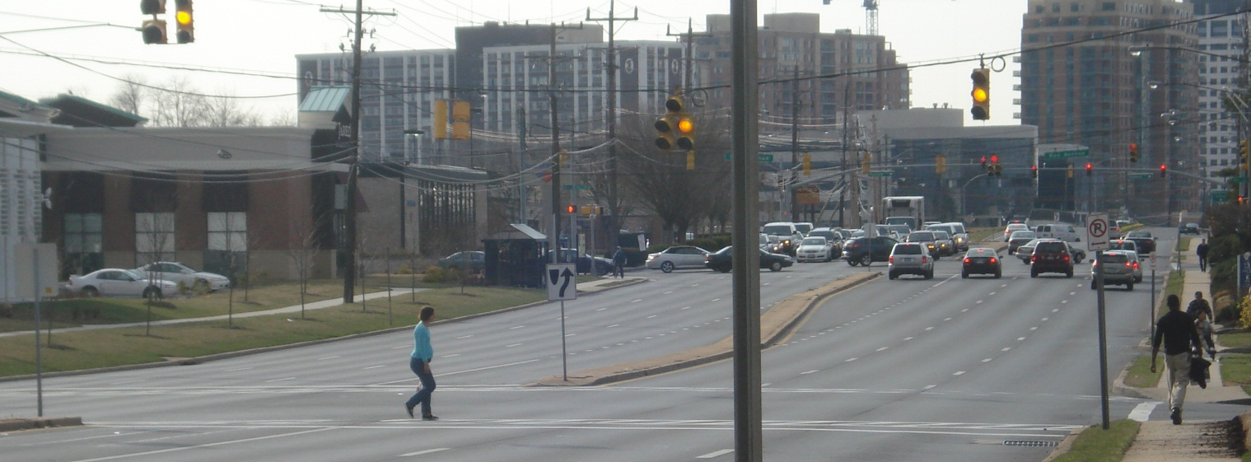
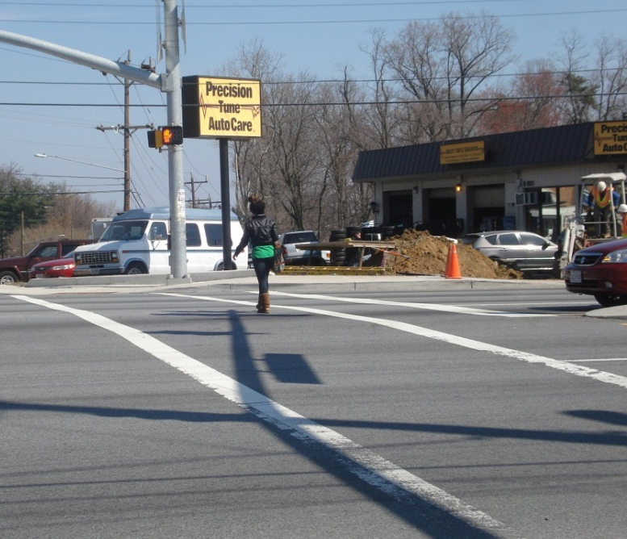
HIA Issues Identified: Lack of Signal Adherence

Slide 18
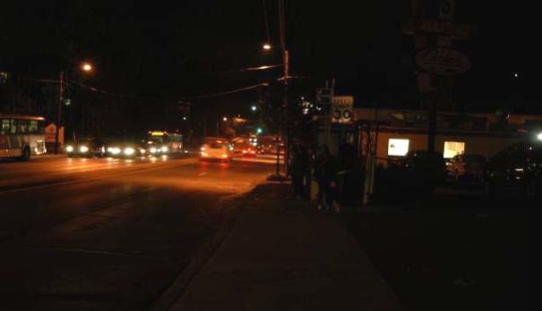
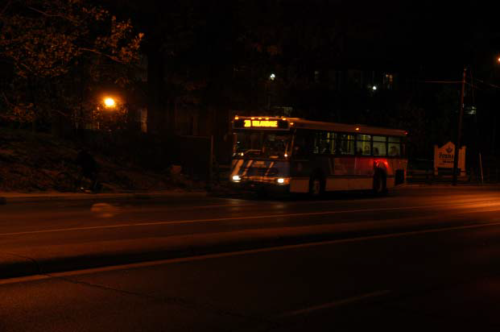
HIA Issues Identified: Limited Nighttime Visibility

Slide 19
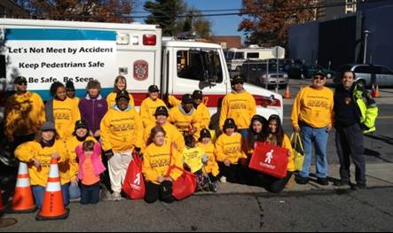
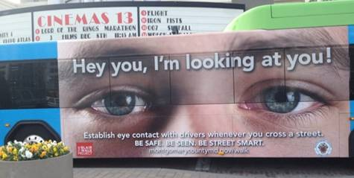
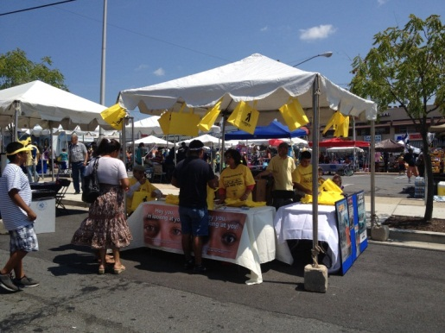
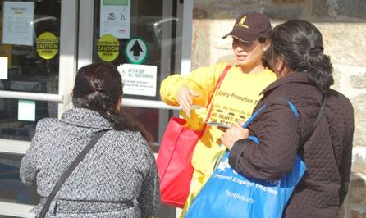
High Incidence Areas: Group 1 Education
Four Corners (Blair High School)
Piney Branch, Randolph, Reedie, Connecticut
Curb Markers
Safety Promotion Teams on Street
Volunteers at festivals
Outreach to local business
Shopping center intercepts
“Best Eyes” Campaign
SWAG bracelets
Text message contest
Train-the-Trainer
Fall “See Them See You” Campaign

Slide 20
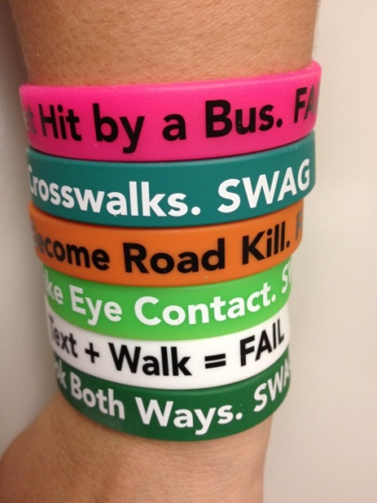
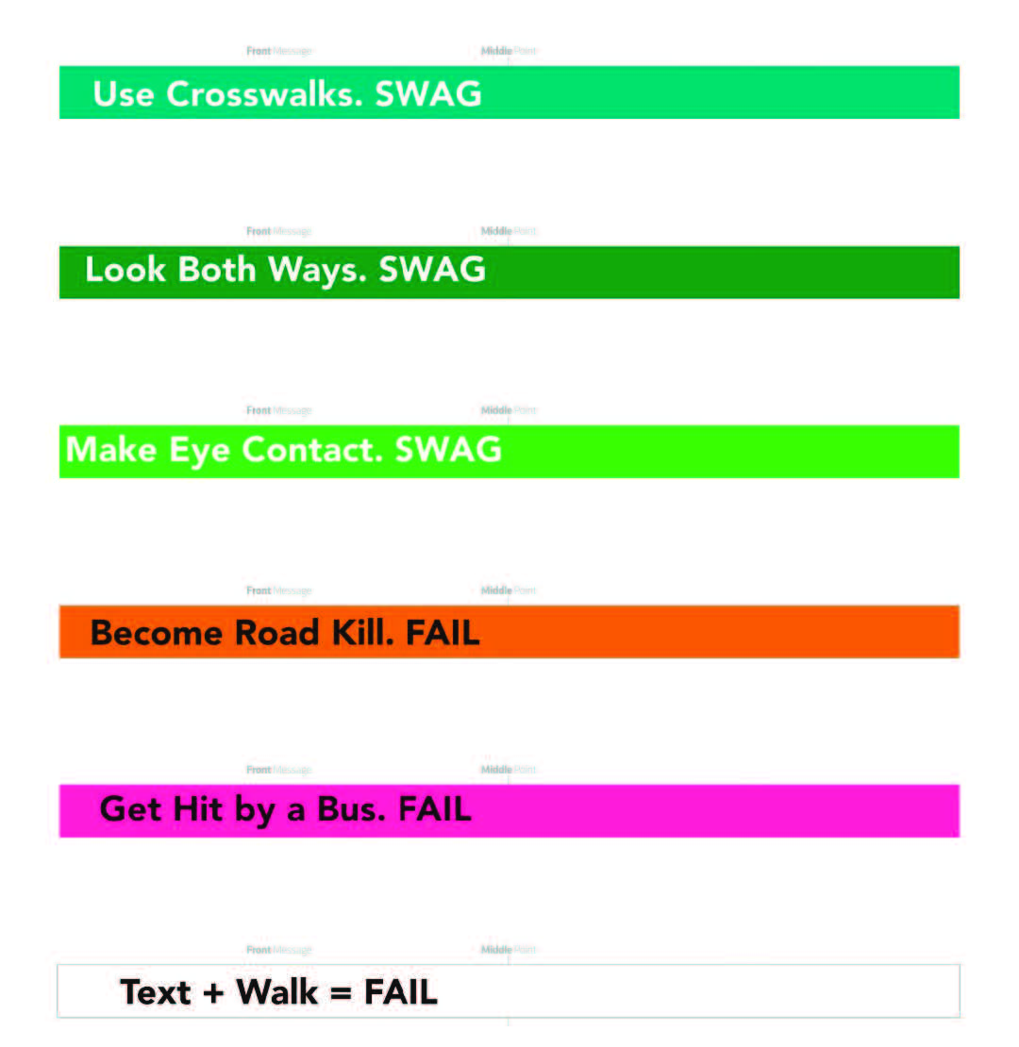
Four Corners Spring Education Campaign: SWAG Bracelets
Bracelet concept originated by students
Reinforce good behavior (SWAG) and bad behavior (FAIL)
Build on overall campaign message:
  See them See you
  Wait for the Walk
  Always Use Crosswalks
  Go Reflective!

Slide 21
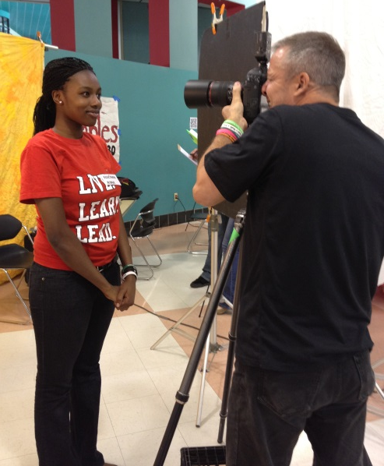
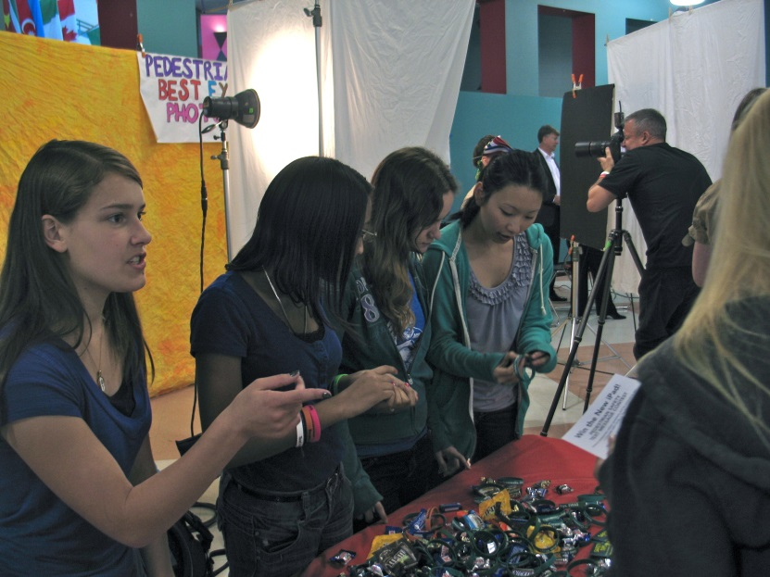
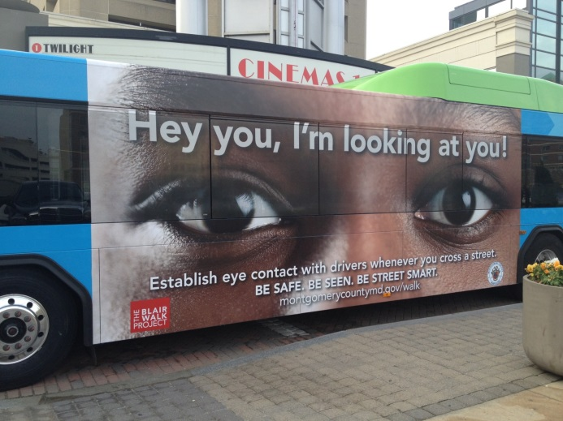
Blair High School Best Eyes Contest
Initial recruiting event
Photo shoot event
Special student-created giveaways

Slide 22
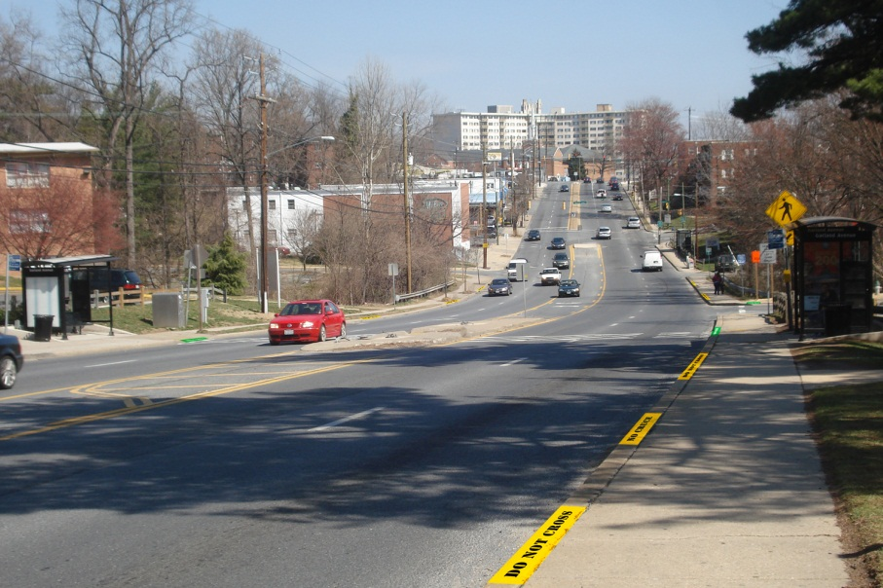
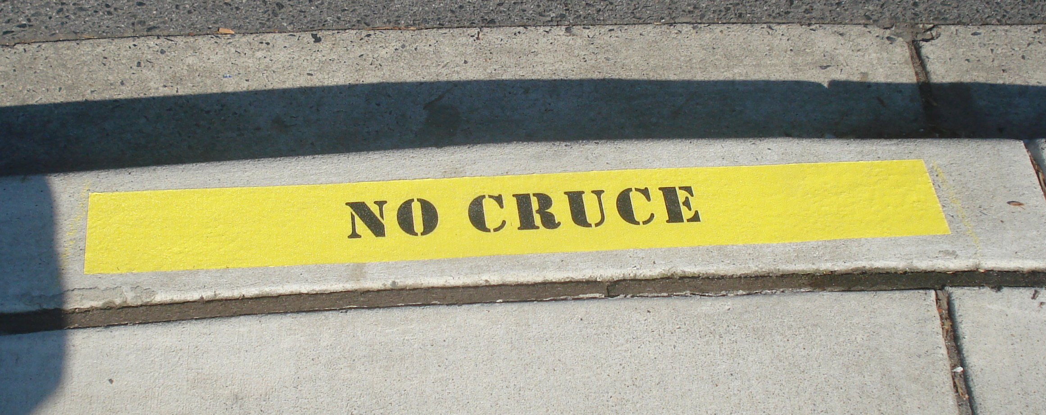
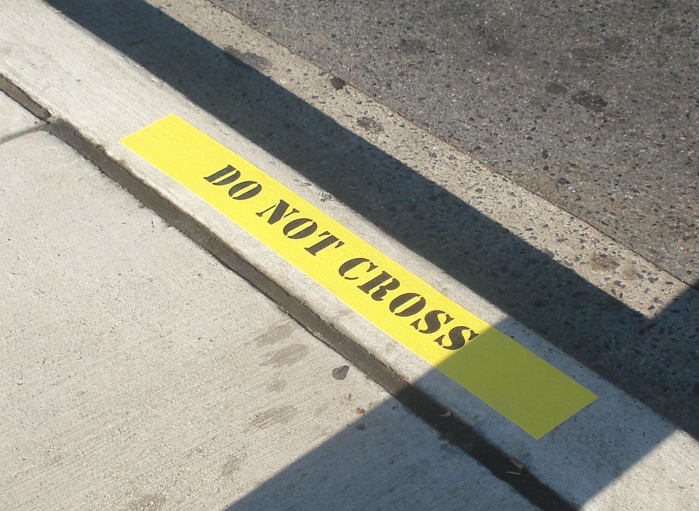
Piney Branch HIA: Curb Markers
Concept developed by education team – designed to mimic police caution tape
Approved by SHA as “Experimental Traffic Control Device”
“Do Not Cross” and “No Cruce” installed every 20-30-feet
“Cross Here” installed at crosswalks

Slide 23
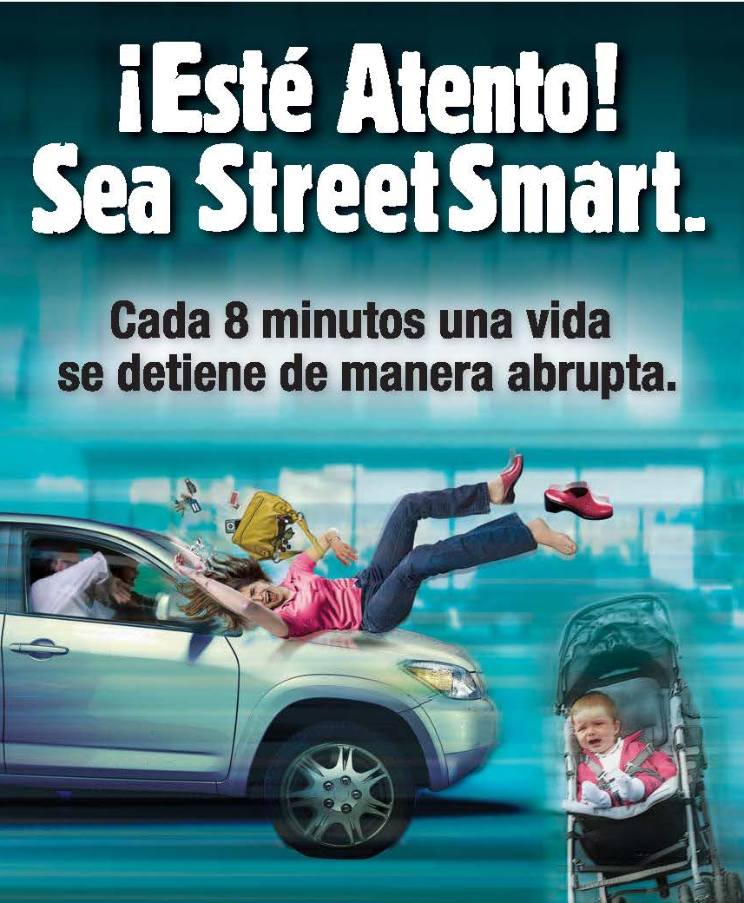
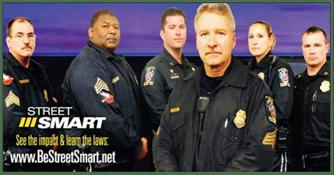
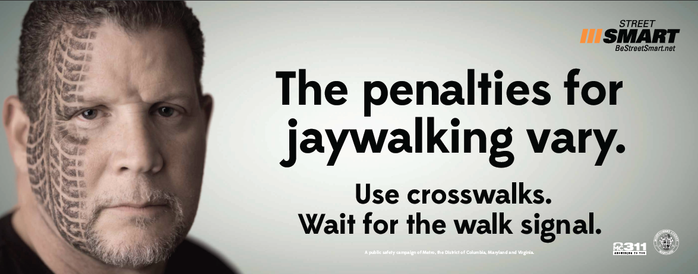
Regional StreetSmart Campaign

Slide 24
Safety Promotion Teams
Group of volunteers reaching out to their community about pedestrian safety
  SWAG Team (English)
  Protectores del Camino (Spanish)
Intercept pedestrians on the street
  Discuss pedestrian safety tips
  Distribute reflective/visible materials
Community festivals and pedestrian safety events
In Group 1 HIAs, distributed approximately:
  20,000 Safety Tips brochures
  6,000 Reflective materials
  10,000 Shopping bags

Slide 25
Key Messages to Teach Pedestrians
Cross the street at marked crosswalks and intersections
Stay visible after dark
Begin crossing the street on the “walk” signal
Make eye contact with drivers
Stop texting and talking on the cell – remove earphones when crossing street

Slide 26
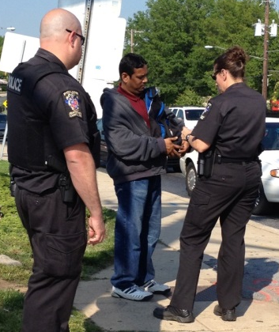
Pedestrian and Driver
Enforcement Efforts
MCPD conducts targeted enforcement of drivers and pedestrians throughout the County
Tickets for violations such as:
  Midblock crossing
  Crossing against pedestrian signal
  Drivers not yielding to pedestrians
“Crosswalk Sting” Strategy
  Police decoy in visible clothing crosses at a crosswalk
  Drivers who do not stop for the pedestrian are ticketed
Citations and Warnings Issued to Date
  700 Driver Citations
  2,170 Pedestrian Citations
  916 Warnings

Slide 27
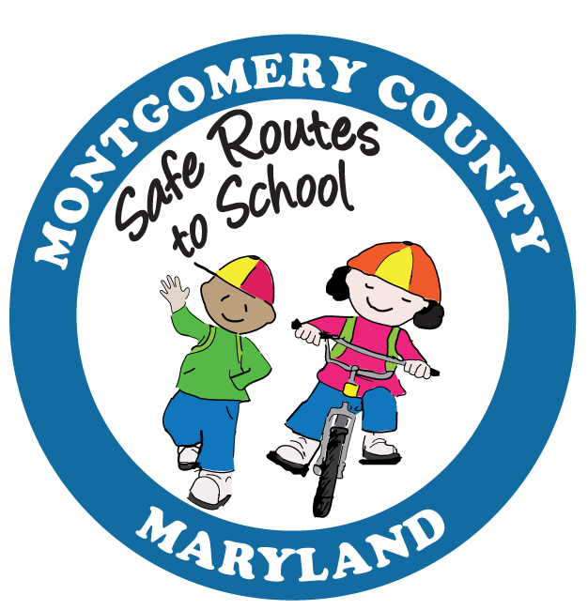
MCDOT Safe Routes to Schools Prioritization
Started in 2005, over 160 schools have had comprehensive school zone traffic safety assessments conducted and improvements implemented.
ENGINEERING: Prioritized to weight pedestrian collisions
  Weighted scores with pedestrian collisions - used to prioritize schools
  Factored into engineering evaluation criteria for overall score
  Safe Routes to School (SRTS) list prioritized using crash data
  SRTS Grant Applications reflect priorities
EDUCATION: Increased at schools with high pedestrian collisions
  SRTS Coordinator now working with Elementary, Middle, and High Schools
  SRTS Coordinator placing highest priority on schools with pedestrian collisions within 1/4 mile
ENFORCEMENT: Increased at schools with high pedestrian collisions
  Enforcement actions targeted at schools with higher number of pedestrian collisions
Since 2009, combined engineering improvements, education activities, and enforcement actions have resulted in a 79% reduction in pedestrian collisions with ¼ mile radius of grant schools under Safe Routes to School.

Slide 28
MCDOT Pedestrian Safety Education in High Schools
Education Campaigns: Blair and Seneca Valley High Schools (2011-2012)
FY14: Council Authorizes $100,000 for High School Pedestrian Safety Education
Inter-agency Work Group Develops Plan – Partnership with MCPS
Crash Data Analyzed to Identify Targeted Approach
Working with School Principals and Data to Reach Target Schools
Launch Fall Campaign in Late October – Second Wave in March
Use Web-based Resources – “Tool Kit” Made Available to All Schools
From 2010 to 2012, there have been 172 pedestrian collisions within ½ mile of Montgomery County’s High Schools – 30 involve 13-18 year olds.

Slide 29
If a pedestrian is hit by a car traveling 40 mph, what is the chance that they will die?
  20%
  50%
  85%

Slide 30
If a pedestrian is hit by a car traveling 20 mph, what is the chance that they will survive?
  50%
  75%
  95%

Slide 31
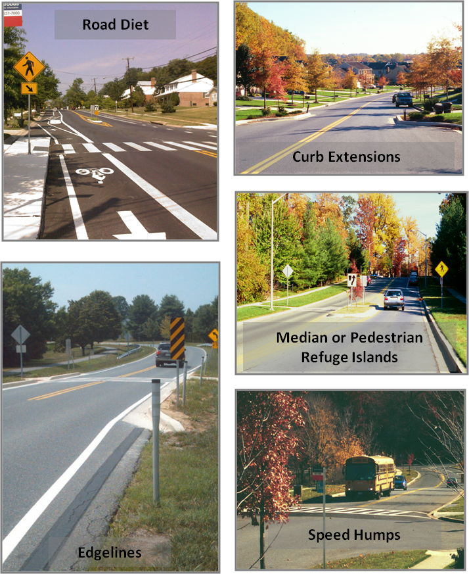
Pedestrian Safety Engineering-Traffic Calming
31
Notes:
31

Slide 32
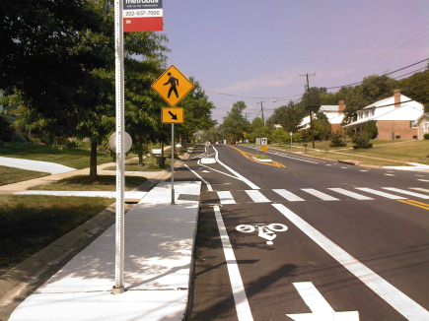
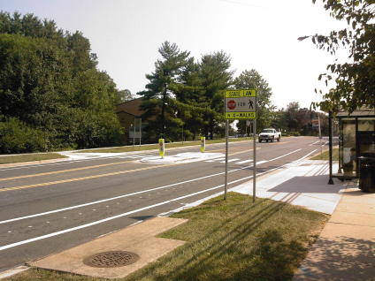
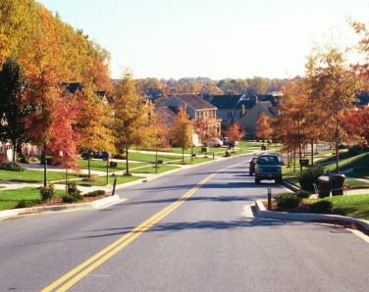
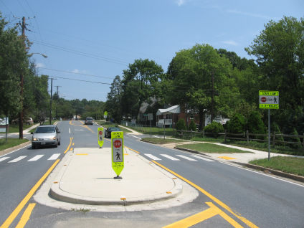
Results of Traffic Calming
Project Name | Speeds (MPH)
 | Posted | Avg. Before | Avg. After
Fairland Rd | 40 | 53 | 42
Calverton Blvd | 30 | 41 | 35
Lockwood Dr | 30 | 40 | 30
Sligo Ave | 30 | 34 | 31
Carroll Ave | 25 | 33 | 27
Spartan Rd | 30 | 40 | 33
Dale Dr | 30 | 39 | 34
Prince Phillip Dr | 30 | 36 | 31
Waring Station Rd | 30 | 38 | 34
Cedar Ln | 30 | 36 | 30
Jones Bridge Rd | 30 | 36 | 30
Rainbow Dr | 25 | 31 | 26
Franklin Ave | 30 | 34 | 33
Road Diets
Edgelines
Curb Extensions
Median or Pedestrian Refuge Islands
Traffic Calming successfully reduces speeding and has reduced pedestrian collisions by an average 50% where constructed.
32
Speed decline >/= 5mph
Notes:
32

Slide 33
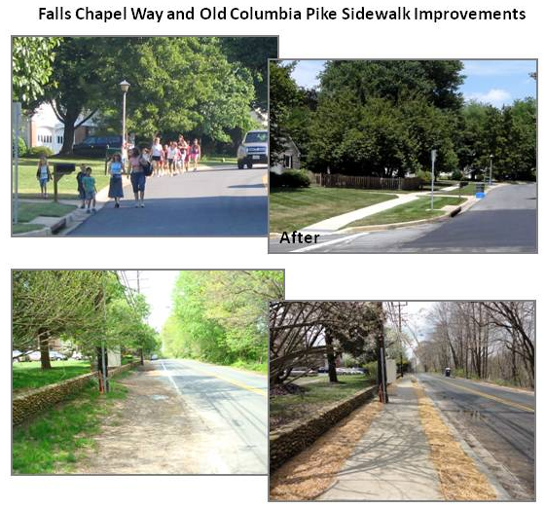
Pedestrian Safety Engineering-Sidewalks
33
Notes:
33

Slide 34
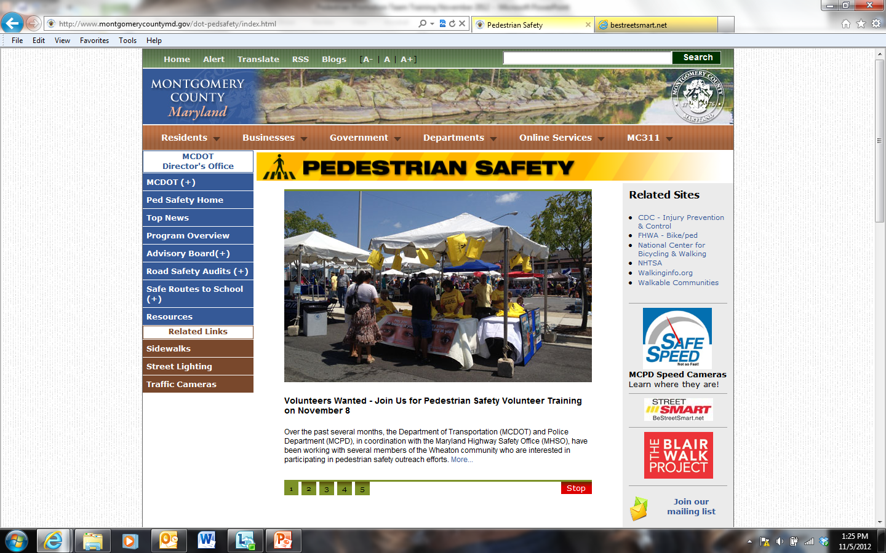
Pedestrian Safety Website
www.montgomerycountymd.gov/walk

Slide 35
QUESTIONS?
Visit us at montgomerycountymd.gov/walk
Jeff Dunckel
Pedestrian Safety Coordinator
Jeff.Dunckel@montgomerycountymd.gov
240-777-7197

